Slide 1




University-Industry Collaboration
General Manager
Valeria Pignedoli
Mister Smart Innovation s.c.r.l.
Online Workshop
11 March 2021 | Online

Slide 2


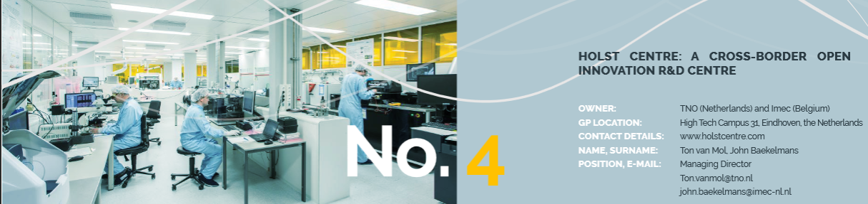
1. InnoInfraShare Sharing strategies for European Research and Innovation Infrastructures
Goal: to improve the accessibility and the exploitation of local Research and Innovation infrastructure (RII) assets by SMEs
20 GPs on services for SMEs and business model for SME's access; marketing activities; exploitation of interregional and international potential
Notes:
RII (parners shared definition): organisations that offer services to users to support the translation of technologies into
actual business useful products and solutions. It offers state-of-the-art and innovation-oriented technology infrastructure and experts than can provide support to business’ innovation activity.

Slide 3



2. Good practice:
Mister Smart Innovation
Founded in 2009
Private research organization which represents a virtuous example of Public Private Partnership (PPP)
Shareholders:
CNR National Research Council
the Universities of Ferrara and Parma
several companies operating in various manufacturing sectors
Mission: to foster university-industry collaboration and develop technological innovations, namely in promoting Key Enabling Technologies (KETs), in regional S3 priorities
Mister operates in a floating area between TRL 3-4 and TRL 7-8.
Main sectors: Industry 4.0; Health Tech, Smart Materials.
The turnover comes from publicly funded projects (60%) and privately funded projects (40%)
Notes:
Health tech: microfluidics, biomedical sensors, automatic testing bench; Industry 4.0: electronics & microcontrollers, mechanical designa & packaging, additive manifacturing, machine learning, custom sensors, open source sofware & iot infrastructure; Smart materials: lighting materials, biomediucal nanomaterials, magnetocaloric and photovoltaic materials

Slide 4
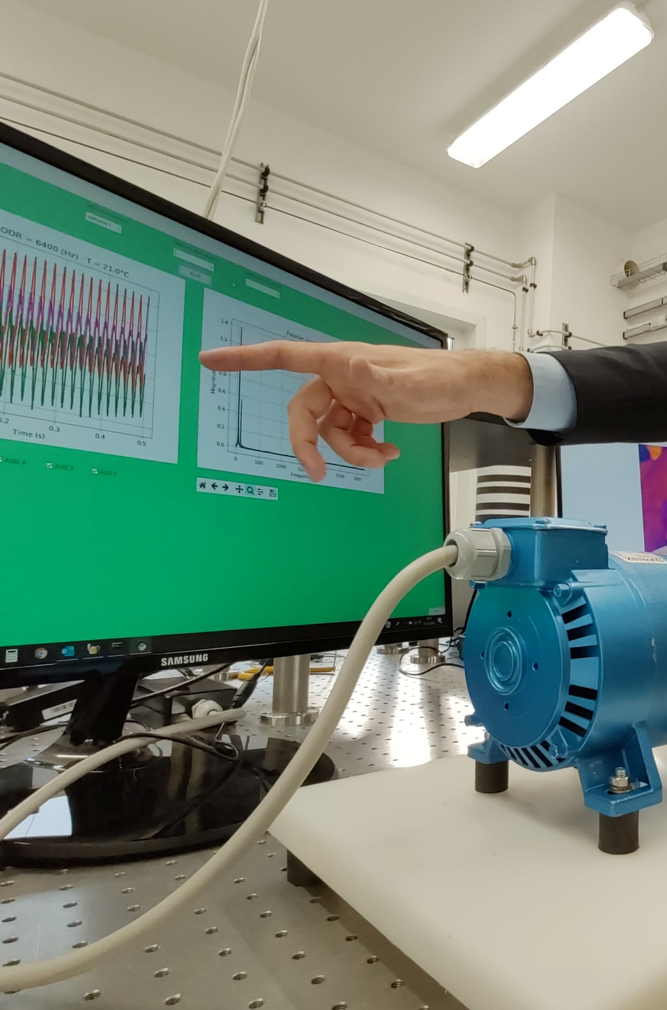
Technology Transfer
We offer collaborations through private R&D contracts and technology transfer partnerships or in regional, national and European co-funded projects.
Professional education
We design and deliver professional education path for companies and direct training for young people such as internships or doctorates experiences.
Dissemination
Working closely with institutional and private partners, we designed modern formats to light up the innovation debate and pushing the limits of scientific dissemination.
Notes:
Some numbers: almost 20 projects on strategic industrial research co-funded in the last 5 years; >130 projects on technology transfer in the last 10 years; More than 800 contacts (delegations, visitors, companies, students, stakeholder, partners…) in the last 3 years; more than 10 activities of support for startups and young entrepreneurship in the last 3 years

Slide 5
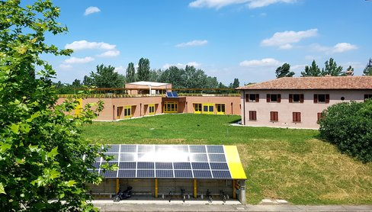
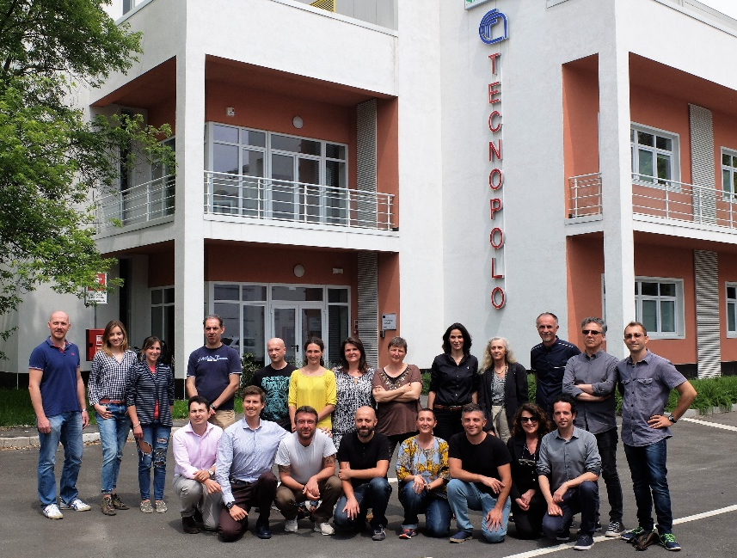
Since 2017 MISTER has been in charge of the Tecnopolo Bologna CNR management activities.
Tecnopolo Bologna CNR, located in the heart of CNR Research Area in Bologna and on Parma University Campus, provides 6000 mq dedicated to:
state-of-the-art facilities and reserach infrastructures
2 PPP consortia for industrial research and tech transfer (Mister and Proambiente)
Innovation accelerators for companies and start-ups
Services for dissemination, demonstration and information activities
Notes:
The Tecnopolo is meant to be the privileged access point to the Industrial Research Laboratories of the Emilia Romagna High Technology Network for local companies.

Slide 6
3. Recommendations
  1.Innovation has a significant direct impact on our economy; our mission is to turn knowledge into value
  2. MISTER/ Tecnopolo Bologna CNR is a research-centered innovation model based on focussed value propositions and strategic trajectories
  3. The transferability potential lies in a public-private partnership model, in the openess of the platform and in the provision of a multi-KETs platform model
  4. MISTER’s model is engineered for multi-localization and it is scalable
Notes:
Please discuss recommendations (max 5) for regional policymakers aiming to promote University-Industry Collaboration (3 minutes)
The good practice highlights that technology transfer is most successful in technology-intensive sectors such as manufacturing and the health sectors. Such type of initiatives will be most successful in regions with already strong public and private research capacities. -Regional policymakers can learn from the PPP dimension of this good practice for technology transfer initiatives as it offers more flexibility to adapt to private sector challenges and additional financial autonomy and sustainability from political influences and changes.

