Slide 1




University-Industry Collaboration
TCUE Plan – University Business Knowledge Transfer in Castilla y León
Susana Cámara
Universidad de Burgos
Online Workshop
11 March 2021 | Online

Slide 2

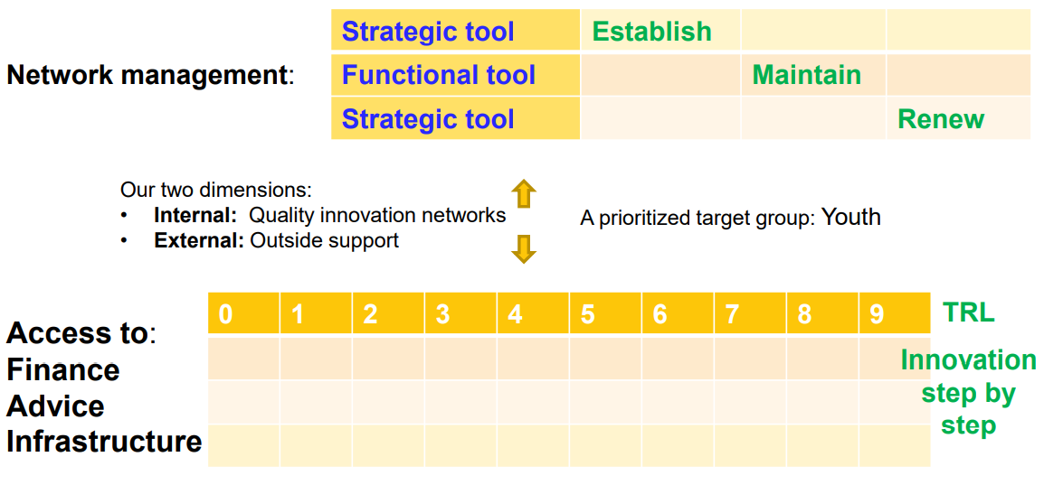









1. P-IRIS. Policies to improve rural areas' innovation systems by professionalising networking activities and use of innovation tools

Slide 3


University – Business Cooperation:
In 2008, The Regional government, Junta de Castilla y León, launched the Regional University – Business Strategy to improve the cooperation between business and university.
The Regional Ministry of Education grouped most of its activities in TCUE -Programme (Spanish acronym-for University-Business Knowledge Transfer Programme)
              Who participates?
  Burgos University.
  León University.
  Salamanca University.
  Valladolid University.
  Pontificia University of Salamanca.
  IE University of Segovia.
  European University Miguel de Cervantes of Valladolid.
  Catholic University of Ávila
  University Isabel I of Castilla
www.redtcue.es
Notes:
Ofrezca una breve descripción general de la presentación. Describa el enfoque principal de la presentación y por qué es importante.
Introduzca cada uno de los principales temas.
Si desea proporcionar al público una guía, puede repetir esta diapositiva de información general a lo largo de toda la presentación, resaltando el tema particular que va a discutir a continuación.

Slide 4
Activities
All activities have been grouped into 4 major ACTIONS:
INNOVATIVE UNIVERSITY: This block concentrates the activities focused on organizing and strengthening the structures supporting the transfer of university knowledge, on promoting development, protection and exploitation of own technologies and also on recognizing the effort of university researches in this field,
BUSINESS-UNIVERSITY PROJECTS: Focused on promoting the development of joint R&D&I and on open innovation,
ENTREPRENEURIAL UNIVERSITY: Aiming at promoting entrepreneurship and encouraging creation of spin-off companies and technology-based enterprises
INNOVATIVE ECOSYSTEM: To foster a favourable context/environment for this type of activities in Castilla y León.
Notes:
Ofrezca una breve descripción general de la presentación. Describa el enfoque principal de la presentación y por qué es importante.
Introduzca cada uno de los principales temas.
Si desea proporcionar al público una guía, puede repetir esta diapositiva de información general a lo largo de toda la presentación, resaltando el tema particular que va a discutir a continuación.

Slide 5











University-Business Challenge Contest
Prizes (up to 45.000€) aim at financing the university participation in the project.
Telematic inscription on: www.redtcue.es
PRIZES
-3 best R & D projects
-1 special prize for new entrepreneurs
-1 Accésit for associations of public interest
Companies/entrepreneurs/associations: Inscription of a Technological demand
Universities: technological solutions
Companies/entrepreneurs/associations evaluate university proposals
Jury
PARTICIPANTS
1 year to develop the joint project
Companies, or groups of companies, new entrepreneurs, associations of public interest.
University research groups
Notes:
Ofrezca una breve descripción general de la presentación. Describa el enfoque principal de la presentación y por qué es importante.
Introduzca cada uno de los principales temas.
Si desea proporcionar al público una guía, puede repetir esta diapositiva de información general a lo largo de toda la presentación, resaltando el tema particular que va a discutir a continuación.

Slide 6

Entrepreneurial Campus Contest
Main objectives:
Promotion of the entrepreneurship spirit
Identification of entrepreneurial ideas and projects emerging from regional universities
Creation of new companies based on university knowledge and established in Castilla y León (CyL)
Transformation of university knowledge into new companies

Slide 7
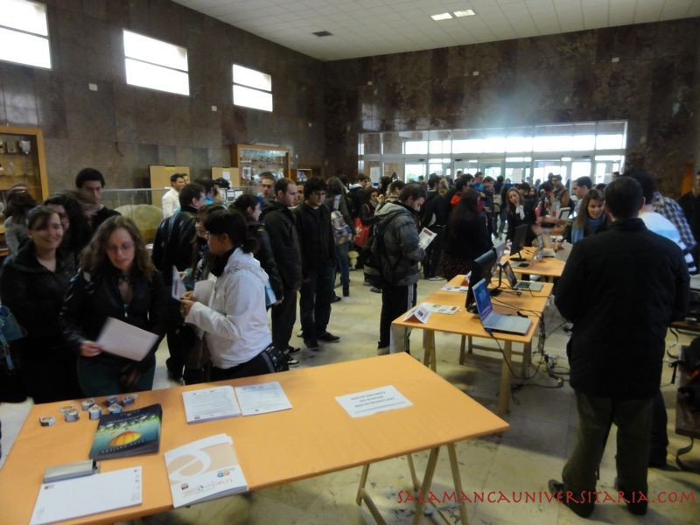
Market-oriented Prototypes Programme
Main objectives:
Development of market-oriented prototypes at the university
Link university research with market needs
Link the last stage of the students' career in science and technology with the real needs of the market and society
To promote a new way to offer talent to companies
Protection of industrial and intellectual rights

Slide 8
THANK YOU VERY MUCH!
Susana Cámara Decimavilla
OTRI-OTC Universidad de Burgos
Knowledge Transfer Office University of Burgos
Edificio de Administración y Servicios
C/ Don Juan de Austria, Nº 1
09001 BURGOS
E-mail: susanac@ubu.es
Web: http://www.ubu.es/otriotc

