Slide 1

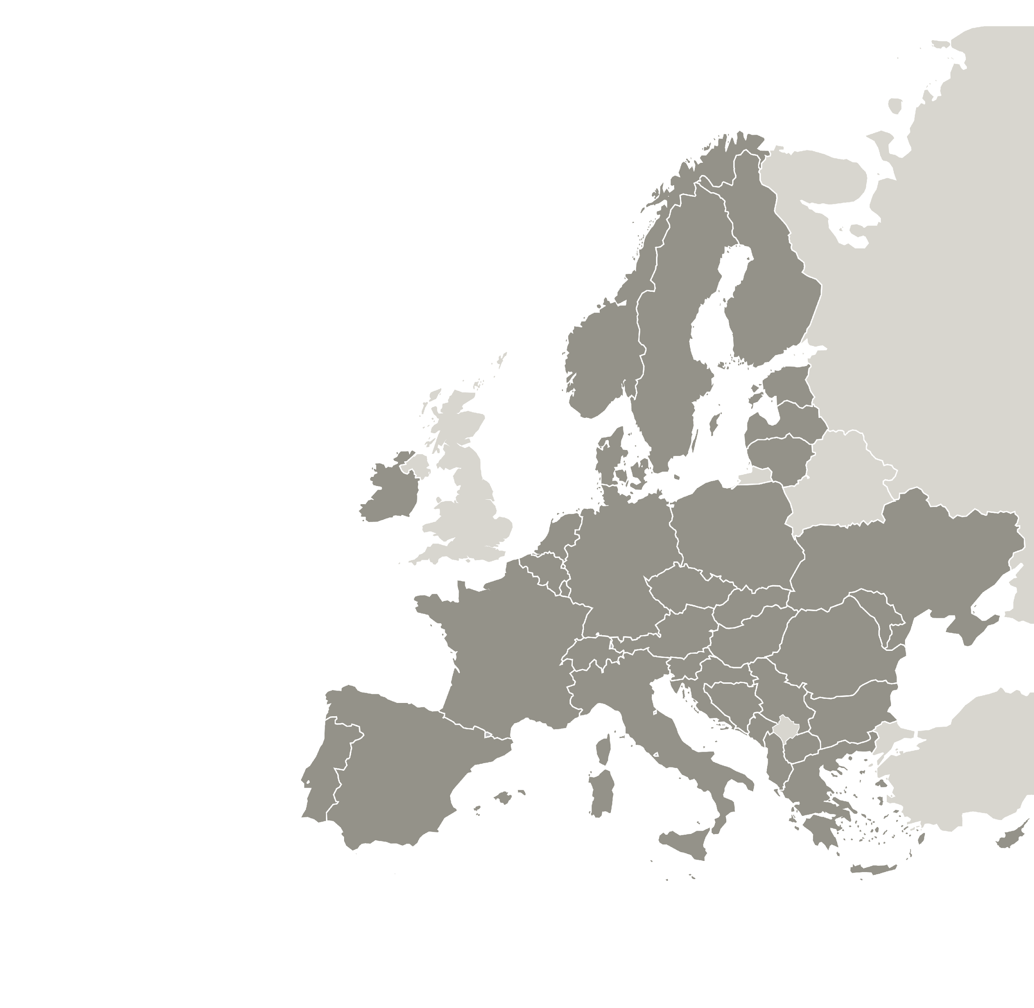





BELGIUM
ITALY
LITHUANIA
LATVIA
POLAND
SPAIN
6
COUNTRIES
7
Project Partners
7 COUNTRIES
Poland
Germany
Hungary
Ireland
Italy
Latvia
Spain
8
Partners Project
Policy recommendations document on revitalisation
Foundation for Landscape Protection (FOK)
Advisory partner

Slide 2
Outline of the presentation
  Introduction: InterRevita's understanding of revitalisation
  New European Bauhaus: values guiding the revitalisation
  Recommendations of the InterRevita project partners
  Revitalisation in practice: practical examples of recommendations
  EU-level recommendations

Slide 3
InterRevita's understanding of revitalisation
We understand revitalisation as a broad term for integrating interventions at the regional and local level for improving the liveability and quality of life based on different pillars:
Social
Economic
Environmental
Cultural

Slide 4
Understanding revitalisation: a holistic perspective
Revitalisation
Urban development
Environmental sustainability
Socio-economic renewal
Climate change resilience
Community well-being
Local entrepreneurship
Revitalisation is a comprehensive process that integrates diverse perspectives, which need to be taken into account simultaneously.
Is there any other element that you are missing in the graphic?

Slide 5

New European Bauhaus
The New European Bauhaus initiative calls on all of us to imagine and build together a sustainable and inclusive future that is beautiful for our eyes, minds and souls.
Places, practices and experiences in line with NEB are:
Beatiful, inspired by art and culture, responding to needs beyond functionality.
Sustainable, in harmony with nature, the environment and our planet.
Inclusive, encouraging a dialogue across cultures, disciplines, genders and ages.
NEB values guide revitalisation as understood by the InterRevita project

Slide 6
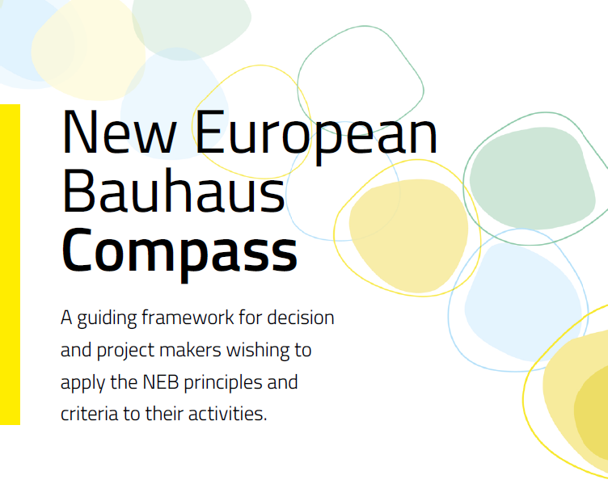
New European Bauhaus – recommended reading
https://new-european-bauhaus.europa.eu/tools-and-resources/use-compass_en

Slide 7
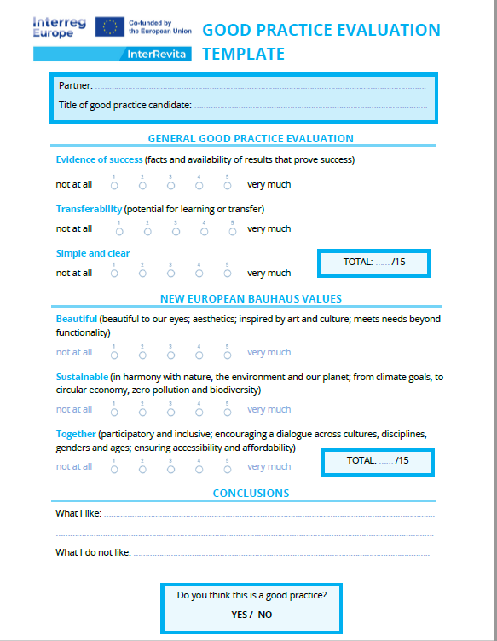
The InterRevita project has integrated New European Bauhaus in the evaluation proces of good practices from the participating regions.

Slide 8
Recommendations of the InterRevita project partners
  R1: Involve citizens and other stakeholders in decision-making process
  R2: Invest in public spaces
  R3: Improve public infrastructure
  R4: Improve citizents’ quality of life
  R5: Promote culture as a driver of heritage preservation, economic growth and community cohesion
  R6: Advance resilience and climate action
  R7: Support entrepreneurship and business development
  R8: Encourage intermunicipal cooperation

Slide 9
R1: Involve citizens and other stakeholders in decision-making process
It is important to involve the local community through prior consultations to understand exactly their needs and expectations. All good practices must contain an element of participatory governance.

Slide 10
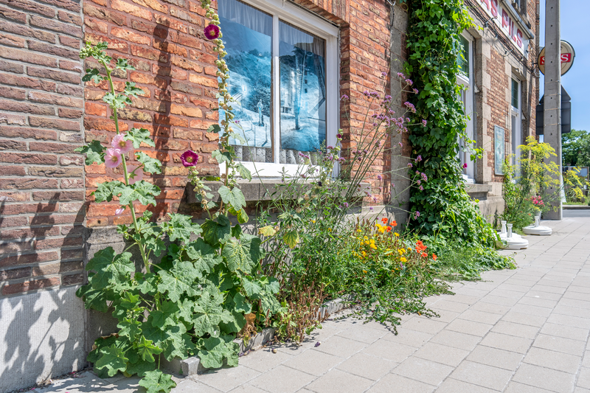
Low-cost actions to mobilize citizens in climate adaptation, Belgium
More information:
Low-cost actions to mobilize citizens in climate adaptation
The City of Roeselare is running various actions in which citizens/neighbourhoods can participate. An example of this is the planting of a facade garden by residents.
If more than 8 people in a street opt ​​for a facade garden, the city constructs and plant them and pays for the plants. Citizens are also encouraged, independently of this joint project, to create a facade garden.

Slide 11
Roblox as participation tool to redesign a playground, Belgium
This action aimed to involve the children in designing a playground that they themselves would later use.
Roblox, a tool that enables the creation of a virtual universe, was used for the engagement.

Slide 12
R2: Invest in public spaces
Prioritise the development and maintenance of public spaces such as parks, plazas and pedestrian zones to enhance community interaction, environmental sustainability and urban aesthetics.

Slide 13
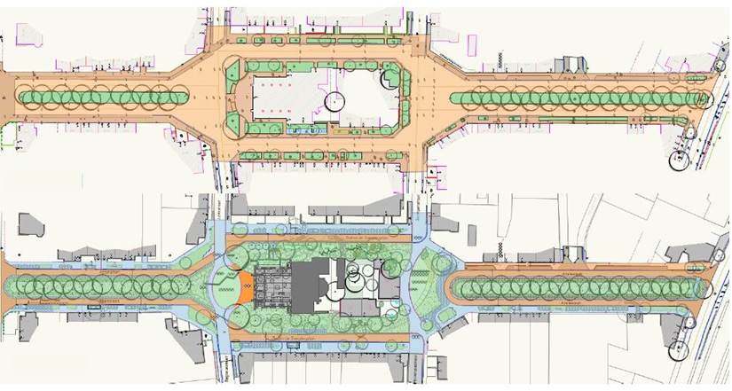
The St. Joseph church area deseal, Belgium
More information:
The St. Joseph church area deseals (Sint-Jozef breekt uit)
To reverse the feel of the paved road infrastructure, a design brought in addition to greening and water, explicit place for experience, neighbourhood and mobility.

Slide 14
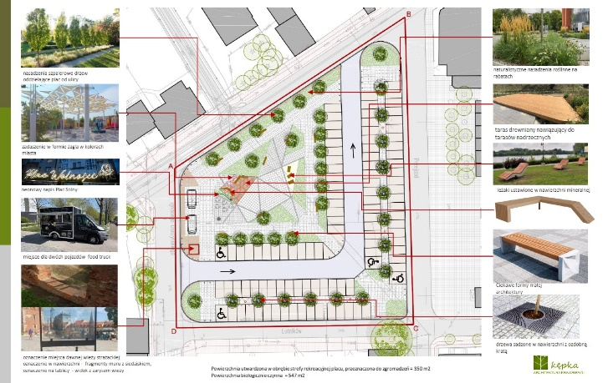
Salt Square - Revitalisation of Salt Square for social, tourist and economic activities, Poland
More information:
Nowy Dwór Mazowiecki - Plac Solny - zdjęcia, mapa
The revitalised square, provides a balance between an intergenerational integration function, economic activity and parking.
Culinary and cultural events take place there on a regular basis and there are specially created seating and resting areas.

Slide 15
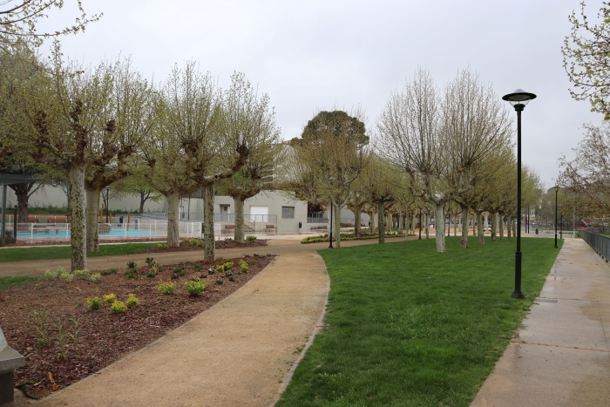
Green infrastructure in Tudela, Spain
More information:
Hoy 27 de marzo se abre al público el Corredor Verde Turístico de Tudela - Ayuntamiento de Tudela
This action has transformed public space into a natural environment for leisure and activity.
The idea has been to improve mobility in the area, achieve adequate walking routes and enhance the value of the Ebro River in the surroundings of the city.

Slide 16
R3: Improve public infrastructure
Upgrade and modernize public infrastructure, including public venues for culture, leisure and sport to support sustainable urban growth.

Slide 17
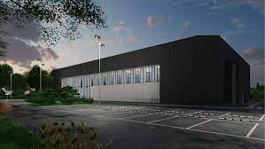
Reconstruction of Sport and Leisure Centre, Lithuania
The aim of this intervention was to create a multifunctional attraction for active recreation and sports the center for the whole family, using the existing natural resources and the city's sports and entertainment infrastructure.
It promotes inbound tourism by creating high-quality infrastructure for the development of active tourism.

Slide 18
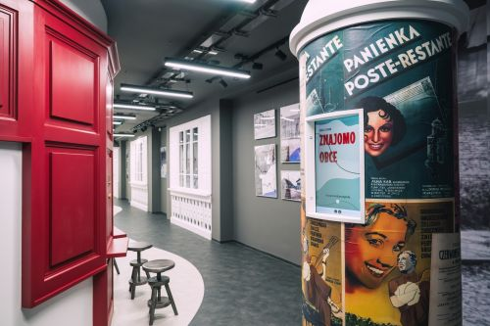
Adaptation of the Public Library to promote the city’s history and cultural heritage, Poland
More information:
Miejska i Powiatowa Biblioteka Publiczna w Nowym Dworze Mazowieckim (nowydwormaz.pl)
The modernization and adaptation of the Public Library for the Exhibition of the History of the City made it possible to create a space that meets cultural and educational goals.
This place becomes a centre where innovative methods of transferring knowledge about the history of the region are used.

Slide 19
R4: Improve citizents’ quality of life
Prioritize investments in cultural activities and public spaces to create inclusive, safe and vibrant communities where residents can thrive.

Slide 20
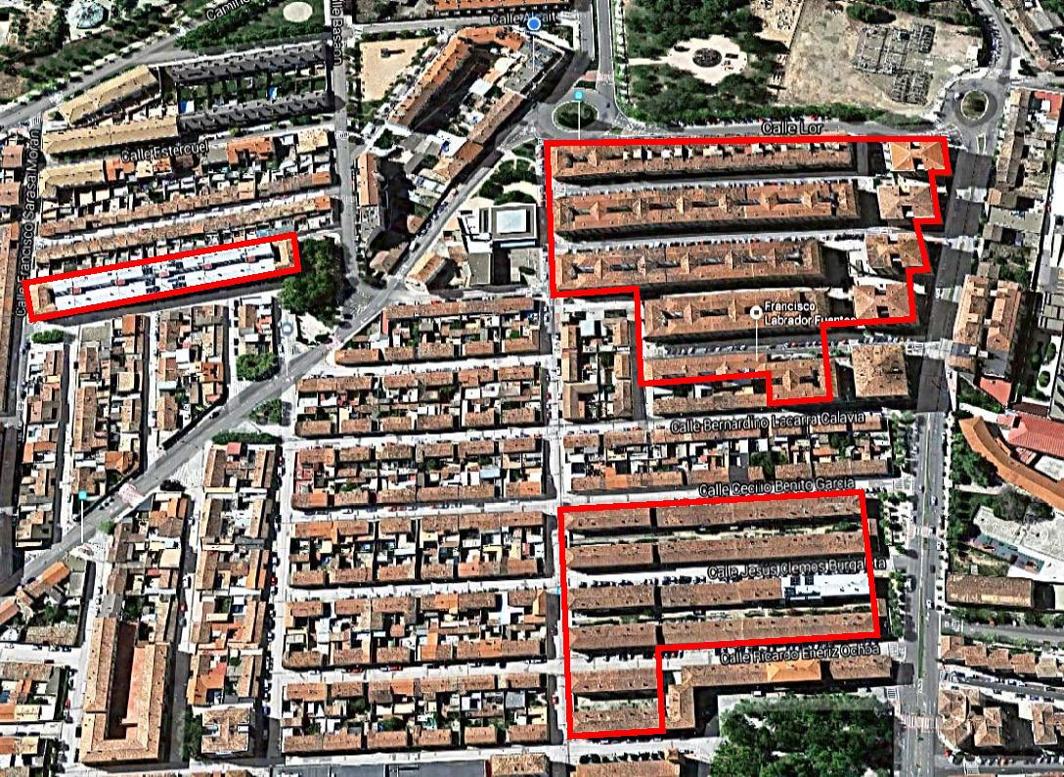
Energy district renovation in Tudela, Spain
More information:
Nasuvinsa: Proyecto Lourdes Renove
Under this action a district heating of 486 dwellings has been renovated incorporating BIOMASS (pellets) as an energy source.
In addition, 2 photovoltaic installations have been installed on the roofs of two entrances.

Slide 21
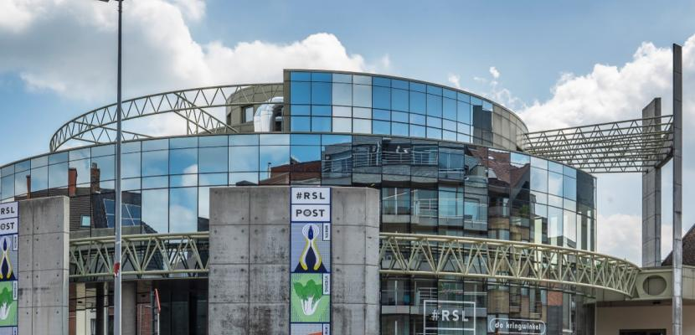
RSL Op Post, Belgium
More information:
RSL Op Post
RSL Op Post rethinks traditional social care for vulnerable citizens by empowering them to leverage their talents and environment for self-sustainability and expanding social networks.

Slide 22
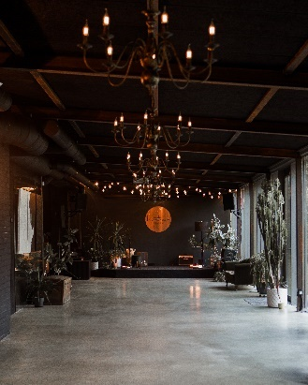
Association Tuvu (Close) – to be close to those who need it!, Latvia
More information:
Association Tuvu (Close) – to be close to those who need it!
http://www.biedribatuvu.lv/home/
Association “Tuvu” was established in 2013 to help people in crises situations. It was established in old Soviet time garage, so now the space clearly shows the efforts put to create this place as cozy gathering place in vintage style with stage, café, large gathering room, space for play and creative activities.

Slide 23
R5: Promote culture as a driver of heritage preservation, economic growth and community cohesion
Leverage cultural assets and heritage to foster economic opportunities, promote tourism and enhance community identity, while ensuring the preservation and celebration of local traditions and history.

Slide 24
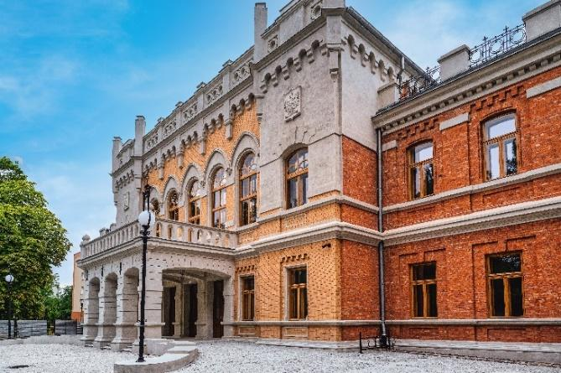
Revitalisation of the historic Officers' Casino for cultural and tourism purposes, Poland
More information:
Kasyno oficerskie | Nowy Dwór Mazowiecki (nowydwormaz.pl)
Main aim of this intervention was to restore the building for residents and tourists and to preserve the cultural heritage.
This building, which now houses, among other things, a cinema hall or restaurant, regularly hosts cultural events in which the residents of Nowy Dwór Mazowiecki can participate.

Slide 25
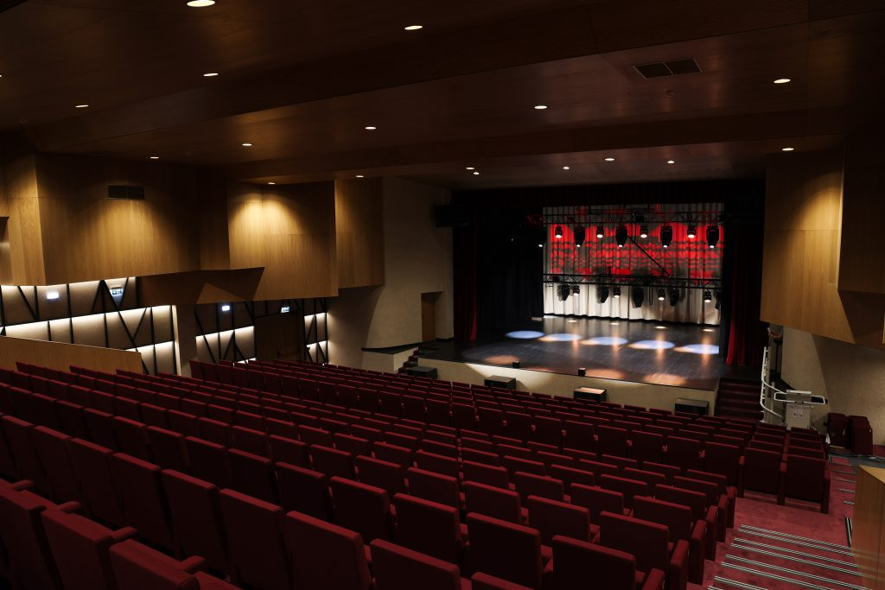
Modernisation of Šilutė Culture and Entertainment Center, Lithuania
As a result of this intervention, a modern cultural infrastructure that meets the needs of modern society was created. It contributed to the cultural development and increase of quality cultural event services
Now the inhabitants have the opportunity to choose from a larger supply of quality professional arts and cultural events.

Slide 26
R6: Advance resilience and climate action
Embed climate adaptation and resilience measures into urban planning, including green infrastructure, renewable energy projects and nature-based solutions tailored to local needs.

Slide 27
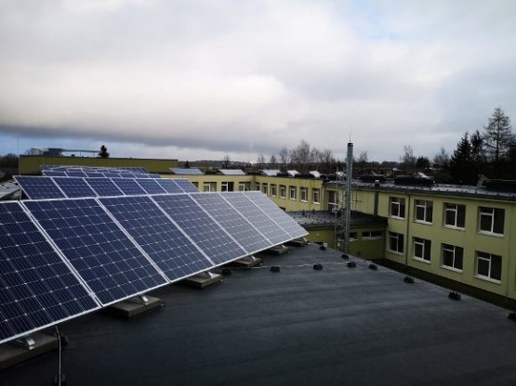
Solar panels and green infrastructure development, Lithuania
The action was to install photomodules on the roofs of buildings owned by the municipality.
Now all administrative bodies and budgetary institutions are independent, as they have their own solar panels that produce electricity from a renewable energy source. In result, the CO2 footprint in the area is decreasing.

Slide 28
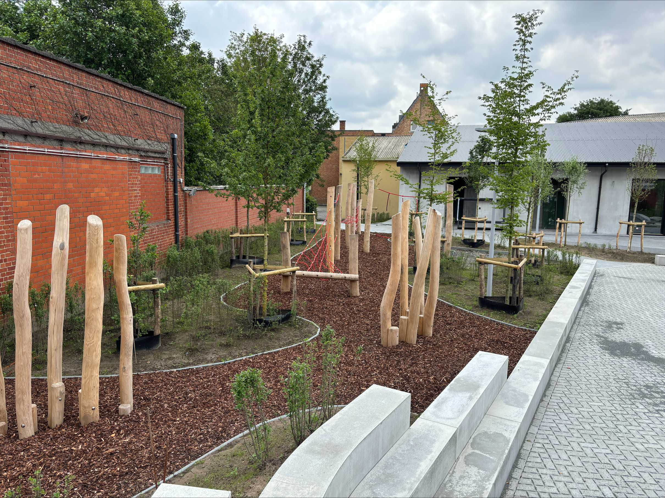
Opening up a greener school yard, Belgium
More information:
A new green (play) area | Neighborhoods #VANRSL
Voorontwerp De Brug
As a result of this intervention, the grey outdoor space of Municipal Primary School De Brug was given a green 'makeover’.
As part of this practice, new sustainable building techniques were tested to make the infrastructure resilient to climate change and to use closed-loop materials.

Slide 29
R7: Support entrepreneurship and business development
Foster local entrepreneurship and business innovation through e.g. the creation of skill development programs and support for small and medium-sized enterprises.

Slide 30
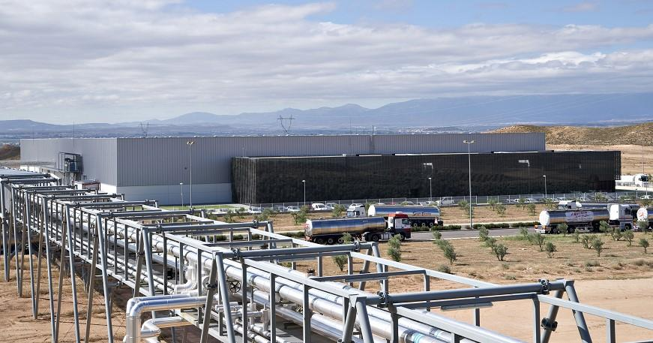
The Agrifood City in Tudela (CAT), Spain
More information:
Agrifood City of Tudela - Ciudad agroalimentaria de Tudela
Main aim of this intervention was to create pioneering business park where infrastructures and services are shared in a sustainable way in order to enhance the competitiveness of companies.
For companies installed in CAT, it offeres technical, personalised support, industrial mini-units for innovative projects as well as joint-use laboratory.

Slide 31
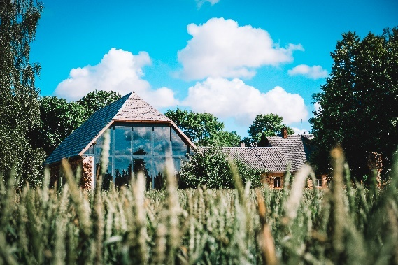
Renovation of Brūveru klēts, Latvia
More information:
Brūveru klēts (Brūveru Barn) - Relaxation and leisure time, celebrations, weddings
The aim was to develop tourist site which will become a source of entrepreneurial development.
It functions as a venues for concerts, weddings, birthday parties as well as corporative events.

Slide 32
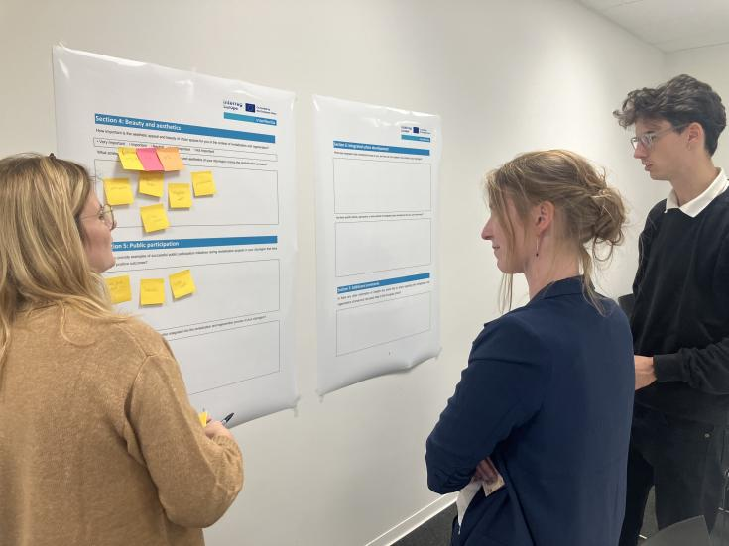
Youth initiatives – promoting youth employment, Lithuania
This action aims to increase youth employment and provide assistance to young people in acquiring the necessary practical skills.
The program is intended for young people from 14 to 19 years old, studying and declaring their place of residence in the territory of Šilutė district municipality and residents of Šilutė district municipality up to and including 36 years of age (inclusive), studying in Lithuanian higher education institutions in full-time, part-time or retraining and medical residency studies of the first (bachelor, professional bachelor), second (master's) stages.

Slide 33
R8: Encourage intermunicipal cooperation
Facilitate partnerships between cities and surrounding municipalities to develop integrated territorial strategies addressing shared challenges like mobility, housing, and green infrastructure.

Slide 34
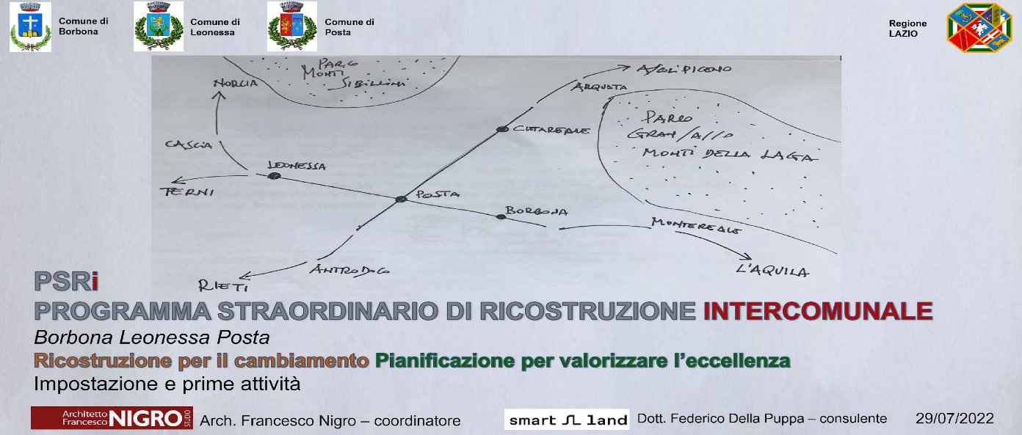
Extraordinary intermunicipal reconstruction programme, Italy
The objective of this action was to support the planning of reconstruction activities and encourage the redevelopment and regeneration of the territory and settlements.

Slide 35

ChiamaBus: Where you need it, when you need it, Italy
ChiamaBus is a service of local public transport on-demand, that aim to contribute to integrate urban development.
It was created to diversifying the transport offer and facilitate the travel to and from the main urban, healthcare and tourist canters in the area interested.

Slide 36
EU-level recommendations
  For EU-level strategies and recommendations please refer to:
  Urban Agenda for the EU
  Policy ecosystem for the New European Bauhaus
  Policy briefs of the Policy Learning Platform of Interreg Europe

Slide 37
Now is your turn!
What are your recommendations?

Slide 38

More information:
www.interregeurope.eu/InterRevita
Collection of practices on revitalisation and integrated urban development

