Slide 1
The TEXAD project
Advanced Circular Textile Waste Solutions for European Municipalities
Project progress March 2025
Notes:
This is the progress presentation for the TEXAD project. There is also an Overall/General powerpoint presentation of the project

Slide 2
TEXAD
Background
We need to ensure that circularity becomes the driver of the textile and fashion sector.
It is essential that the different stakeholders of the recycling value-chain cooperate – inspired and compelled by municipal policies.
Project progress March 2025
Notes:
Some 4 – 6% of the EU overall environmental footprint can be traced back to textiles.
It is estimated that 3.3 to 3.7 million tonnes are discarded in mixed household waste.
But in reality, it might be worse. As there is no Europe-wide obligation to report the amount of textile collected from consumers or companies, meaning that a large percentage of the textile waste possibly ends up in regular bins.

Slide 3
TEXAD
An interregional cooperation project to improve Circular economy policies
TEXAD aims at improving and driving the municipal policy instruments towards a circular model.
Project progress March 2025
Notes:
The TEXAD project contribute towards prevention, proper sorting, collection, and valorisation of textile waste. As waste needs to be transformed from being just waste into new products or secondary raw materials.

Slide 4
TEXAD
Overall objective
TEXAD aims at improving the policy instruments from European municipalities.
We do this by including and reinforcing circularity in the management of textile waste.
And by adapting and aligning the policies to the requirements set by the new EU regulations.
Project progress March 2025
Notes:
A project to build capacities in the municipalities based on exchange of experiences and transferring of best practices.

Slide 5
TEXAD
Specified objectives
TEXAD promote interregional exchange of experience.
TEXAD support the engaging in interregional capacity building.
TEXAD advance the monitoring and evaluation of the impact of municipal policy improvements.
Project progress March 2025
Notes:
TEXAD facilitate knowledge-sharing and experiences among partners – including public policy makers, practitioners, and stakeholders from the textile industry, creating opportunities for mutual learning, joint policy development, and improvement.
TEXAD enhance the capabilities of participating municipalities in integrating best practices for circularity in the prevention, collection, sorting and valorisation of textile waste.
TEXAD assess the effectiveness of the implemented changes on the targeted policy instruments.

Slide 6
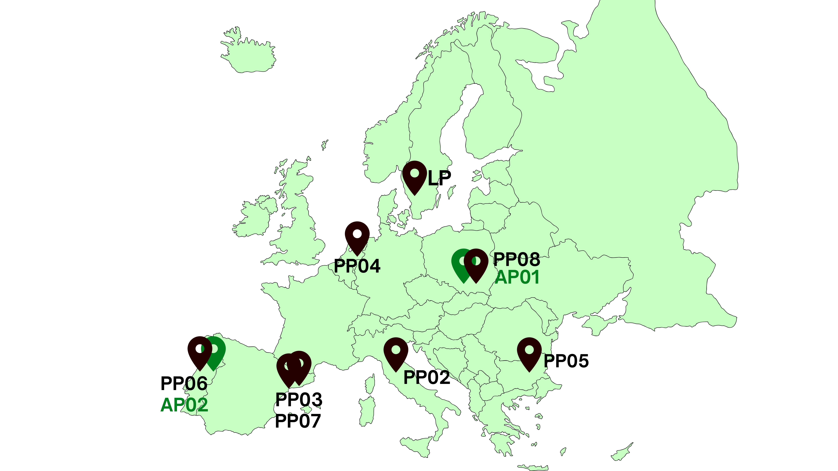
TEXAD
Partners
Six European municipalities
with a strong textile background and best practices to share and one Regional Development Agency (PL).
A fashion cluster as the Advisory Partner, connecting the project with key stakeholders.
TEXAD targets the policy improvement of 6 municipal plans and 2 ERDF OPs.
Project progress March 2025
Notes:
LP01 City of Borås
PP02 Prato Municipality
PP03 Mataró Municipality
PP04 Enschede Municipality
PP05 Stara Zagora Municipality
PP06 Santo Tirso Municipality
PP07 MODACC - Catalan Fashion Cluster
PP08 Rzeszow Regional Development Agency
APA01 Podkarpackie Region
AP02 Norte Regional Coordination and Development Commission

Slide 7
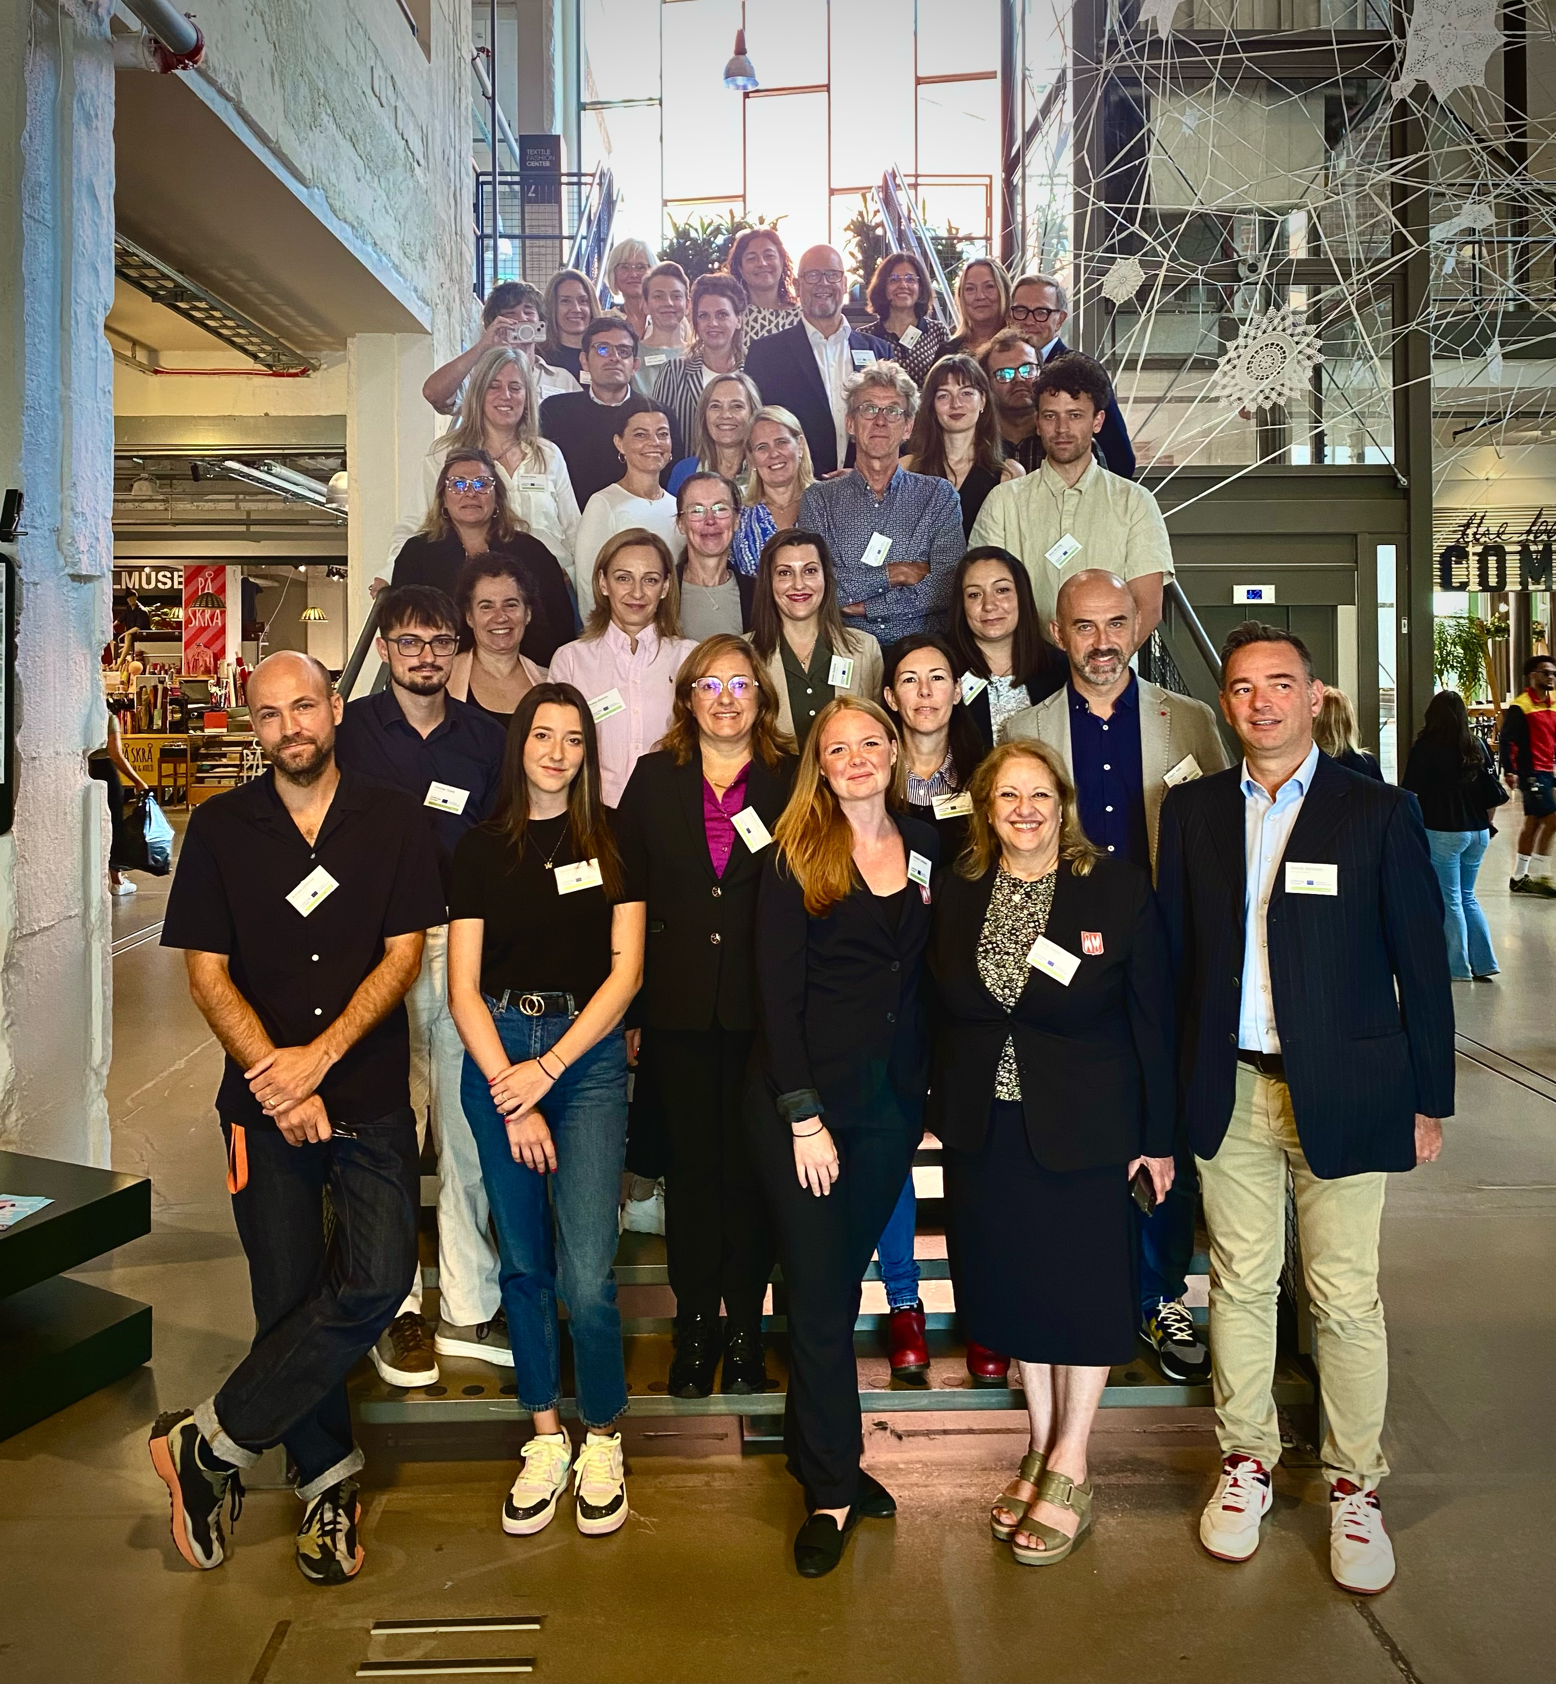
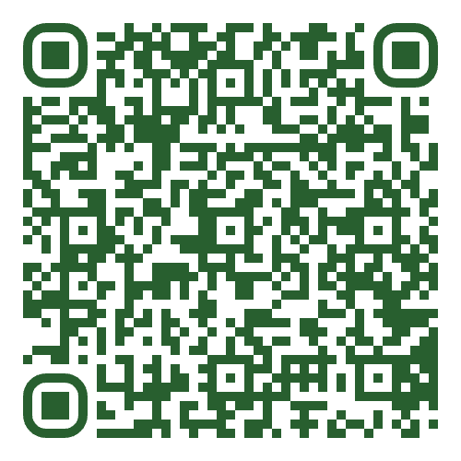
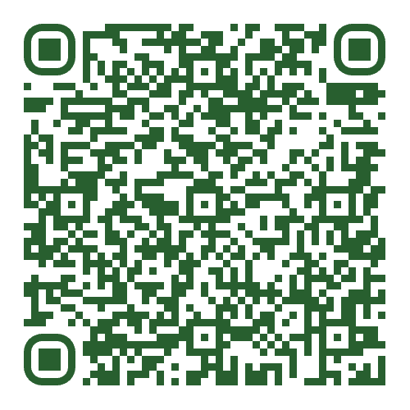
TEXAD
Study visits
Study visits and Steering group.
Two in-person meetings conducted:
Borås, Sweden, September 2024
Prato, Italy, January 2025
Project progress March 2025
Notes:
And four more are to be scheduled. In Mataró, Enschede, Stara Zagora, and Santa Tirso/Podkarpackie region.
The first QR code takes you to a text about the Borås Study visit
https://www.interregeurope.eu/texad/news-and-events/news/texad-sharing-good-practices
The second QR code takes you to a text about the Prato Study visit
https://www.interregeurope.eu/texad/news-and-events/news/prato-texad-second-meeting-concluded

Slide 8
TEXAD
Good Practices chosen
Prevention Education
Valorisation
Consumer awareness
The Prato Textile Hub
GIDA Public-Private Partnership
Prato Circular City
Project progress March 2025
Notes:
The first three are from the Borås, Sweden. The second three from Prato, Italy
There’s an article about the six first Good Practices on the TEXAD web site:
https://www.interregeurope.eu/texad/news-and-events/news/six-texad-good-practices-so-far

Slide 9
TEXAD
Good Practice 1
Prevention Education
By Nordic Textile Academy, about the skilling, re-skilling, and up-skilling for circular jobs. The school’s work is founded on a near collaboration with the industry. And the ability to fast track new skills programmes, while still following the European Qualification Framework.
Project progress March 2025
Notes:
Borås, Sweden

Slide 10
TEXAD
Good Practice 2
Valorisation
A test bed experiment by the Science Park Borås and other stakeholders, including some NGOs. A Good Practice concerning the valorisation of already sorted textile waste. It shows how you can find even more items fit for reuse in already sorted textile waste – in this case up to 28 % more items.
Project progress March 2025
Notes:
Borås, Sweden

Slide 11
TEXAD
Good Practice 3
Consumer Awareness
By the Science Park Borås, about Consumer Awareness. How the Science Park work with Consumer Awareness, based on having a holistic view on Textile waste handling. This includes the five dimensions: Technology, Business models, Policies/regulations, Behavioural actions, and the infrastructure of innovative systems. All based on their insights that you need to Scale up, Scale out, and Scale deep.
Project progress March 2025
Notes:
Borås, Sweden

Slide 12
TEXAD
Good Practice 4
The Prato Textile hub
By Prato Circular City (see GP6 ), focusing on the funding and infrastructure to establish the main Italian textile hub in Prato – consolidating the role of the Prato district as a technological and operational hub for textile recycling at a European level.
Project progress March 2025
Notes:
Prato, Italy

Slide 13
TEXAD
Good Practice 5
GIDA Public-Private Partnership
By the Municipality of Prato and the regional industrial confederation, showing a model for collaboration in sustainable waster waste management. Through its facilities, GIDA manages all the wastewater from both the industry and the citizens. The facilities process up to 50 million cubic meters of wastewater annually, with a portion being recycled back into the textile industry.
Project progress March 2025
Notes:
Prato, Italy

Slide 14
TEXAD
Good Practice 6
Prato Circular City
Designing sustainability at the urban level, by the municipality of Prato. A Good Practice concerning how to accelerate the transition to the circular economy. The project has two main objectives:
1. Strengthening the image of Prato as a "circular city".
2. Establishing a permanent forum to promote shared circular economy actions and to build a governance model of circular city.
Project progress March 2025
Notes:
Prato, Italy

Slide 15
TEXAD
ITWs
Four International Thematic Workshops
Four ITWs are scheduled – in conjunction with the remaining study visits to Mataró, Enschede, Stara Zagora, and Santa Tirso/Podkarpackie region. Each ITW will address one single topic:
Funding
Monitoring and legislation implementation
Consumer and business awareness
Infrastructure and facilities.
Project progress March 2025
Notes:
Each ITW will address one single topic, the four different topics are:
Funding
Monitoring and legislation implementation
Consumer and business awareness
Infrastructure and facilities.
The ITWs will be held in conjunction with the study visits to Mataró, Enschede, Stara Zagora, and Santa Tirso/Podkarpackie region.

Slide 16
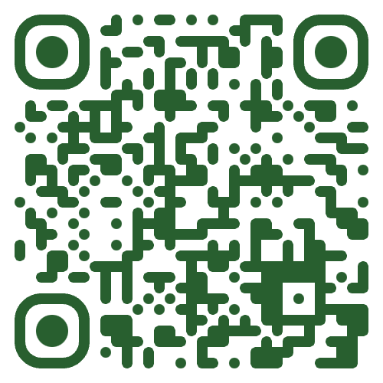
TEXAD
Social media
Web site
Up and running at: www.interregeurope.eu/texad.
Here you find background and facts, as well as articles and more about current events.
Project progress March 2025
Notes:
The TEXAD web site is updated regularly

Slide 17
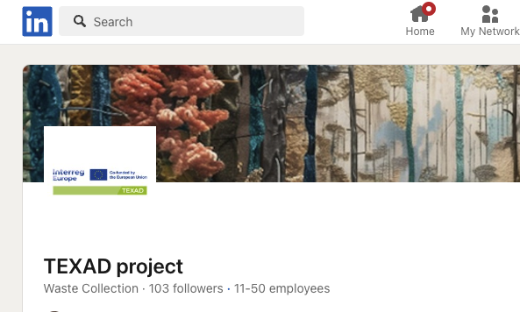
TEXAD
Social media
Social media
Up and running. These include LinkedIn, Instagram, and Facebook.
Project progress March 2025

Slide 18
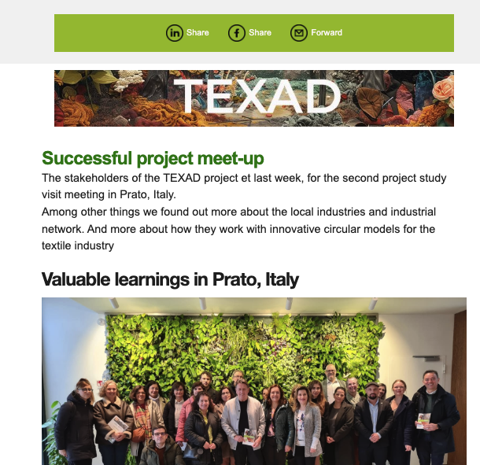
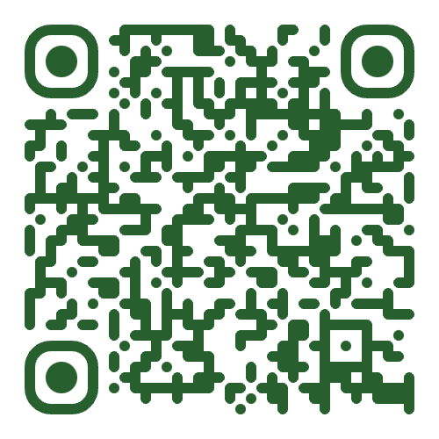
TEXAD
Social media
Newsletter
Four published editions. Some 30+ subscribers.
Use QR code to subscribe.
Project progress March 2025
Notes:
Currently 32 subscribers

Slide 19
TEXAD
Upcoming
Third meetup/study visits:
Mataró, Spain. September 2025.
Project progress March 2025
Notes:
The three remaining Study visits will be held in Enschede, Stara Zagora, and Santa Tirso/Podkarpackie region.

Slide 20
Read more www.interregeurope.eu/texad
TEXAD newsletter mailchi.mp/boras.se/the-texad-newsletter
Project progress March 2025
Notes:
The larger QR code is for the web site. The smaller one for subscribing to the TEXAD newsletter

