Slide 2
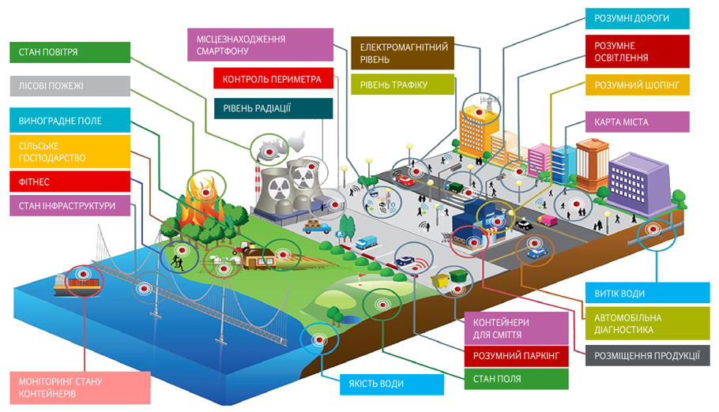
The application of the Internet of Things affects various industries
Smart roads
Smartphone location
Electromagnetic level
Smart lighting
Air condition
Forest fire
Perimeter control
Traffic level
Smart shopping
Grape field
Radiation level
City map
Agriculture
Fitness
State of infrastructure
Water leak
Garbage containers
Automotive diagnostic
Smart parking
Product placement
Monitoring the condition of containers
Water quality
Field condition

Slide 3
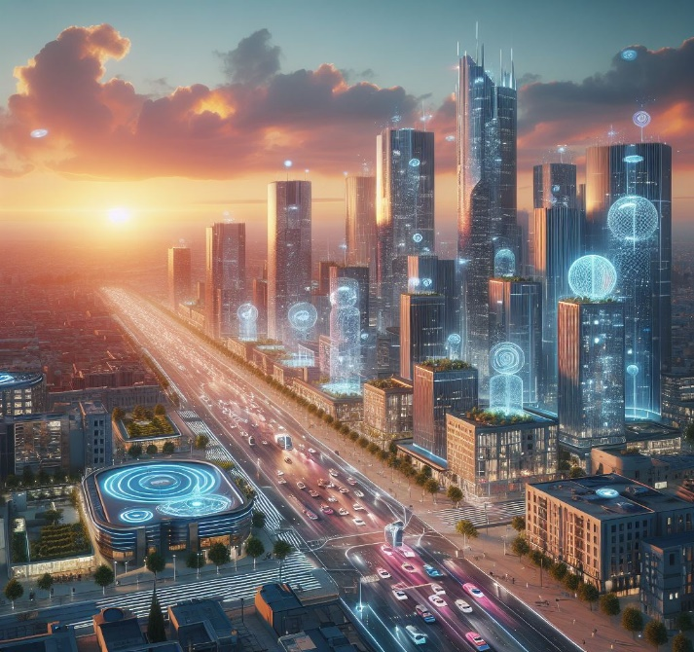
Segments Urban IoT
CO2
Flood forecasting and warning
Management of garbage storage and removal
Accounting for energy consumption
Habitat quality monitoring
Traffic management
Noise level monitoring
State of engineering structures
Smart lighting
P
Parking space management
Energy supply for municipal facilities
Monitoring emergency situations
Monitoring of municipal gas distribution network facilities

Slide 4
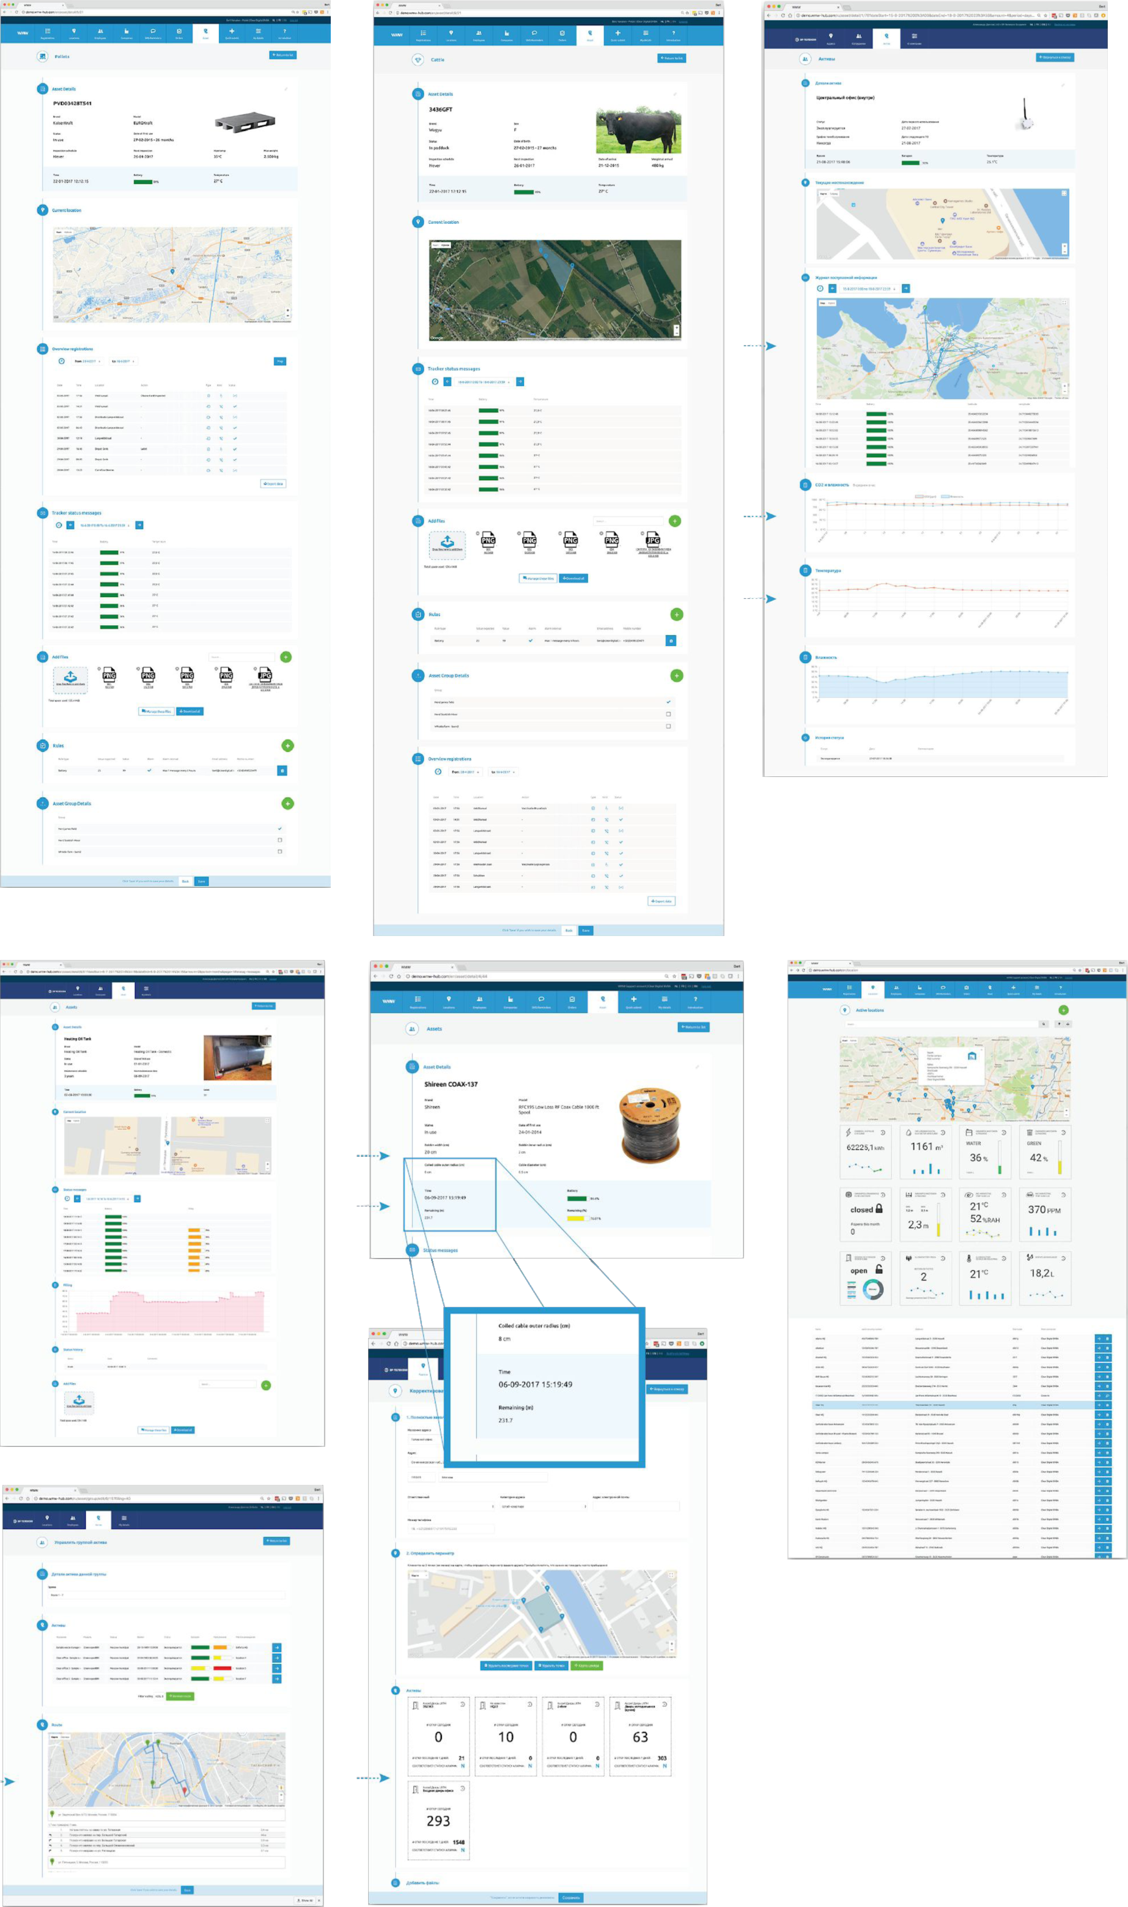
A modern scheme for collecting data from various city sensors, main and apartment meters
Internet
Data monitoring, processing and analysis platform
The range is up to 15 km
up to 5000 devices per base station
Application dashboard
1
2
3
4
Energy-efficient long-range network ~ 10 years battery life.
Reliable radio technology.
Immunе to interference and noise
Low deployment costs, unlicensed spectrum, easy to deploy a base station.
Native encryption and end-to-end communication authentication

Slide 5
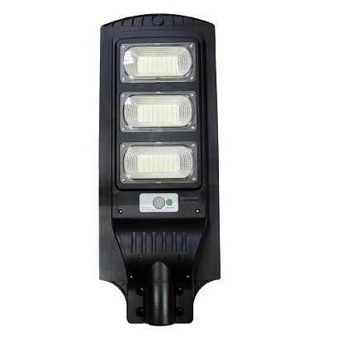
Smart lighting
Console lamp with built-in radio module,
motion sensor and light sensor.
If necessary, the lamp can automatically adjust the brightness when the built-in motion sensor is triggered, as well as control the brightness of other luminaires according to a predefined scheme.
Central control system
Easy-to-use device management interface
Quickly assess the status and operation of the lamp
Controlling the brightness of the spotlights
Automatic dimming according to the calendar program
Brightness control by motion sensor
Monitoring of operating parameters
Support of constant light flux

Slide 6
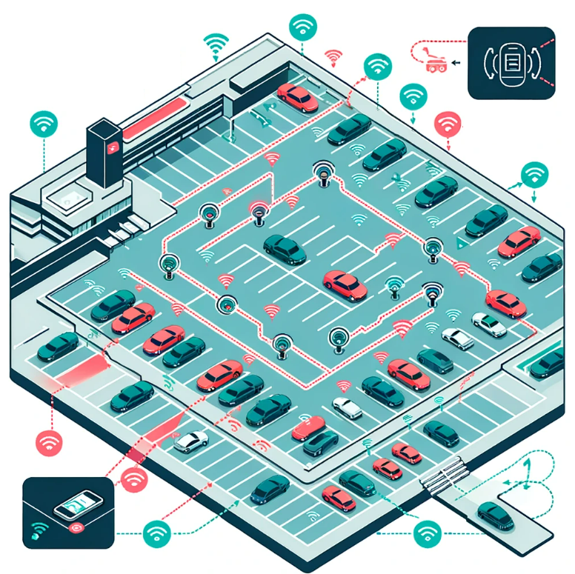
Smart parking
Advantages of parking sensors
Complete information about each parking space in real time.
Send drivers to vacant spaces, improving traffic flow and reducing pollution.
Instant information about overdue payments.
Information for profitable planning in the future.
Optimal use of available space.
Smart parking scheme

Slide 7
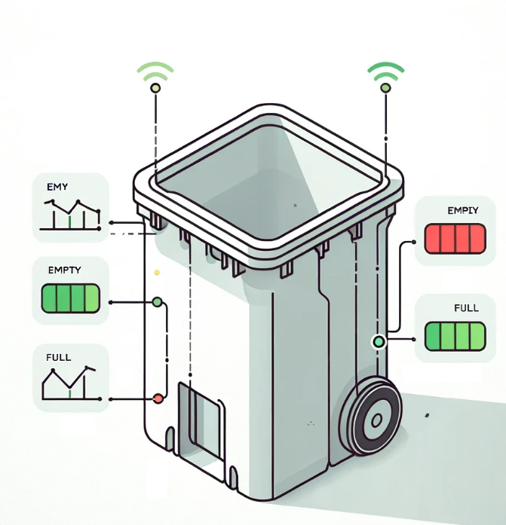
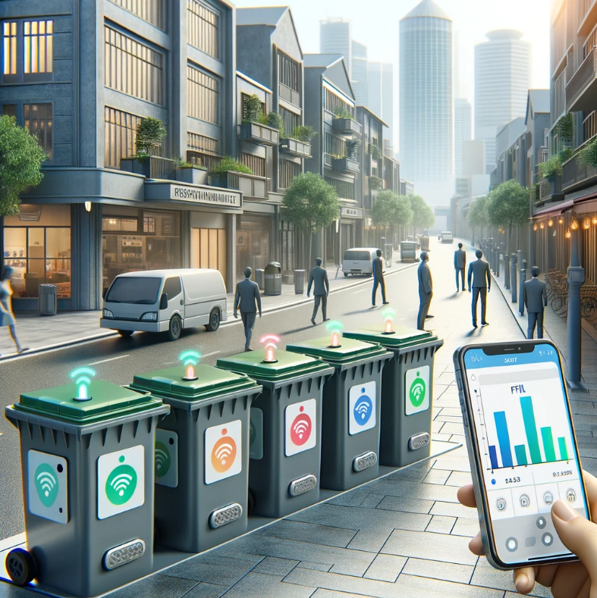
Trash bin fullness sensors
Advantages of garbage can sensors
Waste container sensors are used toto determine the status of the containers. Depending on whether they are emptyor full, the waste collection schedule is adjusted accordingly, which in turn saves money.
With the help of a real-time waste management system using smart bins, an interested person can access all smart bins anytime and anywhere. The system will inform about the status of each bin in real time so that the relevant authorities can dispatch a garbage collection vehicle only when the bin is full. By implementing this optimization of system resources, it is possible to reduce logistics costs and reduce CO2 emissions

Slide 8
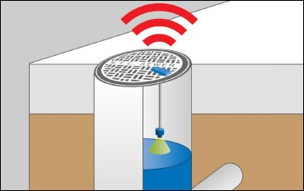
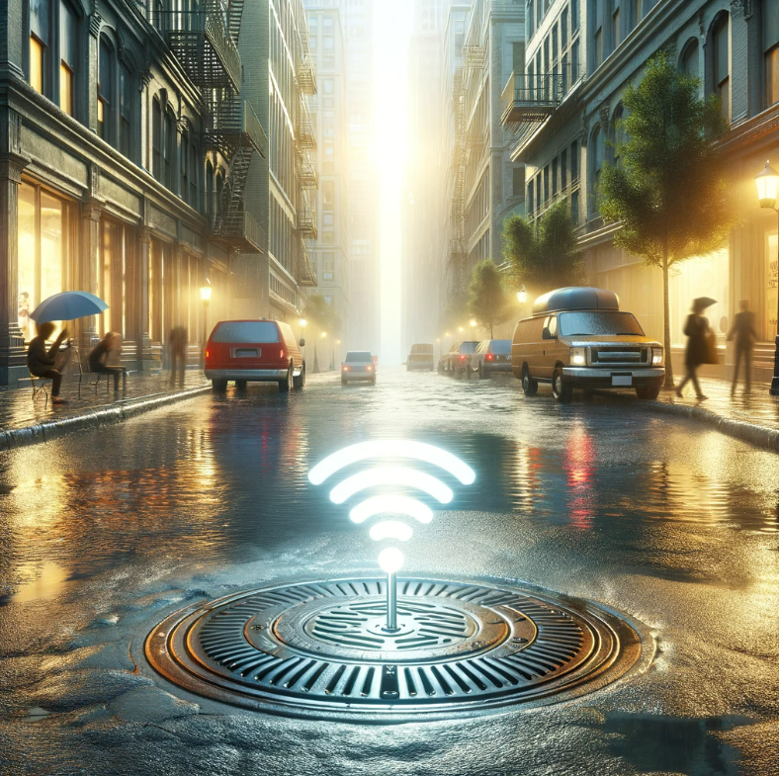
Ultrasonic manhole sensor with liquid level measurement
Features of use
Non-contact distance sensor
Automatic real-time monitoring for several years without battery replacement.
Open remote monitoring.
Water level monitoring in running water.
Flood monitoring.
Wastewater management, sewage system monitoring.
Level / depth monitoring in water tanks.
Snow level monitoring.
Monitoring of irrigation basins.

Slide 9
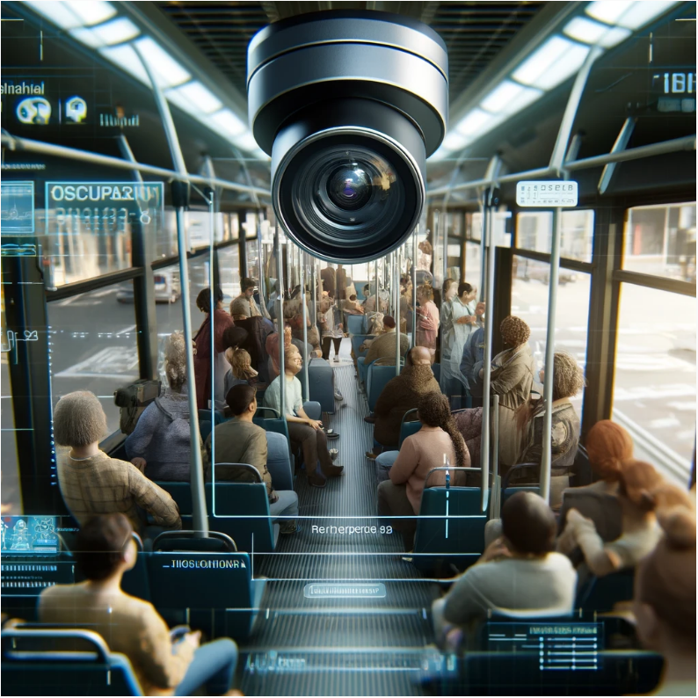
Passenger counting sensors
Fully automatic calculation;
Categorization of passengers by height, recognition of bicycles, wheelchairs and strollers;
Detection of the presence of passengers in the door opening (counter-clamp) for safe closing of the door;
Recognition and evaluation of passenger metric data (Analysis of objects);
Simultaneous recognition of passengers entering and leaving, regardless of crowding and door height.

