Slide 1
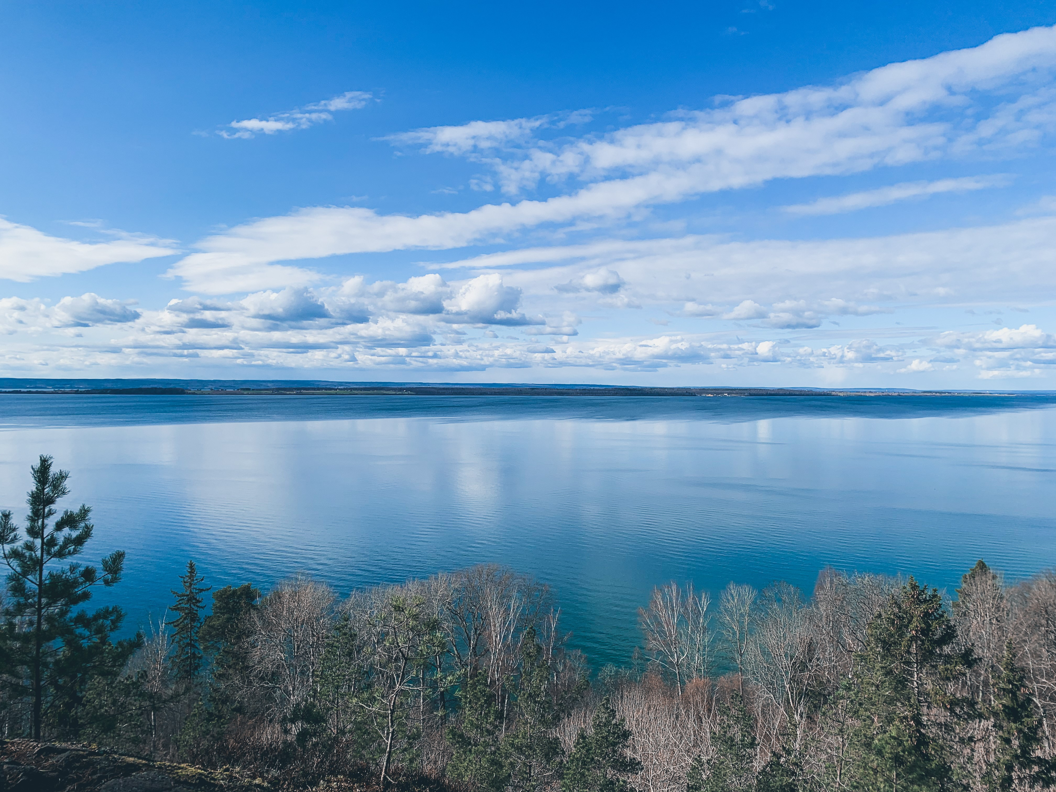
Region of Jönköping is a sustainable and innovative region

Slide 2
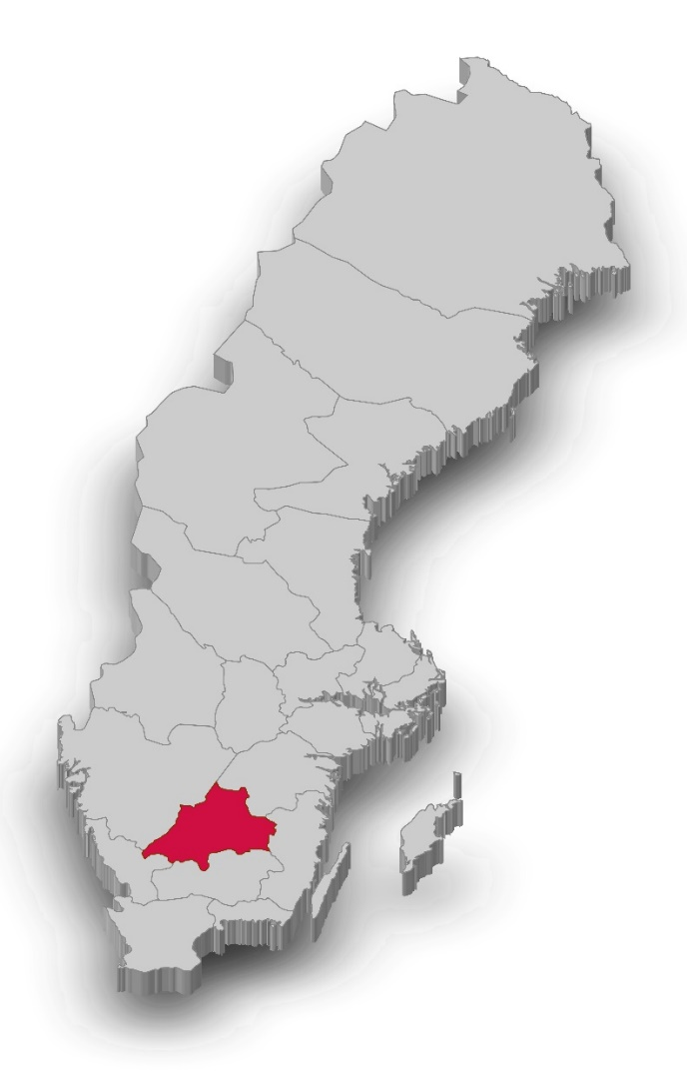
Region Jönköping County
Our strengths
Global leader in production technology
Variety of companies and industries in the region – creating a unique spiral of development and specialisation.
Geographical position in the centre of Northern Europe
Close cooperation with research centers and universities.
360 000 inhabitants – 6th largest i Sweden
13 Municipalities
Low unployment rates but also low levels of acadmic education
1 University and 3 hospitals

Slide 3
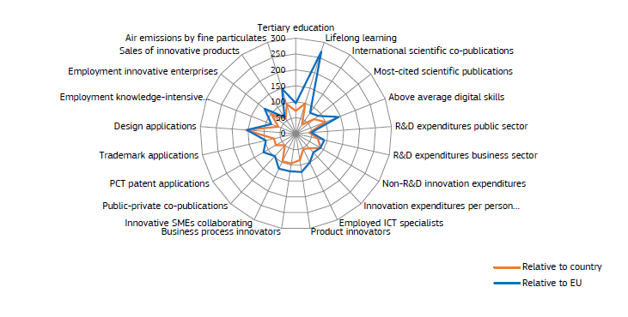
Region Jönköping County
Our strengths
Global leader in production technology.
Variety of companies and industries in the region – creating a unique spiral of development and specialisation.
Strong innovator
Geographical position in the centre of Northern Europe
Close cooperation with research centers and universities.

Slide 4

S3 - European strategy
Strategic goals (-2027):
    Influencing in policy making
    Collaborations to achieve implementation and transformation ability for the regional development mission
    Foundation for Investments and attractivity
  Operational goals (2024 – 2027):
    Participating in working groups, networks, projects to build relationships and social capital.
    Participating and leading projects for getting the reputation of being a partner that is reliable and gets the work done.
  Acting (2024)
    Cooperate – Participating in relevant conferences and networking opportunities.
    Communicate – Learning and doing
    Building capacity – Interreg/CoP
    Creating size for relevancy – SMÖ-S3 och SBHSS

Slide 5
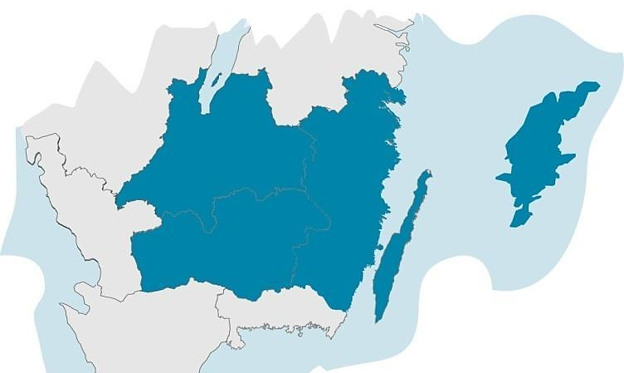
S3-Platform - Småland och öarna
Four Countys
34 municipalities
Three Universitys
882 000 inhabitants
33 000 km²
49 000 companies
1 NUTS2-area

Slide 6





One plattform, five thematic areas with five coordinating stakeholders
Forestry and wood processing
  Smart industry
  Digital services
  Tourism and attracitvity
  Food stuff

Slide 7

In five clusters spanning the area
With knowledge about the local buisness

Slide 8

Podkarpackie innovation system
Rzeszów, 3rd April 2024

Slide 9
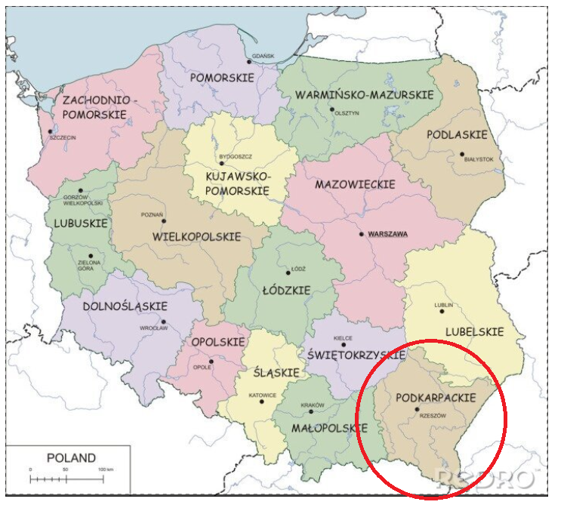
About us
Country: Poland
Region: Podkarpackie
Population: 2 079 098 (2022)
Capital of the region: Rzeszów
Population: 197 181 (2022)
Representative Organisation:
Marshal’s Office of the Podkarpackie Region
Regional Innovation Scoreboard 2023
Group: Emerging Innovator +
Rank: 209

Slide 10
About us
The Podkarpackie Province is
the most south-eastern region
in Poland.
The eastern border of the Republic
of Poland is the longest section the European Union's external land border.
The province covers an area of
17 845 km², which is 5.7%
of the country's area.
The province consists of:
160 municipalities, including 16 urban,
35 urban-rural and 109 rural.
International airport:
Rzeszów Jasionka (RZE)

Slide 11

Smart specialisations
S3 Priorities
Aviation and Cosmonautics

Slide 12
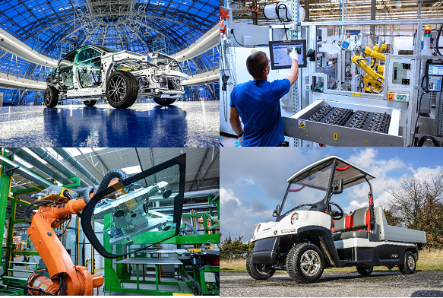
Smart specialisations
S3 Priorities
Automotive

Slide 13

Smart specialisations
S3 Priorities
Information and Telecommunications (ICT)

Slide 14
Smart specialisations
S3 Priorities
Quality of Life

Slide 15
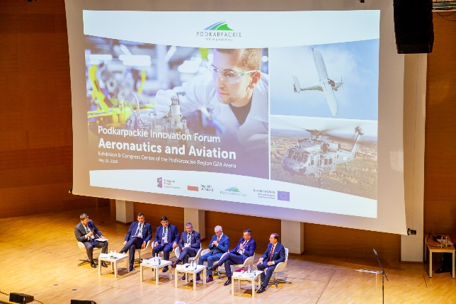
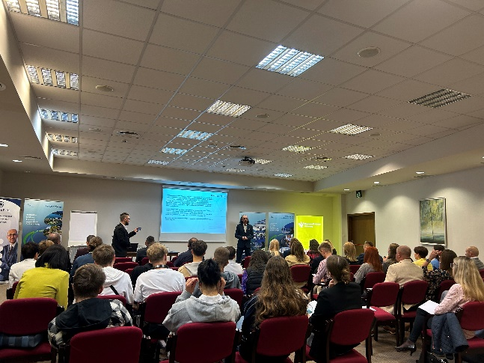
Entrepreneurial discovery process
Podkarpackie Innovation Council
Panels and Metapanels of Smart Specialisations
Podkarpackie Innovation Forums
Meetings of stakeholders of the RIS3

Slide 16
Entrepreneurial discovery process
Start of the new project – Podkarpackie Province – the inteligent region (Operational Programme European Funds for Podkarpackie Region for 2021-2027)
organising EDP as a continuous process to maintain the dialogue inside the ecosystem - increasing the involvement of stakeholders of the regional innovation system in EDP; ongoing stakeholders mapping;
monitoring and evaluation of RIS3;
collaboration with the national level to assure the right synergies
(i.e. Regional Forum of Smart Specialisations, National Smart Specialisations);

Slide 17
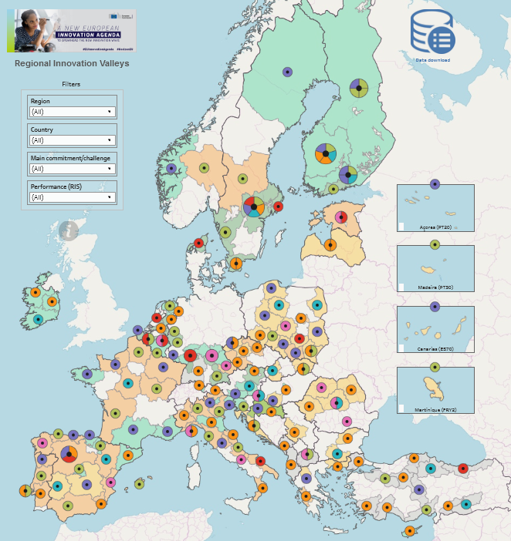

Entrepreneurial discovery process
further cooperation within the pilot project Partnerships for Regional Innovation
(Working Group: EDP)
cooperation within Regional Innovation Valley - expression of interest - circular economy
(if title would be granted ;)
joining the European Regions Research and Innovation Network – application in progress

Slide 18
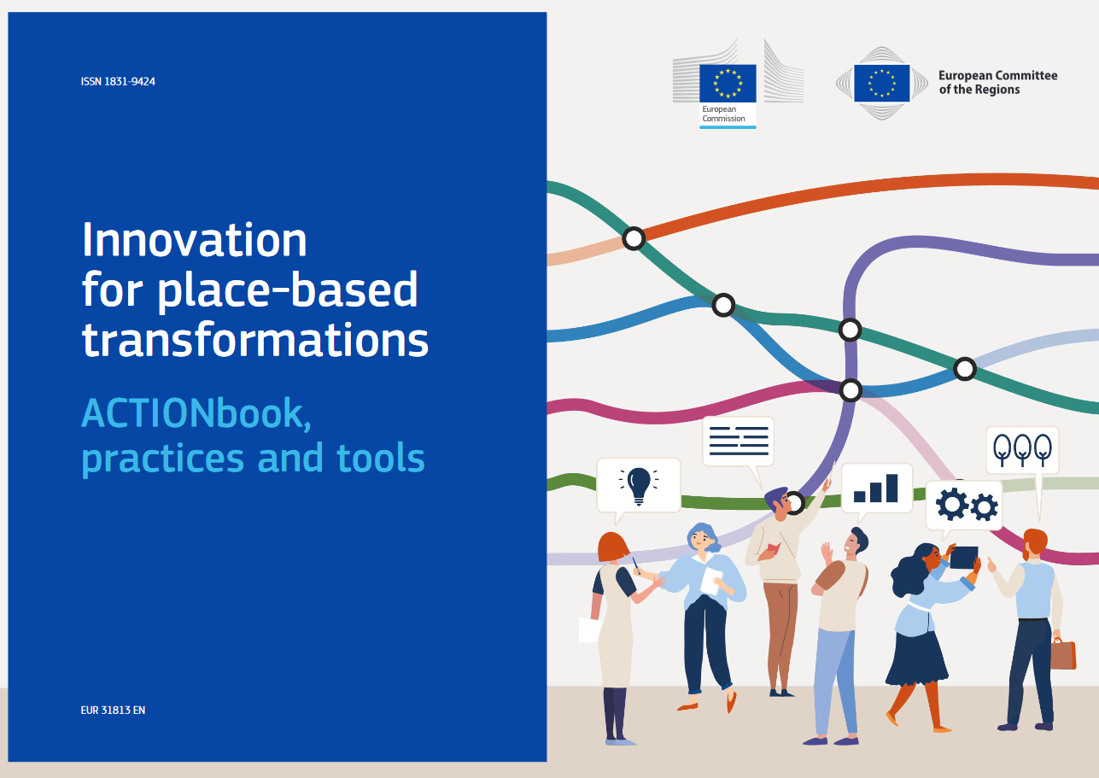

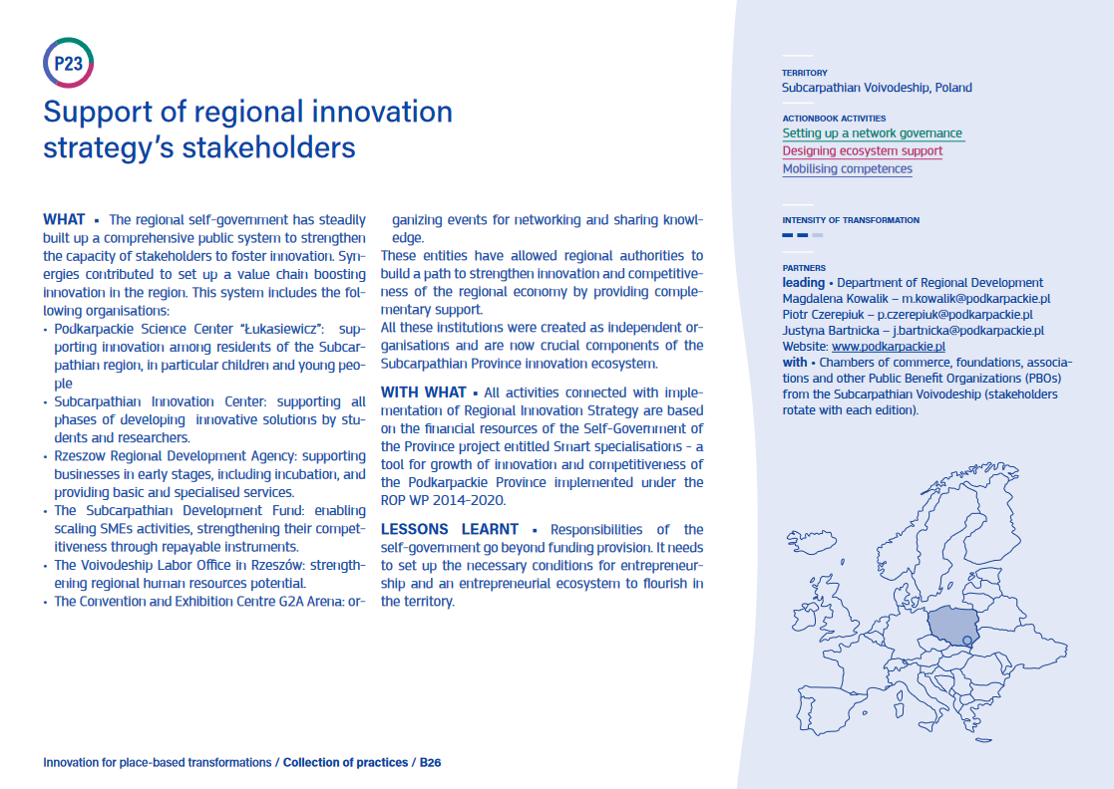
Entrepreneurial discovery process
Innovation for place-based transformations.
ACTIONbook, practices and tools
https://publications.jrc.ec.europa.eu/repository/handle/JRC135826

Slide 19
How to Build a Long-lasting S3-Commitment – Facilitating Sustainable Implementation of Smart Specialization in the Long Run.

Slide 20

Background
Lessons from workshop focusing on common challenges in working with S3.
Beyond EDP-project
Feedback from discussions with senior experts in S3
Participation in Europe, let’s cooperate! in Antwerp

Slide 21

Objectives
to share experiences among each other and identify good practices in terms of EDP and cluster building ,
to develop new knowledge through participation in common learning activities and individual and organizational learning,
to engage with groups of relevant stakeholders and enhance the quality of (existing) governance systems,
to gain expertise from the involved universities, and
to draw policy lessons for improvement of regional interventions.

Slide 22

Why you should take part in this project
Strenghen your capacity as a govermental organisation responsible for realisation of the S3.
Learn from and getting recommendations from your peers on how you could strenghen your long term work with S3.
Getting insight in other regions approch to building long term capacity for smart specialisation.
Strenghen your european network and involvment.

Slide 23

Partners
Partners (Responsible for S3):
  Region Jönköping County (Lead/North)
  Podkarpackie (East)
  TBD (South)
  TBD (West)
  Candidate country (TBD)
  University of Economics Bratislava
Stakeholder/Associated partners
TBD

Slide 24

Expectations in partners
Sufficient resources
  Project work group
  Application process
Responsible authorithy for S3
Geografical coverage and development
Identification of the most relevant regional stakeholders

Slide 25

Organisation
Jönköping is lead partner.
Steering group involving each partner.
Working groups
Experts can be included to broaden expertis.

Slide 26

Activities
1 Region in focus each semester
  Study visit with meeting with stakeholders
  Thematic seminar/workshop based of focus region.
  Recomendations and good practices – Exchange of experience
Development of catalog with good practices

Slide 27
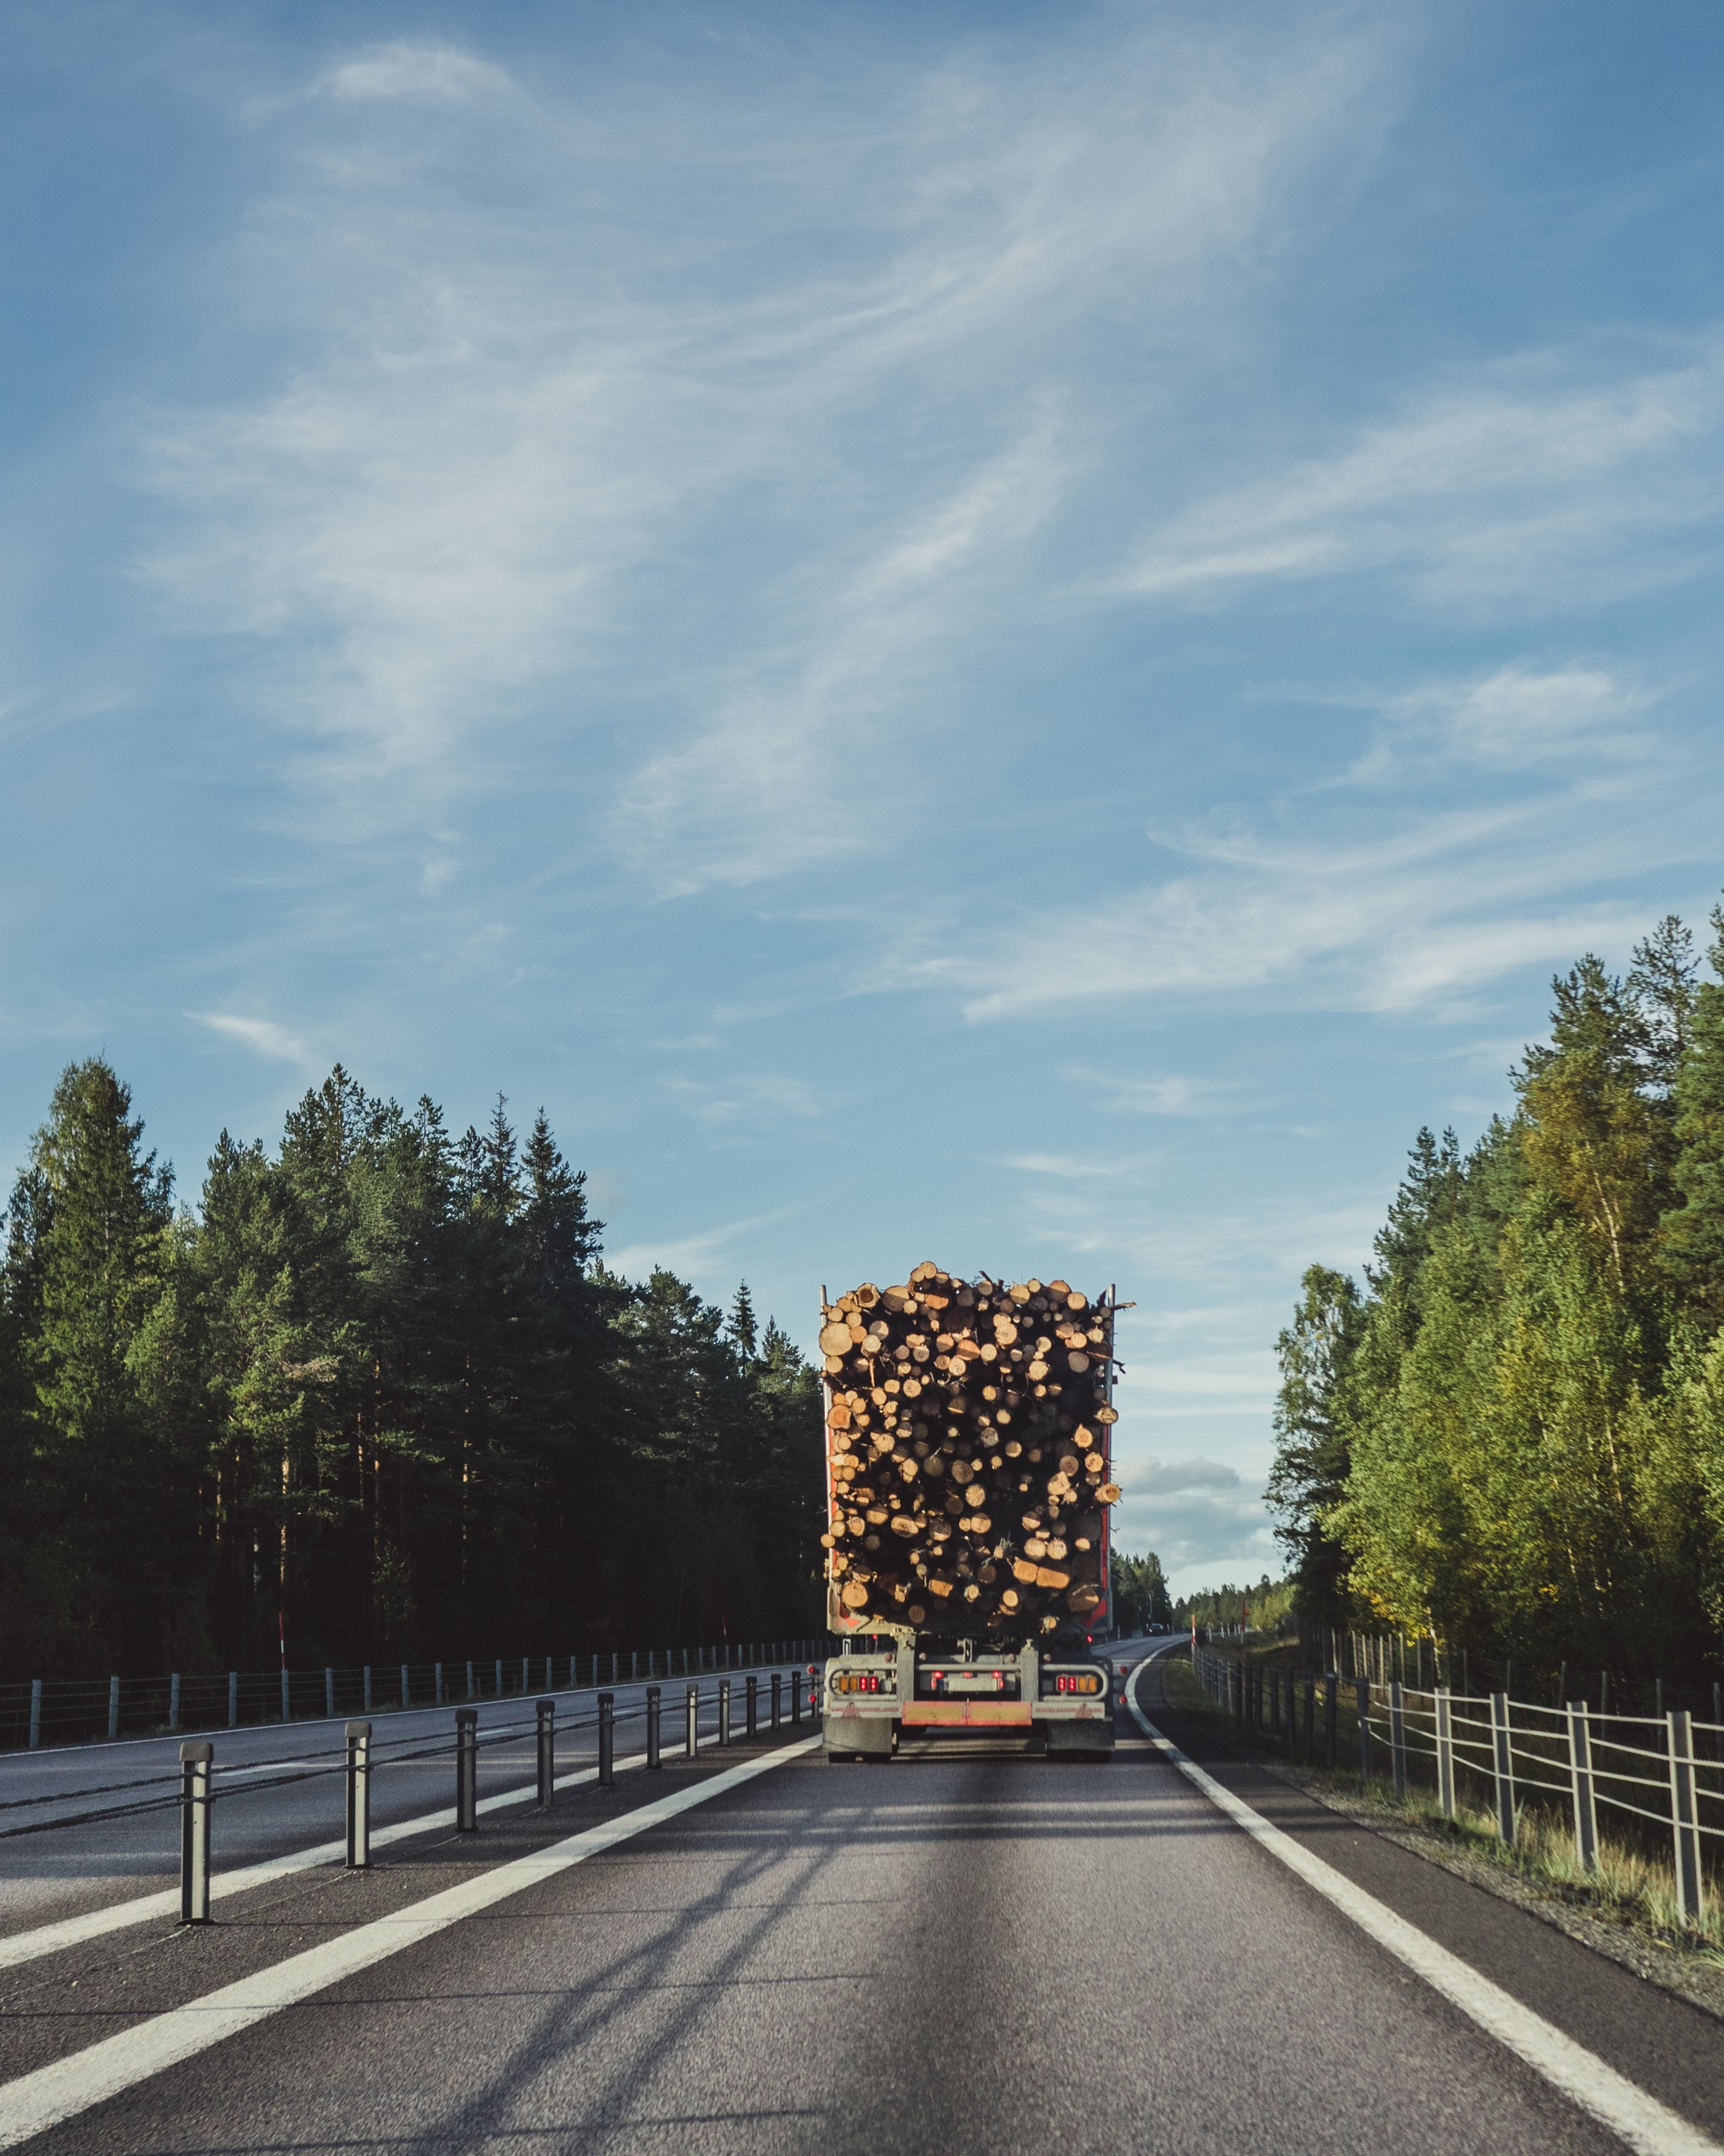
The next steps
Decision on participation – Partners
12/4-24
Decision on consortium – Jönköping and Podkarpackie
Formation of application working group

Slide 28
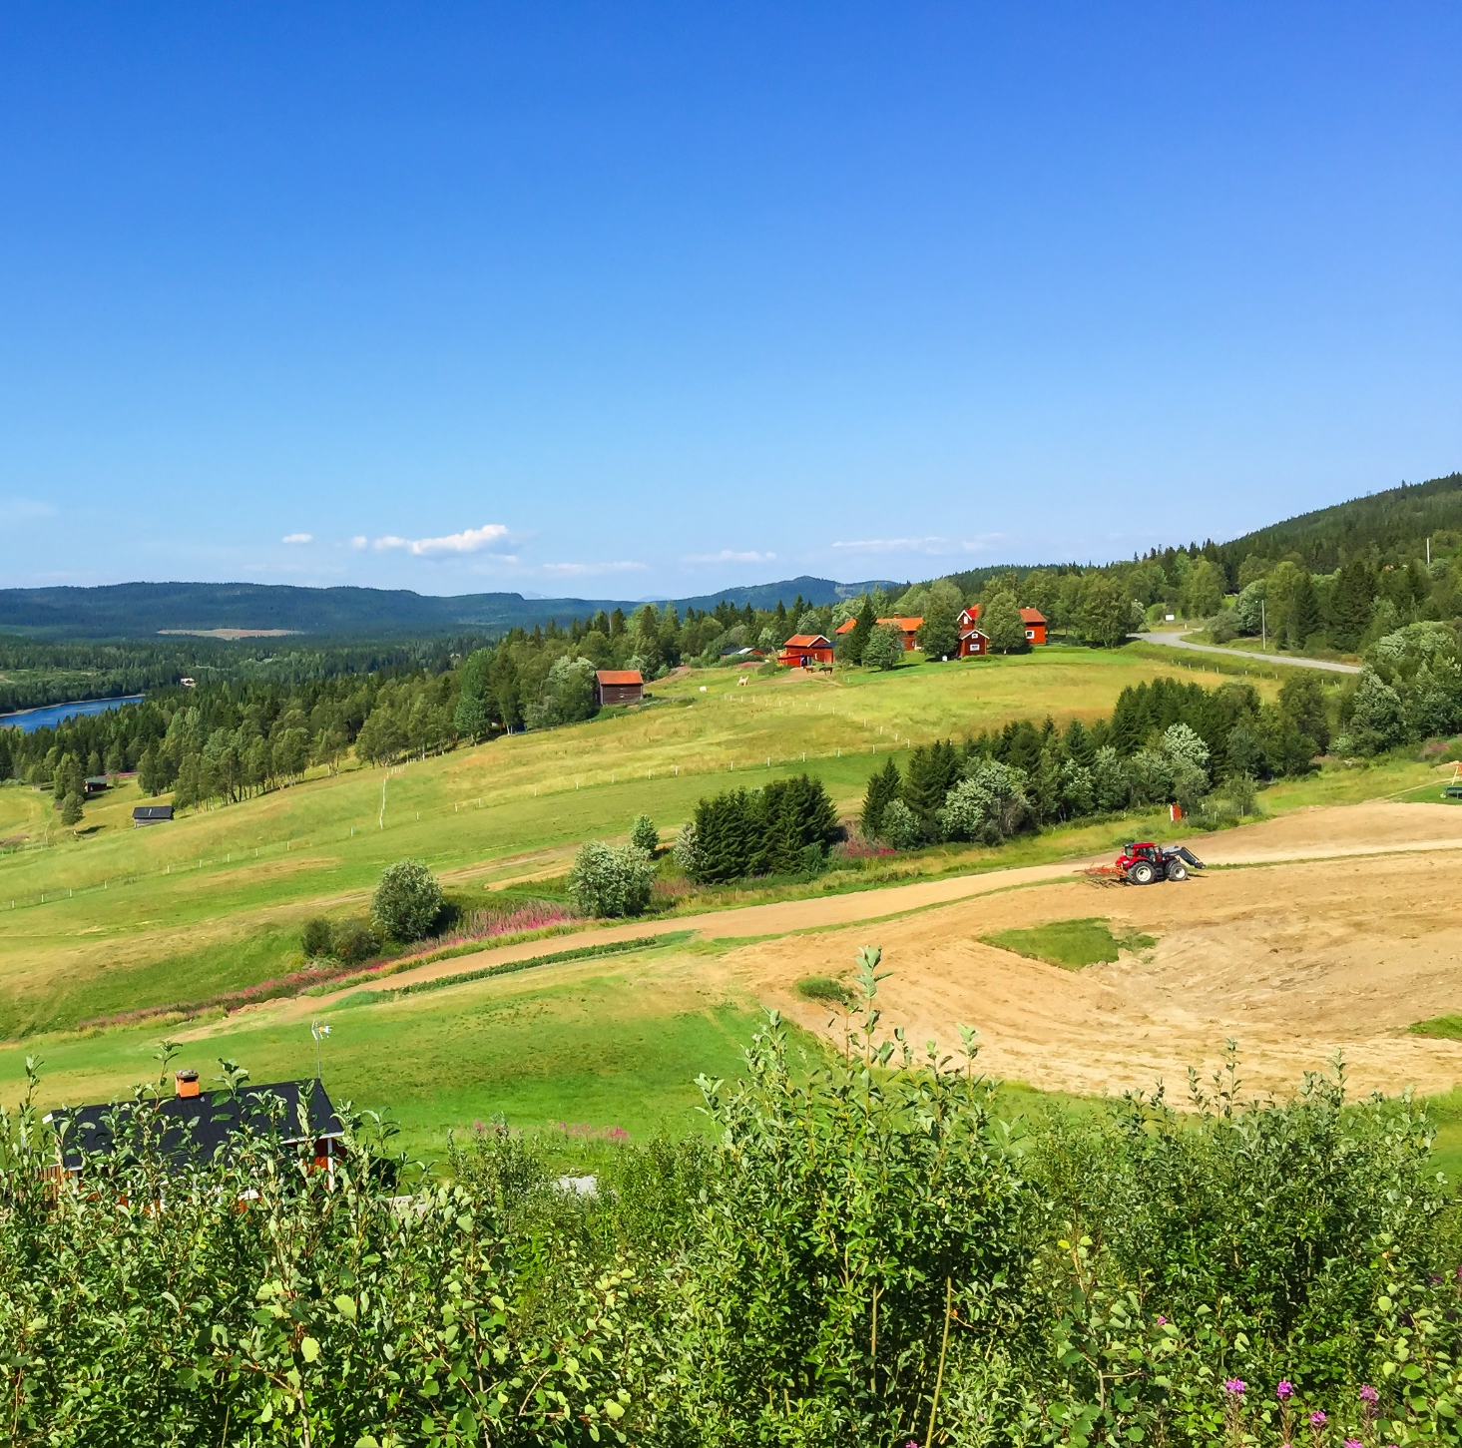
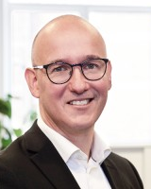
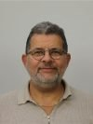
Please contact us for further discussions
Peter Friberg
Senior strategist,
Smart specialization
+46730-61 79 26
peter.a.friberg@rjl.se
Micael Ragnar
Regional developer,
Investments and Economic growth​
+4672-54 95 460​
micael.ragnar@rjl.se

Slide 29

Please contact us for
further discussions
Justyna Bartnicka
E-mail: j.bartnicka@podkarpackie.pl
Phone: + 48 17 743 32 36
Anna Tendera-Cioch
E-mail: a.cioch@podkarpackie.pl
Phone: + 48 17 743 32 35
Marshal’s Office
of the Podkarpackie Region
Department of Regional Development
Lubelska 4, 35-241 Rzeszow
Poland

