Slide 1
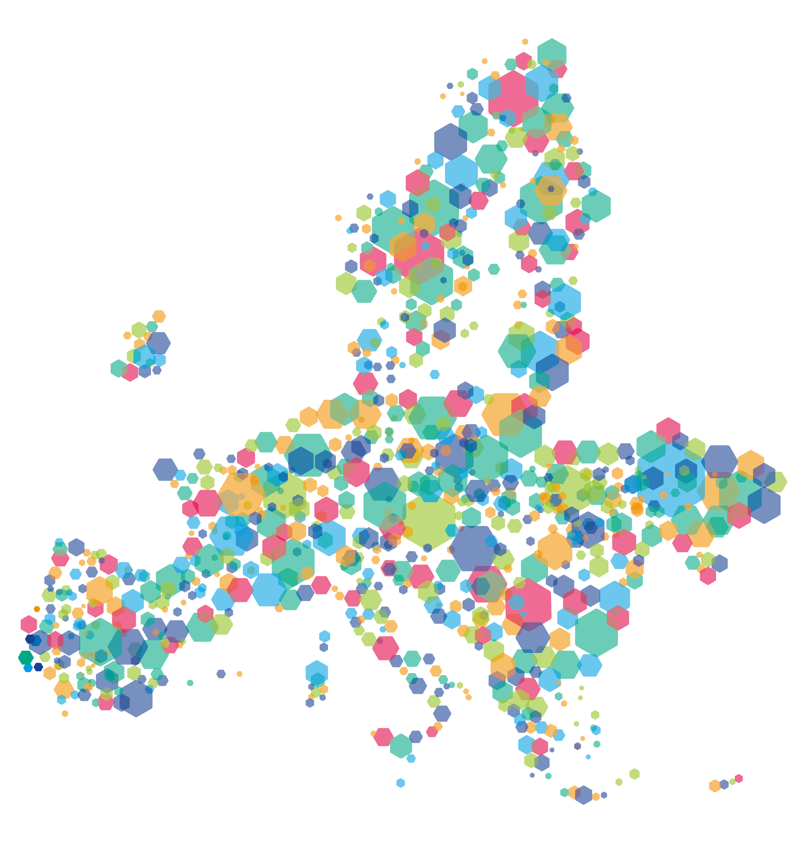
Project website
training
23 April 2024
Project website training
Online
Notes:
Room 1

Slide 2

Content
Communication requirements and principles
Getting started
Editing the project website
Help and tips

Slide 3
1.
Communication requirements

Slide 4
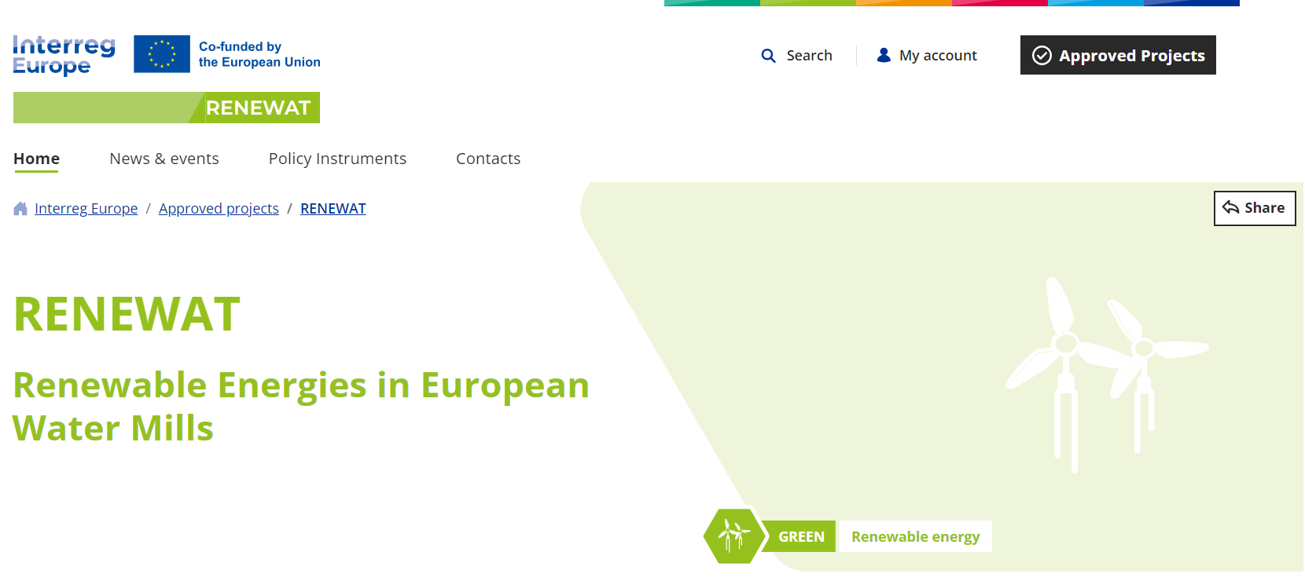
Harmonised project communication
One brand for all Interreg programmes

Slide 5
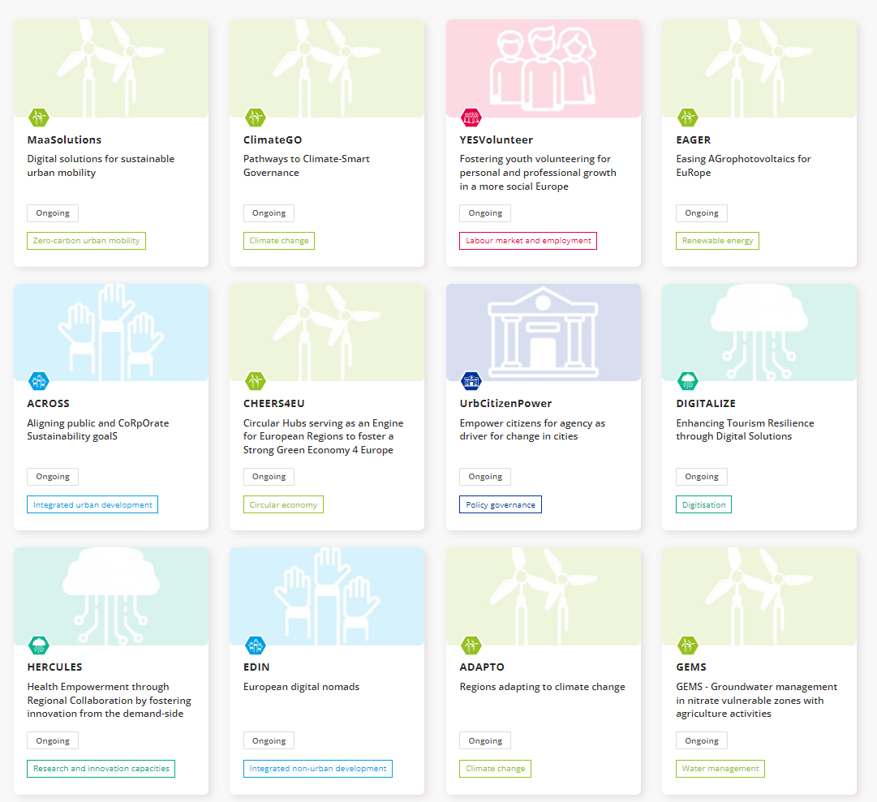
Integrated project communication
Project websites hosted by the programme
  Your project visible in the search
  We will promote your key news & events (contact us)

Slide 6
Required activities
Partners’ websites and social media
  Short project description (aims and results) and the EU financial support
Project website updates
  Images, videos, publications, etc., free to use by the programme and the European Commission

Slide 7

Updating your website
At least once every six months
High-quality visual content
Your activities
Focus on achievements

Slide 8

Copyright
Royalty-free, non-exclusive and irrevocable license for your images and videos, and that any preexisting rights attached to it must be granted to the EU institutions, and our programme on demand.

Slide 9
2.
General principles: How the websites work

Slide 10
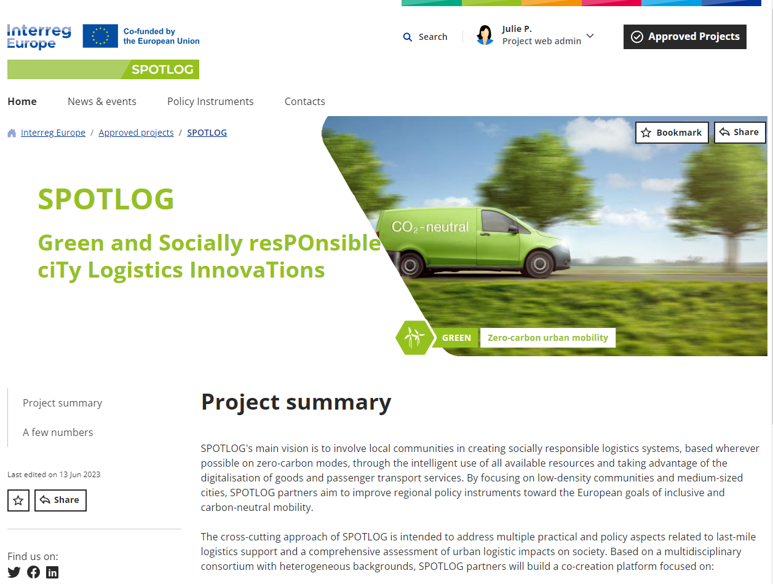
Your project website
Each project has a website
All layouts are the same
Easy to update
Automation

Slide 11
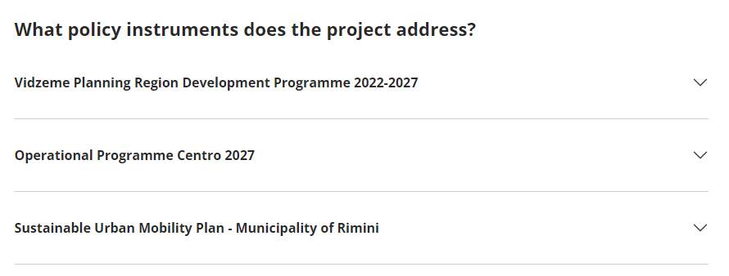
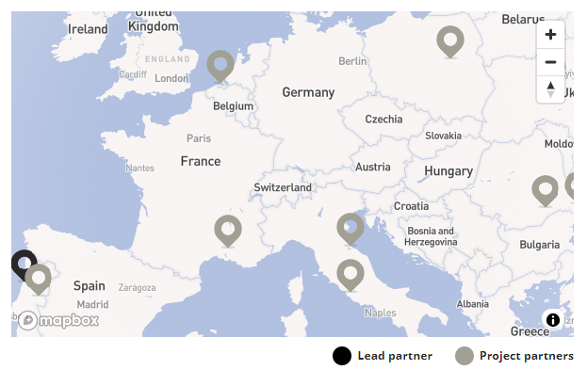
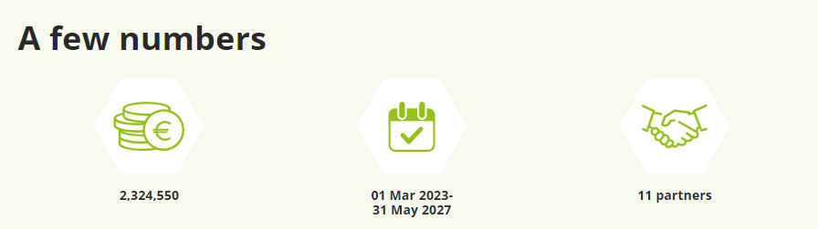
Portal connection
Info sent from the Portal
Update in Portal

Slide 12
3.
Getting
started

Slide 13

Who can edit the project website?
The website administrator
Share among your partnership
Need an Interreg Europe community account

Slide 14

Web admin role
Edit the project website
Approve good practices
Validate community network

Slide 15
4.
Managing your
community

Slide 16
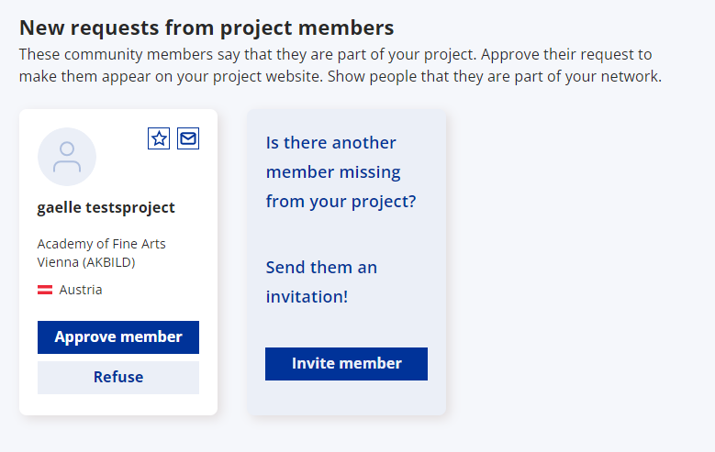
Managing your community network
Stakeholders
Partners
Connected to project
Go to web editing tool
Approve/ refuse

Slide 17
5.
Additional
information

Slide 18

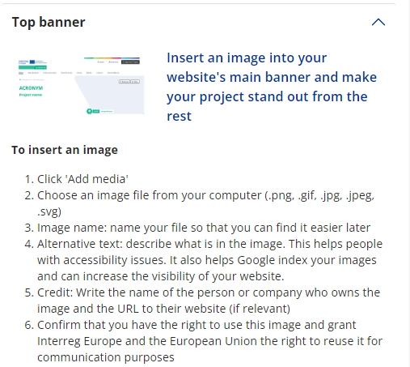
Help and tips
Inside the web editing tool
User manual
Writing for the web guide
Help centre
Tutorial videos

Slide 19

Project training days
24-26 September 2024, Lille (TBC)
  Finance workshop
  Project activities’ workshop
  Communication workshop

Slide 20

Upcoming events
30 April: Policy Learning Platform webinar on biowaste
27 June: Meet the Policy Learning Platform

Slide 21
Thematic workshops (on invitation only)
22 May Sustainable Materials and Circularity in Construction
  Vienna, Austria
23 May Enabling the Renovation Wave
  Vienna, Austria
29 May Entrepreneurship in Declining Rural Areas
  Burgos, Spain
5 June Digital Transformation of Public Sector Services
  Vilnius, Lithuania

Slide 22
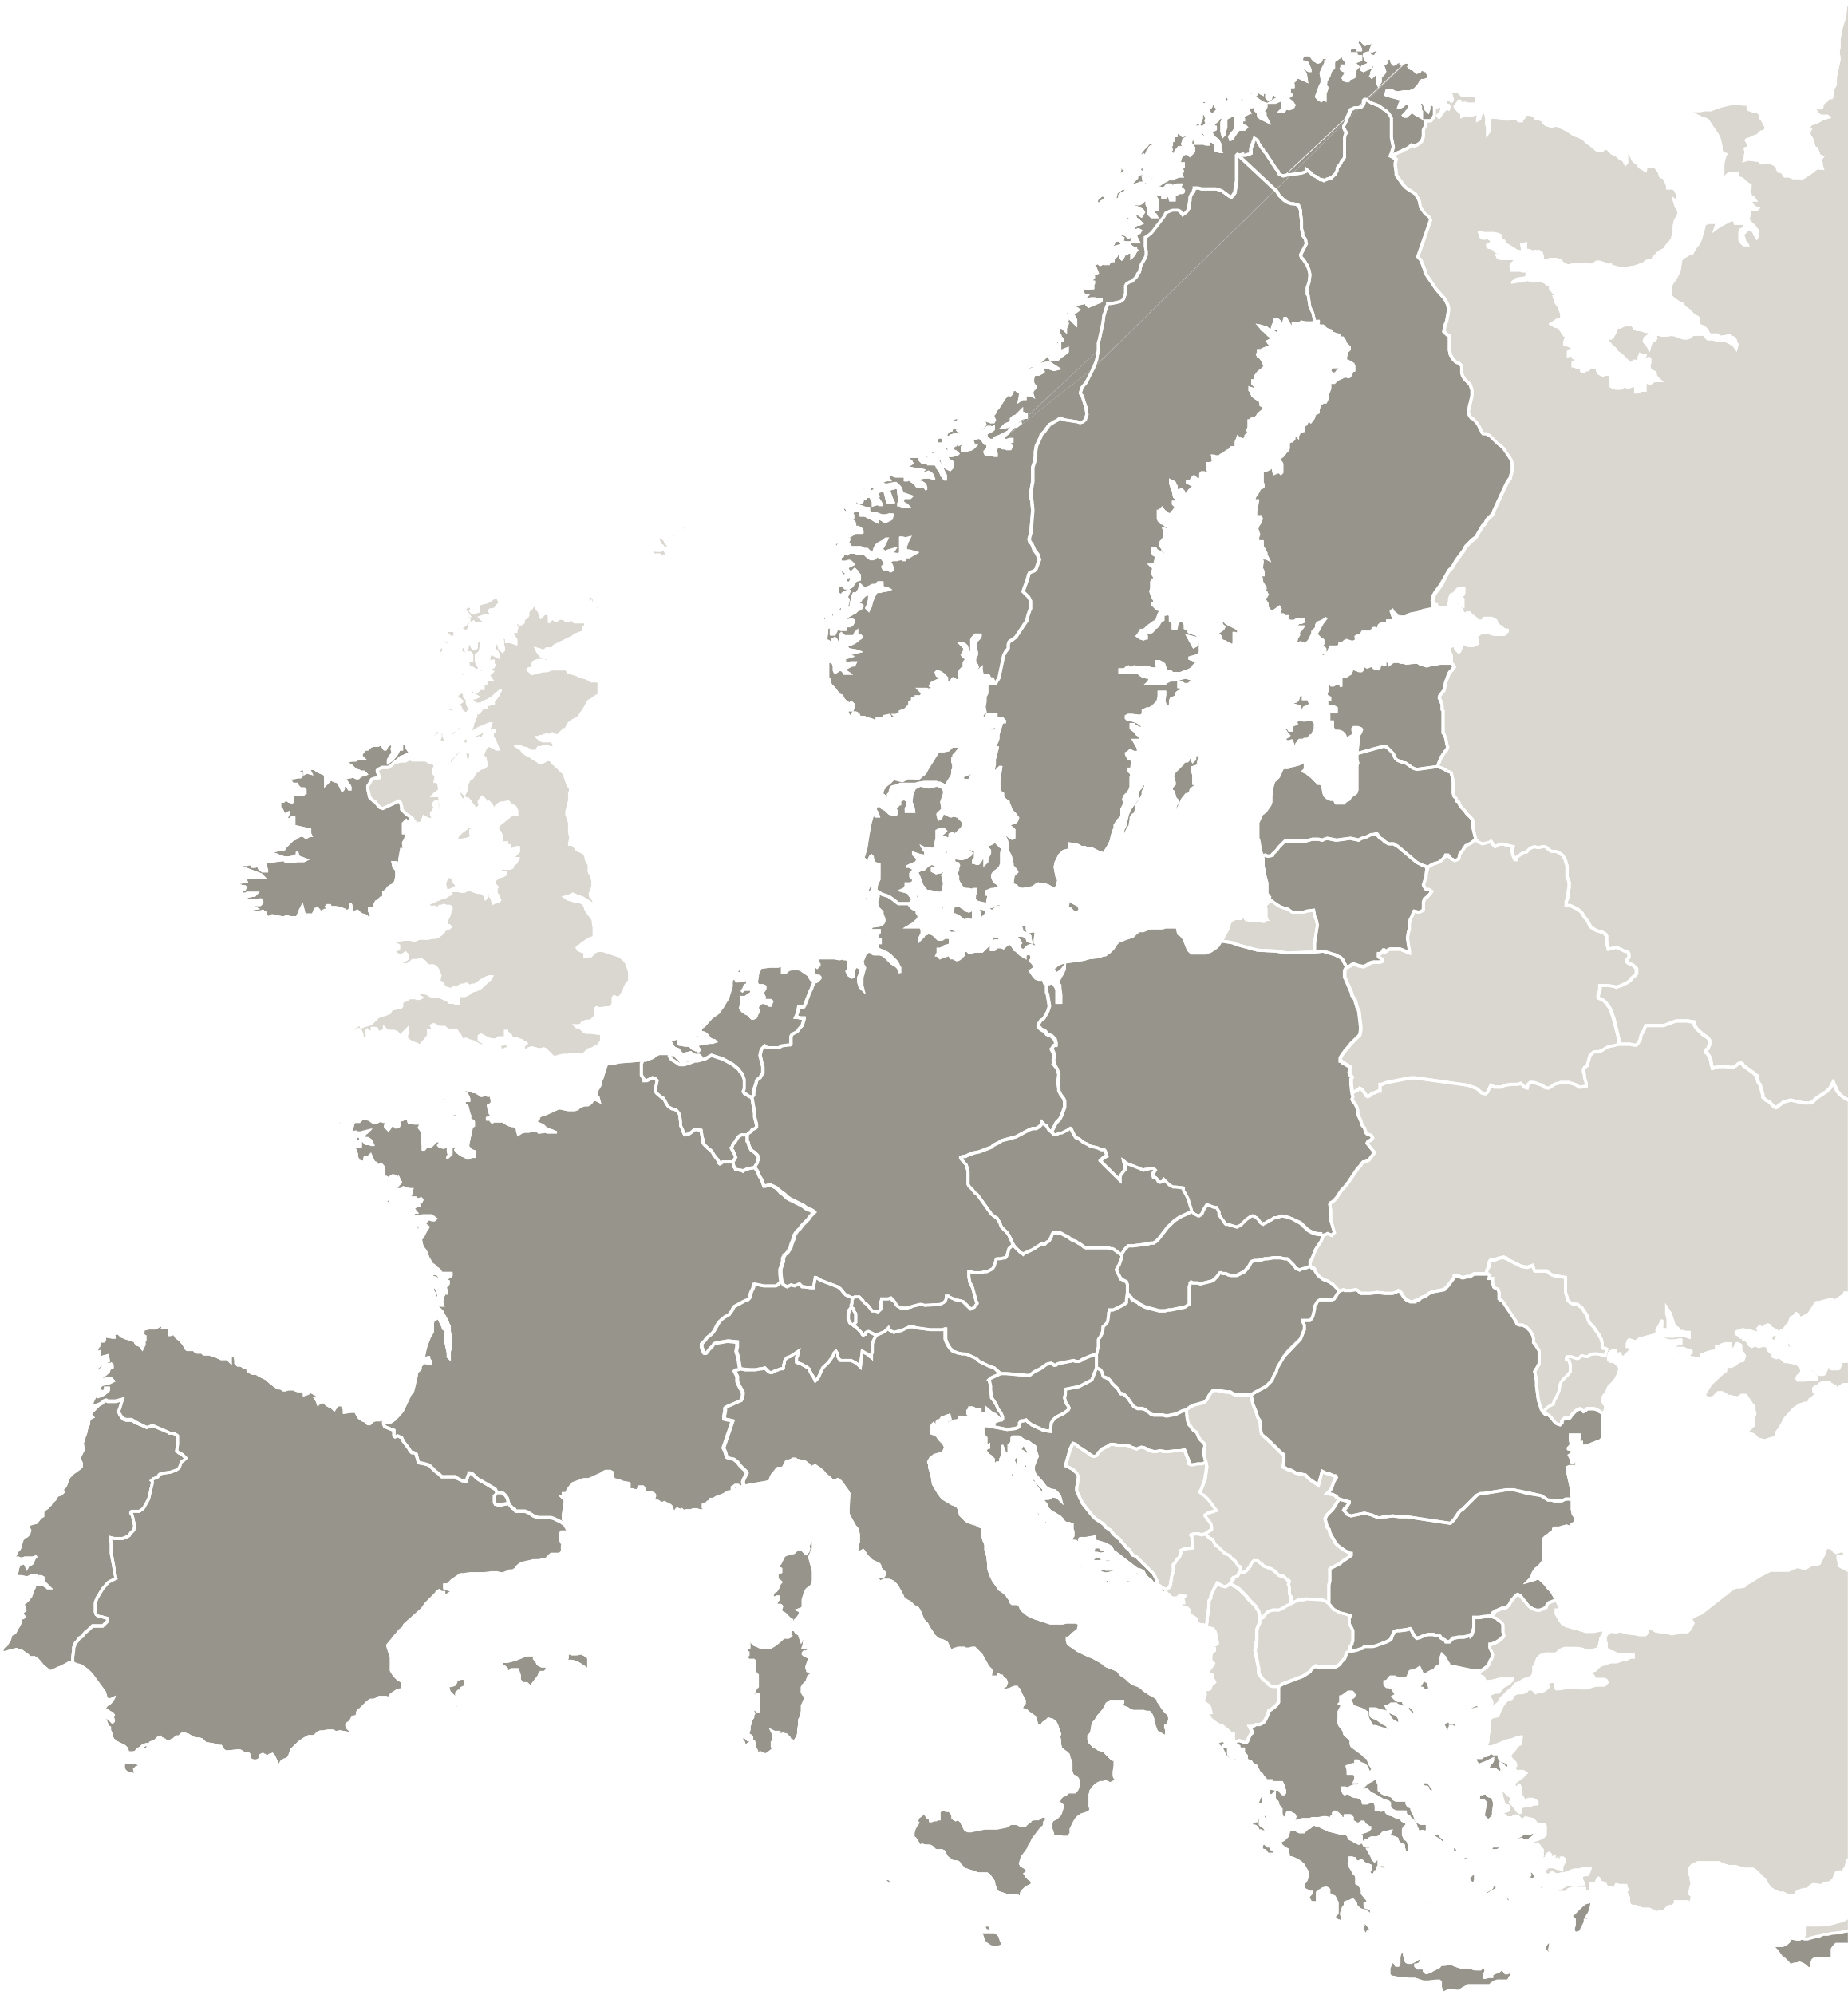
Thank you!
Project website webinar

