Slide 1
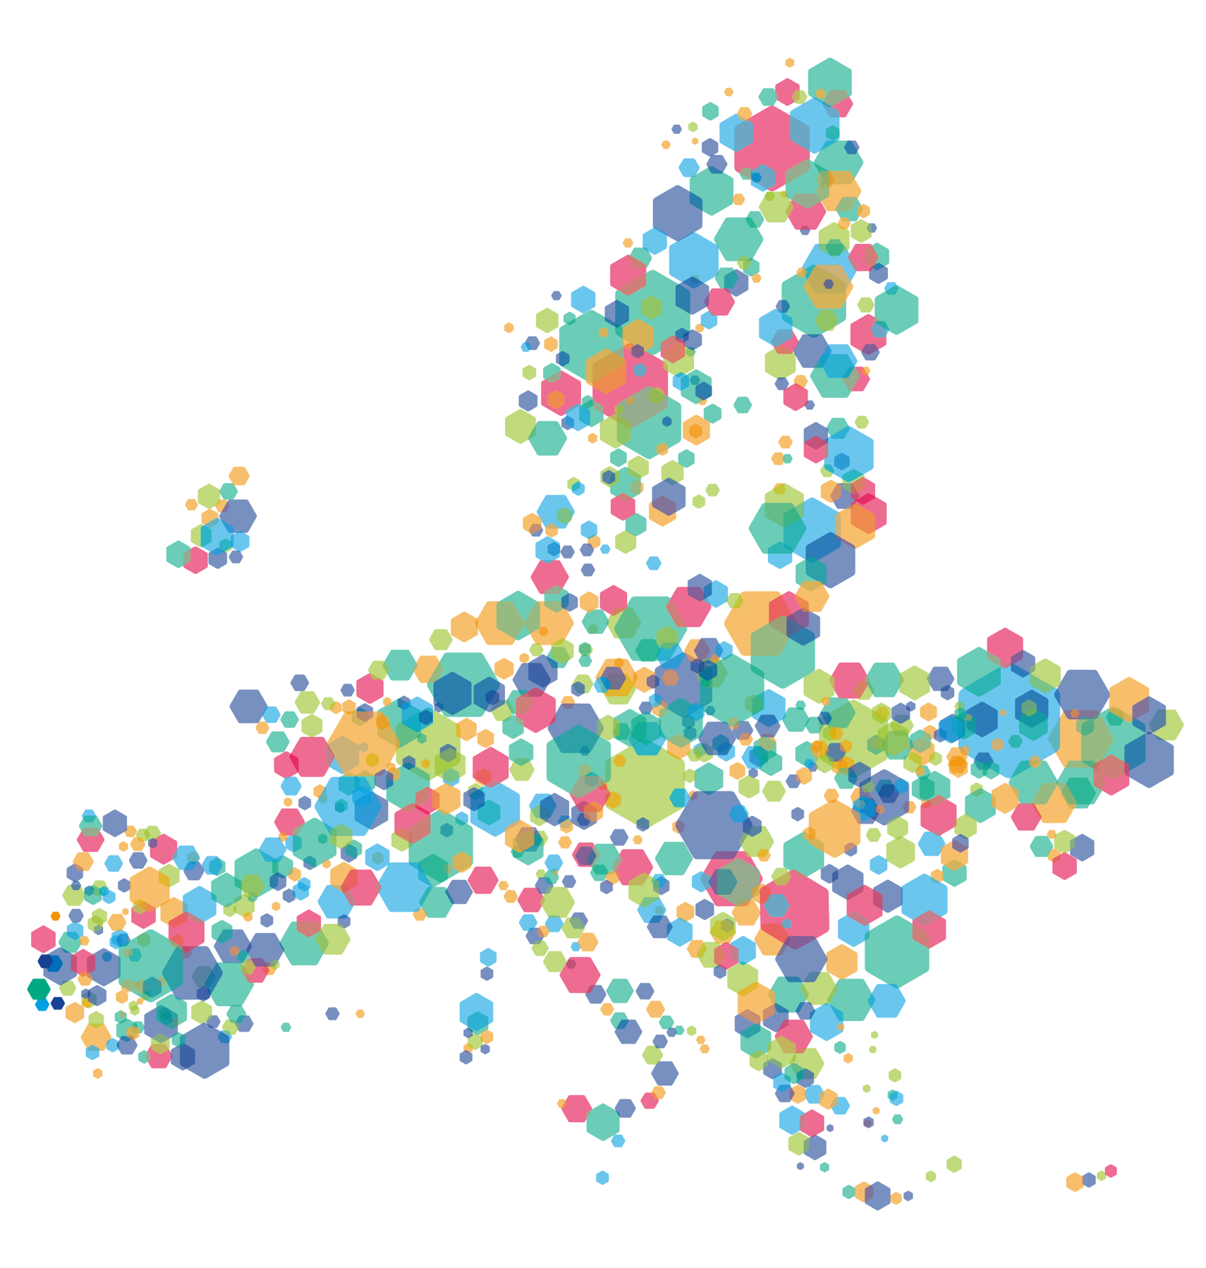

Q&A session
on the third call
5 APR 2024

Slide 2
Outline
Third call key features
Questions & answers
Assistance

Slide 3
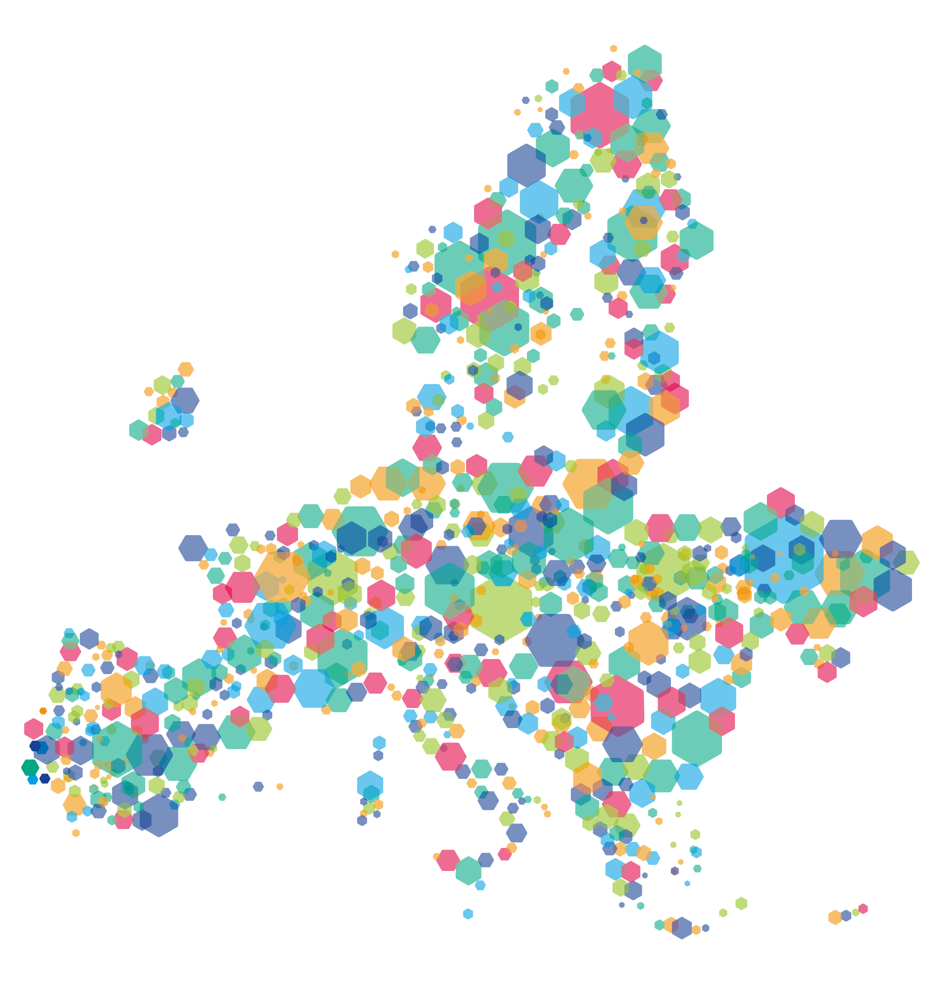
Third call
key features
5 APR 2024

Slide 4
The third call | unique opportunity for you
New feature: programme enlargement First time 36 countries are eligible!
Results of previous calls
  150 approved projects out of 280 applications (success rate of 54%)
  60% of funding already committed!

Slide 5
The third call | timing
11 weeks
Opening: 20 March 2024 (portal available)
Closing: 7 June 2024 at 12:00 CEST (Paris time)
Decision: end of 2024
Application pack available on the programme website:
https://www.interregeurope.eu/apply-for-the-call#anchor-third-call-for-projects

Slide 6

The third call | topics
All topics open
Research & innovation capacities
Digitisation
SME competitiveness
S3, industry and entrepreneurship
Digital connectivity
Energy efficiency
Renewable energy
Smart energy systems
Climate change
Water management
Circular economy
Nature & biodiversity
Zero-carbon urban mobility
Sustainable TEN-T
Sustainable mobility
Employment
Education
Social inclusion
Integration of third-country nationals
Health care
Culture and sustainable tourism
Integrated urban development
Integrated non-urban development
Non-thematic related to the implementation of regional policies:
e.g., evaluation, monitoring, public procurement, state aid, etc.

Slide 7
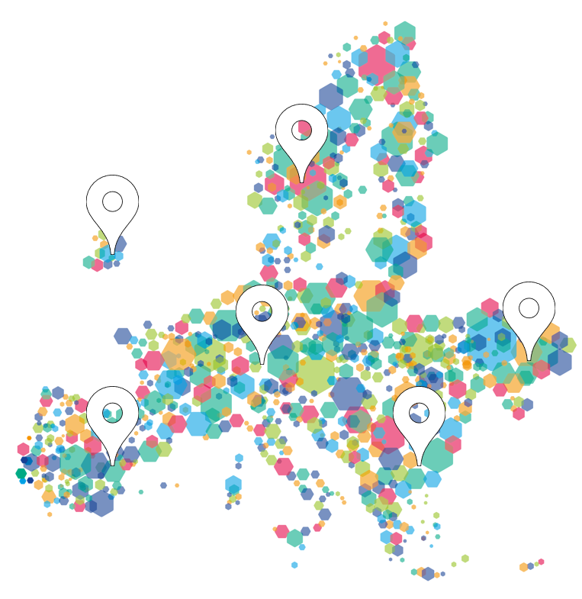

The third call | geographical coverage
Geographical areas | Countries covered
North | Denmark, Estonia, Finland, Germany, Latvia, Lithuania, Norway, Sweden
East | Austria, Bulgaria, Czech Republic, Hungary, Poland, Romania, Slovakia, Slovenia
South | Croatia, Cyprus, Greece, Italy, Malta, Portugal, Spain
West | Belgium, France, Ireland, Luxembourg, Netherlands, Switzerland
Candidate countries | Albania, Bosnia and Herzegovina, Moldova, Montenegro, North Macedonia, Serbia, Ukraine
Four out of five areas to be covered
Mix of more and less advanced regions
Notes:
* For NIDs in France, Spain and Portugal, please mention the exception to this rule for RUPs

Slide 8
The third call | geographical coverage
Strong encouragement to involve partners from:
Seven candidate countries
Switzerland
Regions not yet represented in the first two calls
Contributes to the innovative character of the proposal

Slide 9
The third call | discovery partners
Rationale: facilitate participation from the seven new countries
Albania, Bosnia and Herzegovina, Moldova, Montenegro, North Macedonia, Serbia, Ukraine
Main characteristics:
  Lighter form of involvement: no need to address a policy instrument
  Aim: to discover interregional cooperation and learn from others
  Recommendation: max 2 per project

Slide 10
The third call | Financial features
Cost categories | Reimbursement
Preparation costs | Lump sum €17,500
Staff | Fixed % of the real gross employment cost
Office & administration | Flat rate of 15% of staff costs
Travel & accommodation | Flat rate of 15% of staff costs (real cost reporting only in specific justified cases)
External Expertise and Services
Equipment
Infrastructure and Works | For pilots only
Average project budget (1st & 2nd call): MEUR 1,4 (Interreg funds)
Recommendation: 1 – 2 MEUR (Interreg funds)

Slide 11
The third call | additional questions
FAQ section of the website
https://www.interregeurope.eu/help-centre/apply-for-funding
Ask a question form
https://www.interregeurope.eu/help/ask-us-a-question

Slide 12
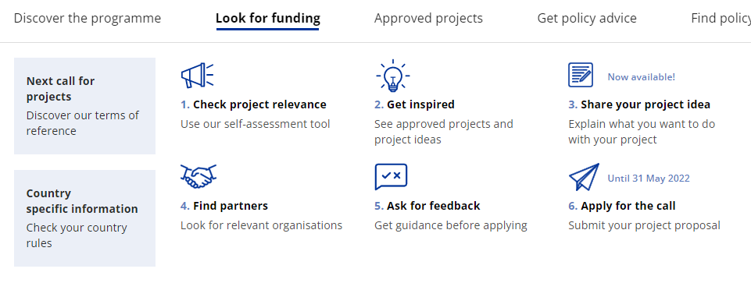
The third call | overview assistance
Open now!
https://www.interregeurope.eu/apply-for-the-call

Slide 13
The third call | assistance events
Q&A online sessions
  Ask questions at registration (or during the session)
  JS replies during the session
  3 upcoming sessions: 26 April, 17 May and 31 May
  Registration open on programme website (remember to login)
  https://www.interregeurope.eu/apply-for-the-call#anchor-call-related-events

Slide 14
The third call | assistance events
Lead applicant webinars week
  A series of 4 webinars between 15 and 18 April 2024, at 10:00
  Tutorial videos combined with live Q&As
  Registration open from programme website (remember to log in)
  15 APR Building a successful partnership
  16 APR Designing project methodology
  17 APR Management, budget and finances
  18 APR Project communication

Slide 15
The third call | assistance events
Country information days
  Info days about the call and the programme in specific countries
  Organised by points of contacts
  National or regional events
  https://www.interregeurope.eu/news-and-events/news/info-days-2024-in-your-country

Slide 16
Thank you!

