Slide 1


Europe, let's
cooperate!
Interregional cooperation forum
20-21 March 2024
Antwerp

Slide 2

Europe, let's cooperate!
Interregional cooperation forum
20-21 March 2024, Antwerp
Agenda - 20 March 2024
14:00-17:00
Networking and inspiration for project preparation
  Interreg Europe corner
  Country corners
  Networking tables
  Individual meetings with the joint secretariat
  Study visits*
  Project poster exhibition
  'Let’s talk' corner
Next steps towards new interregional cooperation projects
Keynote speech on strategic foresight
Networking cocktail
* outside the venue
09:30-10:00
10:00-11:00
11:00-11:30
11:30-12:30
12:30-14:00
Registration
Celebrating the power of interregional cooperation
Coffee break
Cooperation in action: get ready for the third call
Lunch break
17:00-17:10
17:10-17:30
17:30-19:00
See the full agenda and additional details on the event website
www.interregeurope.eu/event/europecooperates2024/programme

Slide 3

Expert view.
John Bachtler, European Policy and Research Centre

Slide 4
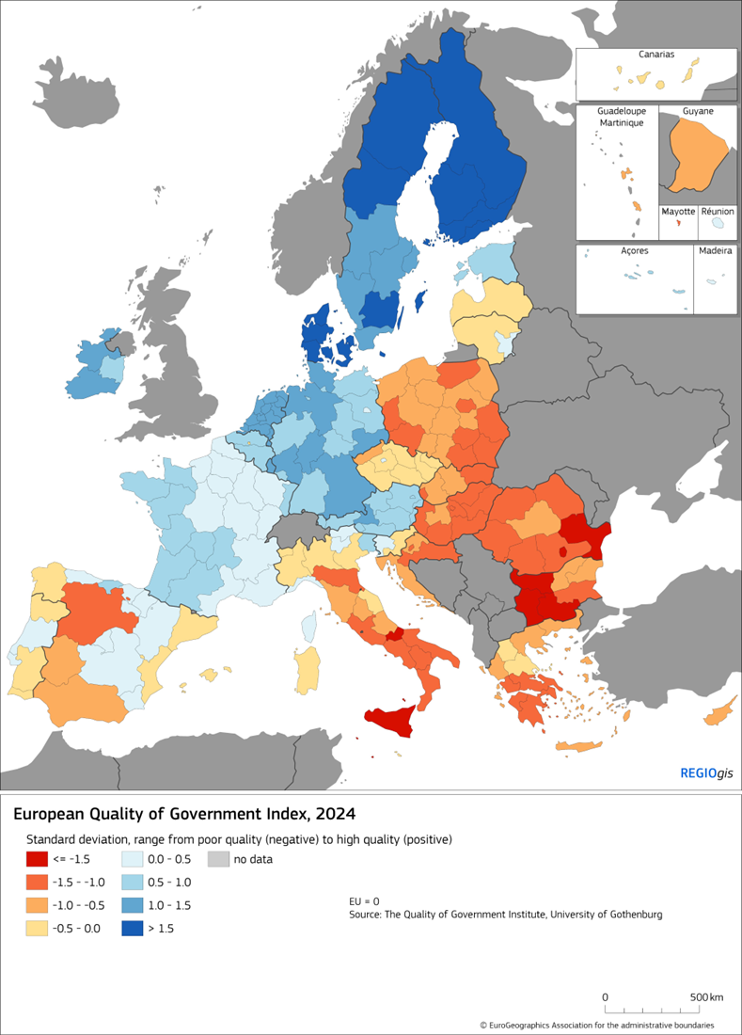
What should cohesion policy do?
cohesion is critical to achieving EU objectives – recognise territorial dimension
  greater focus on exploiting untapped economic potential – dynamic approach
  focus on the main structural challenges – low development, long-term economic stagnation, lack of opportunities
  address geography of discontent
all regions should remain eligible
  LDRs should continue to be the main focus
  but target regions in development traps
more attention to institutional quality – differences undermine policy effectiveness

Slide 5


A More place-based policy, focusing on local potential
Focus on future-oriented, transformative investments sensitive to the unique strengths, challenges and needs of regions
a policy that drives regional and local transformation
promote innovation and diversification opportunities
allow regions to ‘reinvent’ themselves
enhances inter-regional links and collaboration
integrates cohesion with broader development goals
Exploit local capabilities and potential
Develop future opportunities through diversification and collaboration

Slide 6

Upgrading territorial cooperation
enhance inter-regional links & collaboration to facilitate knowledge transfer and innovation
strengthen interaction between more dynamic and more vulnerable regions
improve CBC governance to overcome historical & institutional development constraints
external border issues: dealing with migration flows, political instability, political instability, war, enlargement

Slide 7
Europe, let's
cooperate!
Interregional cooperation forum

