Slide 1
Europe, let's
cooperate!
Interregional cooperation forum
20-21 March 2024
Antwerp

Slide 2
Europe, let's cooperate!
Interregional cooperation forum
20-21 March 2024, Antwerp
Agenda - 20 March 2024
14:00-17:00
Networking and inspiration for project preparation
Interreg Europe corner
Country corners
Networking tables
Individual meetings with the joint secretariat
Study visits*
Project poster exhibition
'Let’s talk' corner
Next steps towards new interregional cooperation projects
Keynote speech on strategic foresight
Networking cocktail
* outside the venue
09:30-10:00
10:00-11:00
11:00-11:30
11:30-12:30
12:30-14:00
Registration
Celebrating the power of interregional cooperation
Coffee break
Cooperation in action: get ready for the third call
Lunch break
17:00-17:10
17:10-17:30
17:30-19:00
See the full agenda and additional details on the event website
www.interregeurope.eu/event/europecooperates2024/programme

Slide 3
#europecooperates
Slido.com

Slide 4
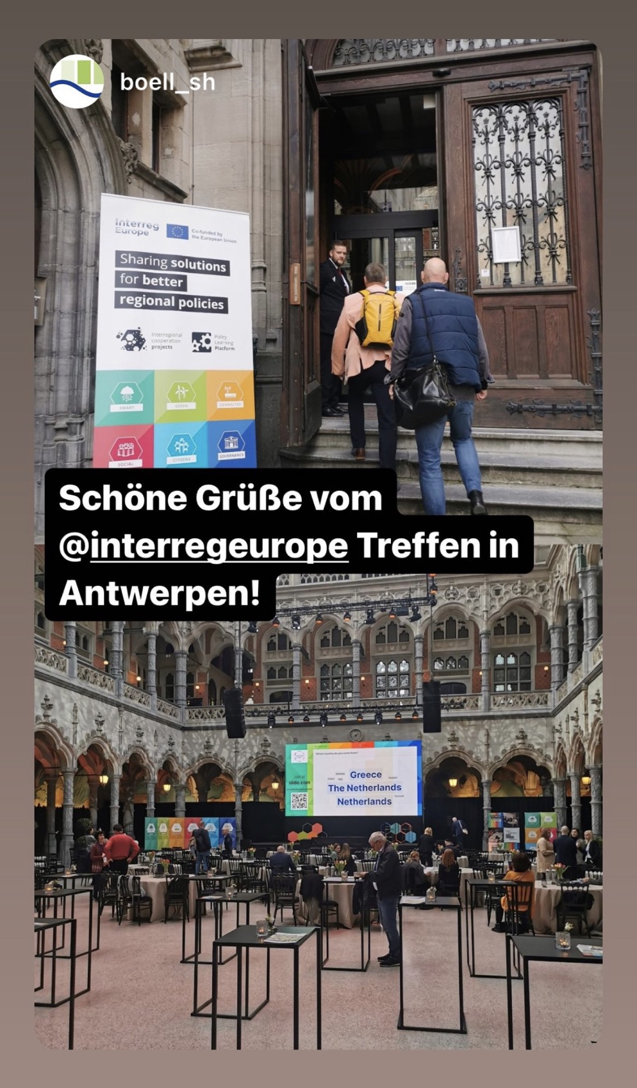
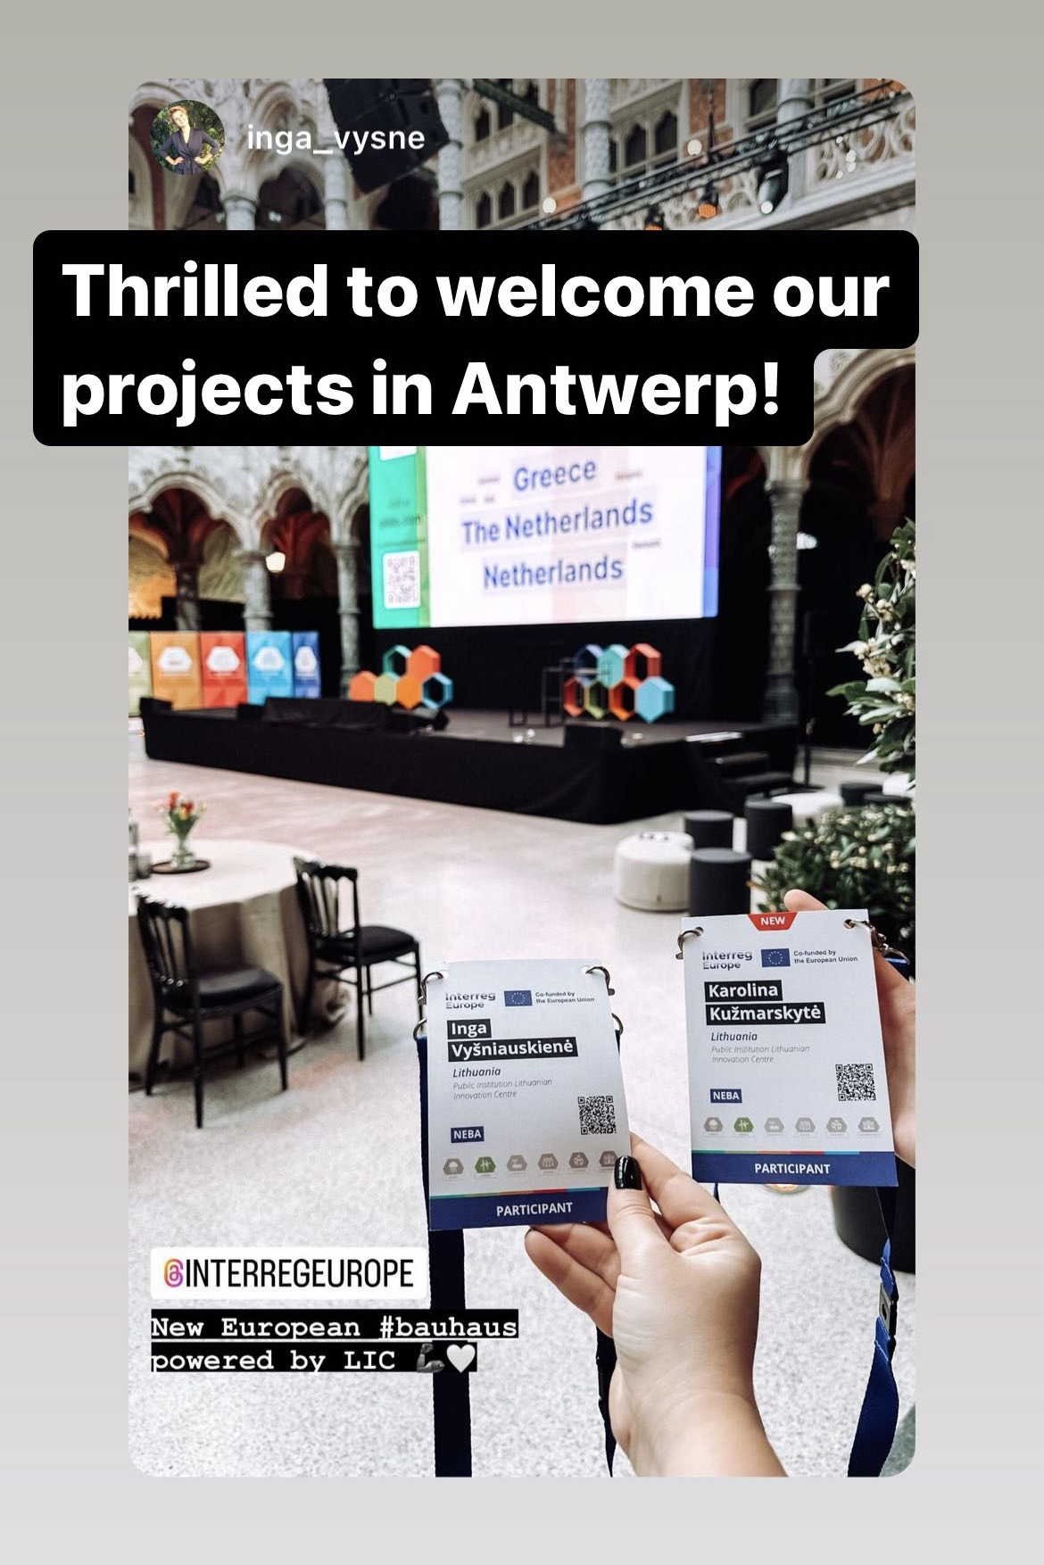
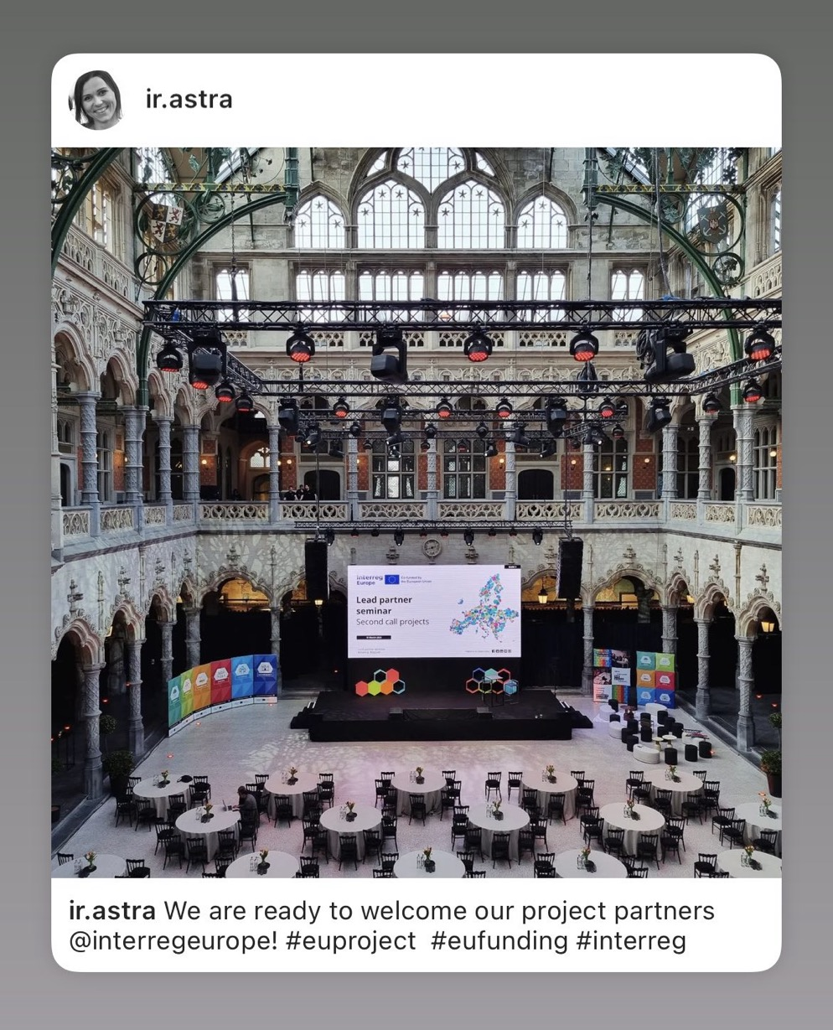

Slide 5
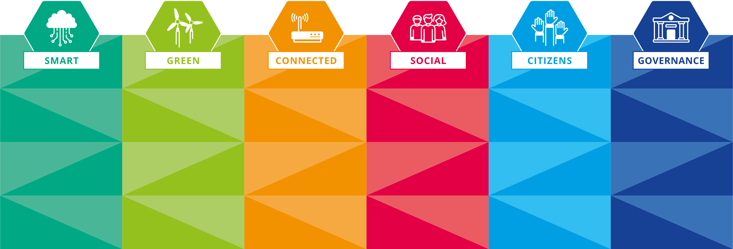
Interreg Europe in a nutshell.
Magda Anagnostou, Interreg Europe
Jason Martinez, Interreg Europe

Slide 6
European Territorial Cooperation (ETC)
Interreg 4 strands, 86 programmes, 10 bn EUR
A | cross-border | 64 programmes EUR 6.7 billion (67%) | (including 10 IPA and 5 NEXT)
B | transnational | 13 programmes EUR 2.3 billion (23%)
C | interregional | 4 programmes EUR 560 million (6%) | Interreg Europe Urbact, Interact, Espon
D | outermost regions | 5 programmes EUR 330 million (3%)
Each strand has its own objectives

Slide 7
Interreg Europe rationale
Supports the identification and transfer of good practices among EU regions in order to improve regional development policies
Primarily dedicated to public authorities​
Focus on exchange of experience​
Different from cross-border or transnational cooperation​

Slide 8
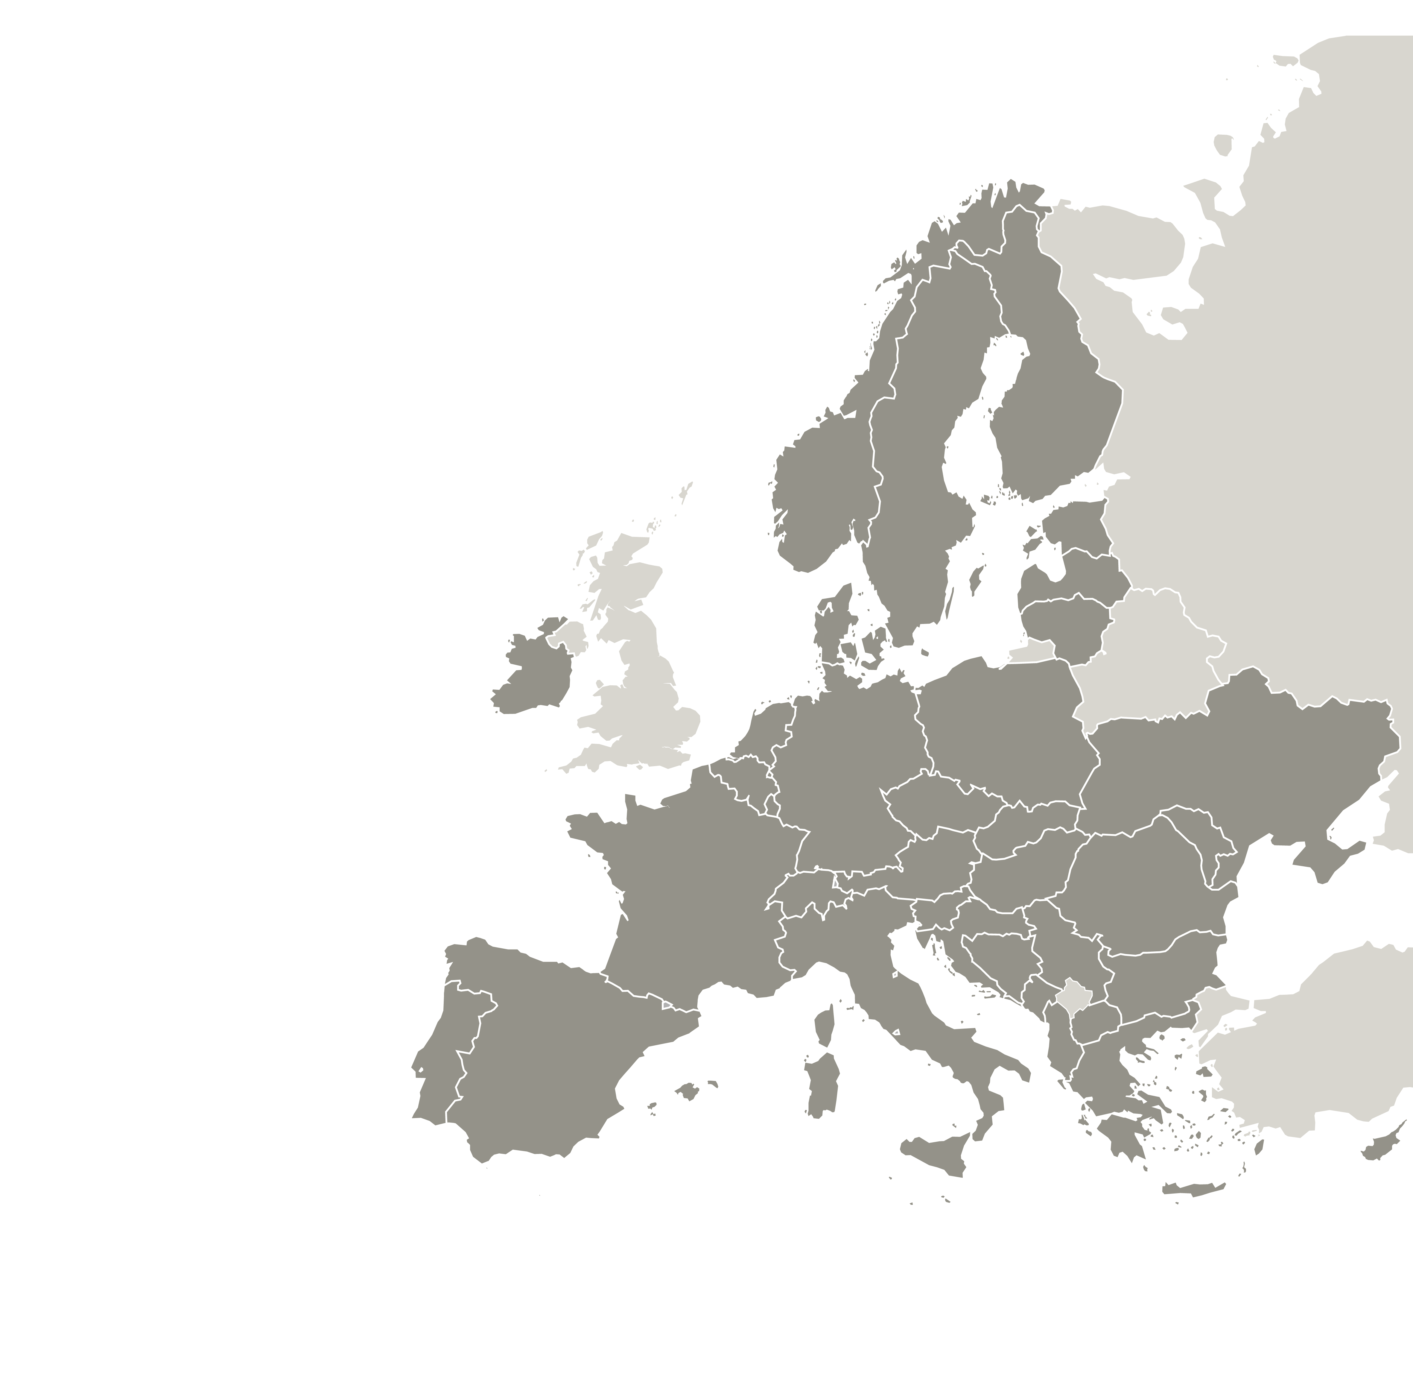
Sharing solutions for better regional policies
6
36
394m
PROGRAMME
BUDGET
TOPICS
COUNTRIES
INVOLVED

Slide 9
Two actions
Interregional cooperation projects
Policy Learning Platform

Slide 10
Interregional
cooperation
projects
WHY?
To find inspiration and new policy solutions in order to solve regional development challenges
Partnerships of European regions
HOW?
Through exchange of experience activities, the partners work together for 4 years
WHO?
Policymakers from different European regions

Slide 11
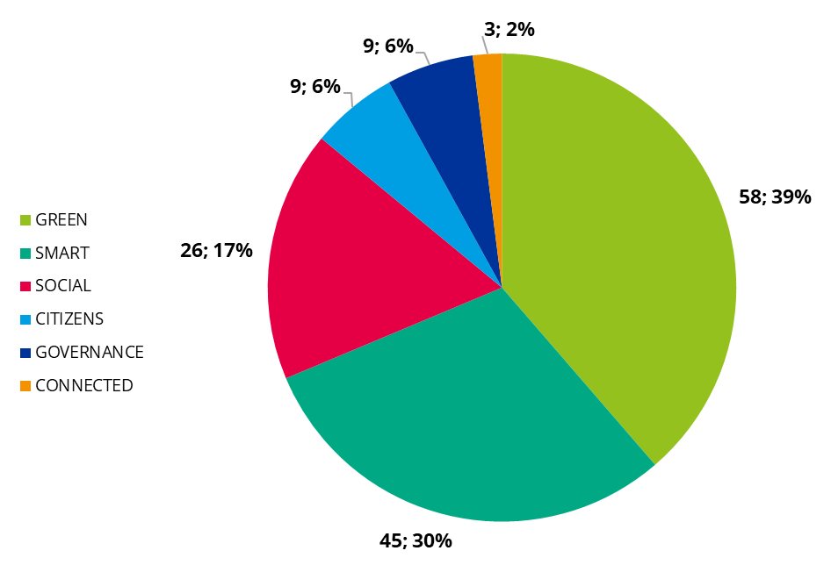
Overview of projects approved so far
150 running projects
1,494 partners
28 countries represented

Slide 12
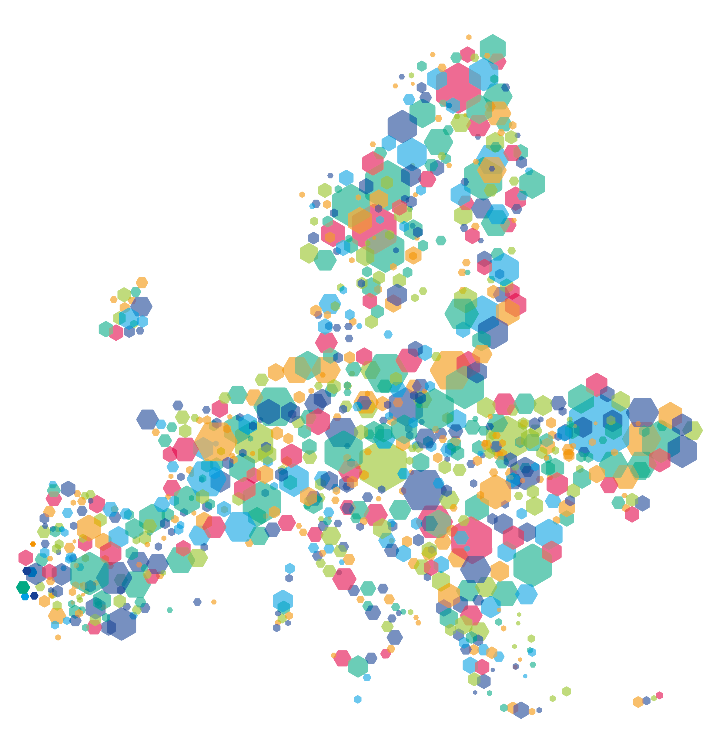
Policy Learning Platform
A shortcut to policy solutions

Slide 13
Policy Learning Platform
#policylearning
Knowledge
Find policy solutions
People
Meet our
community
Expertise
Get policy advice

Slide 14
A wealth of tested policy solutions
Stories, reports & more
3,200+ expert-validated
good practices
Webinar recordings
Policy briefs
https://www.interregeurope.eu/policy-solutions

Slide 15
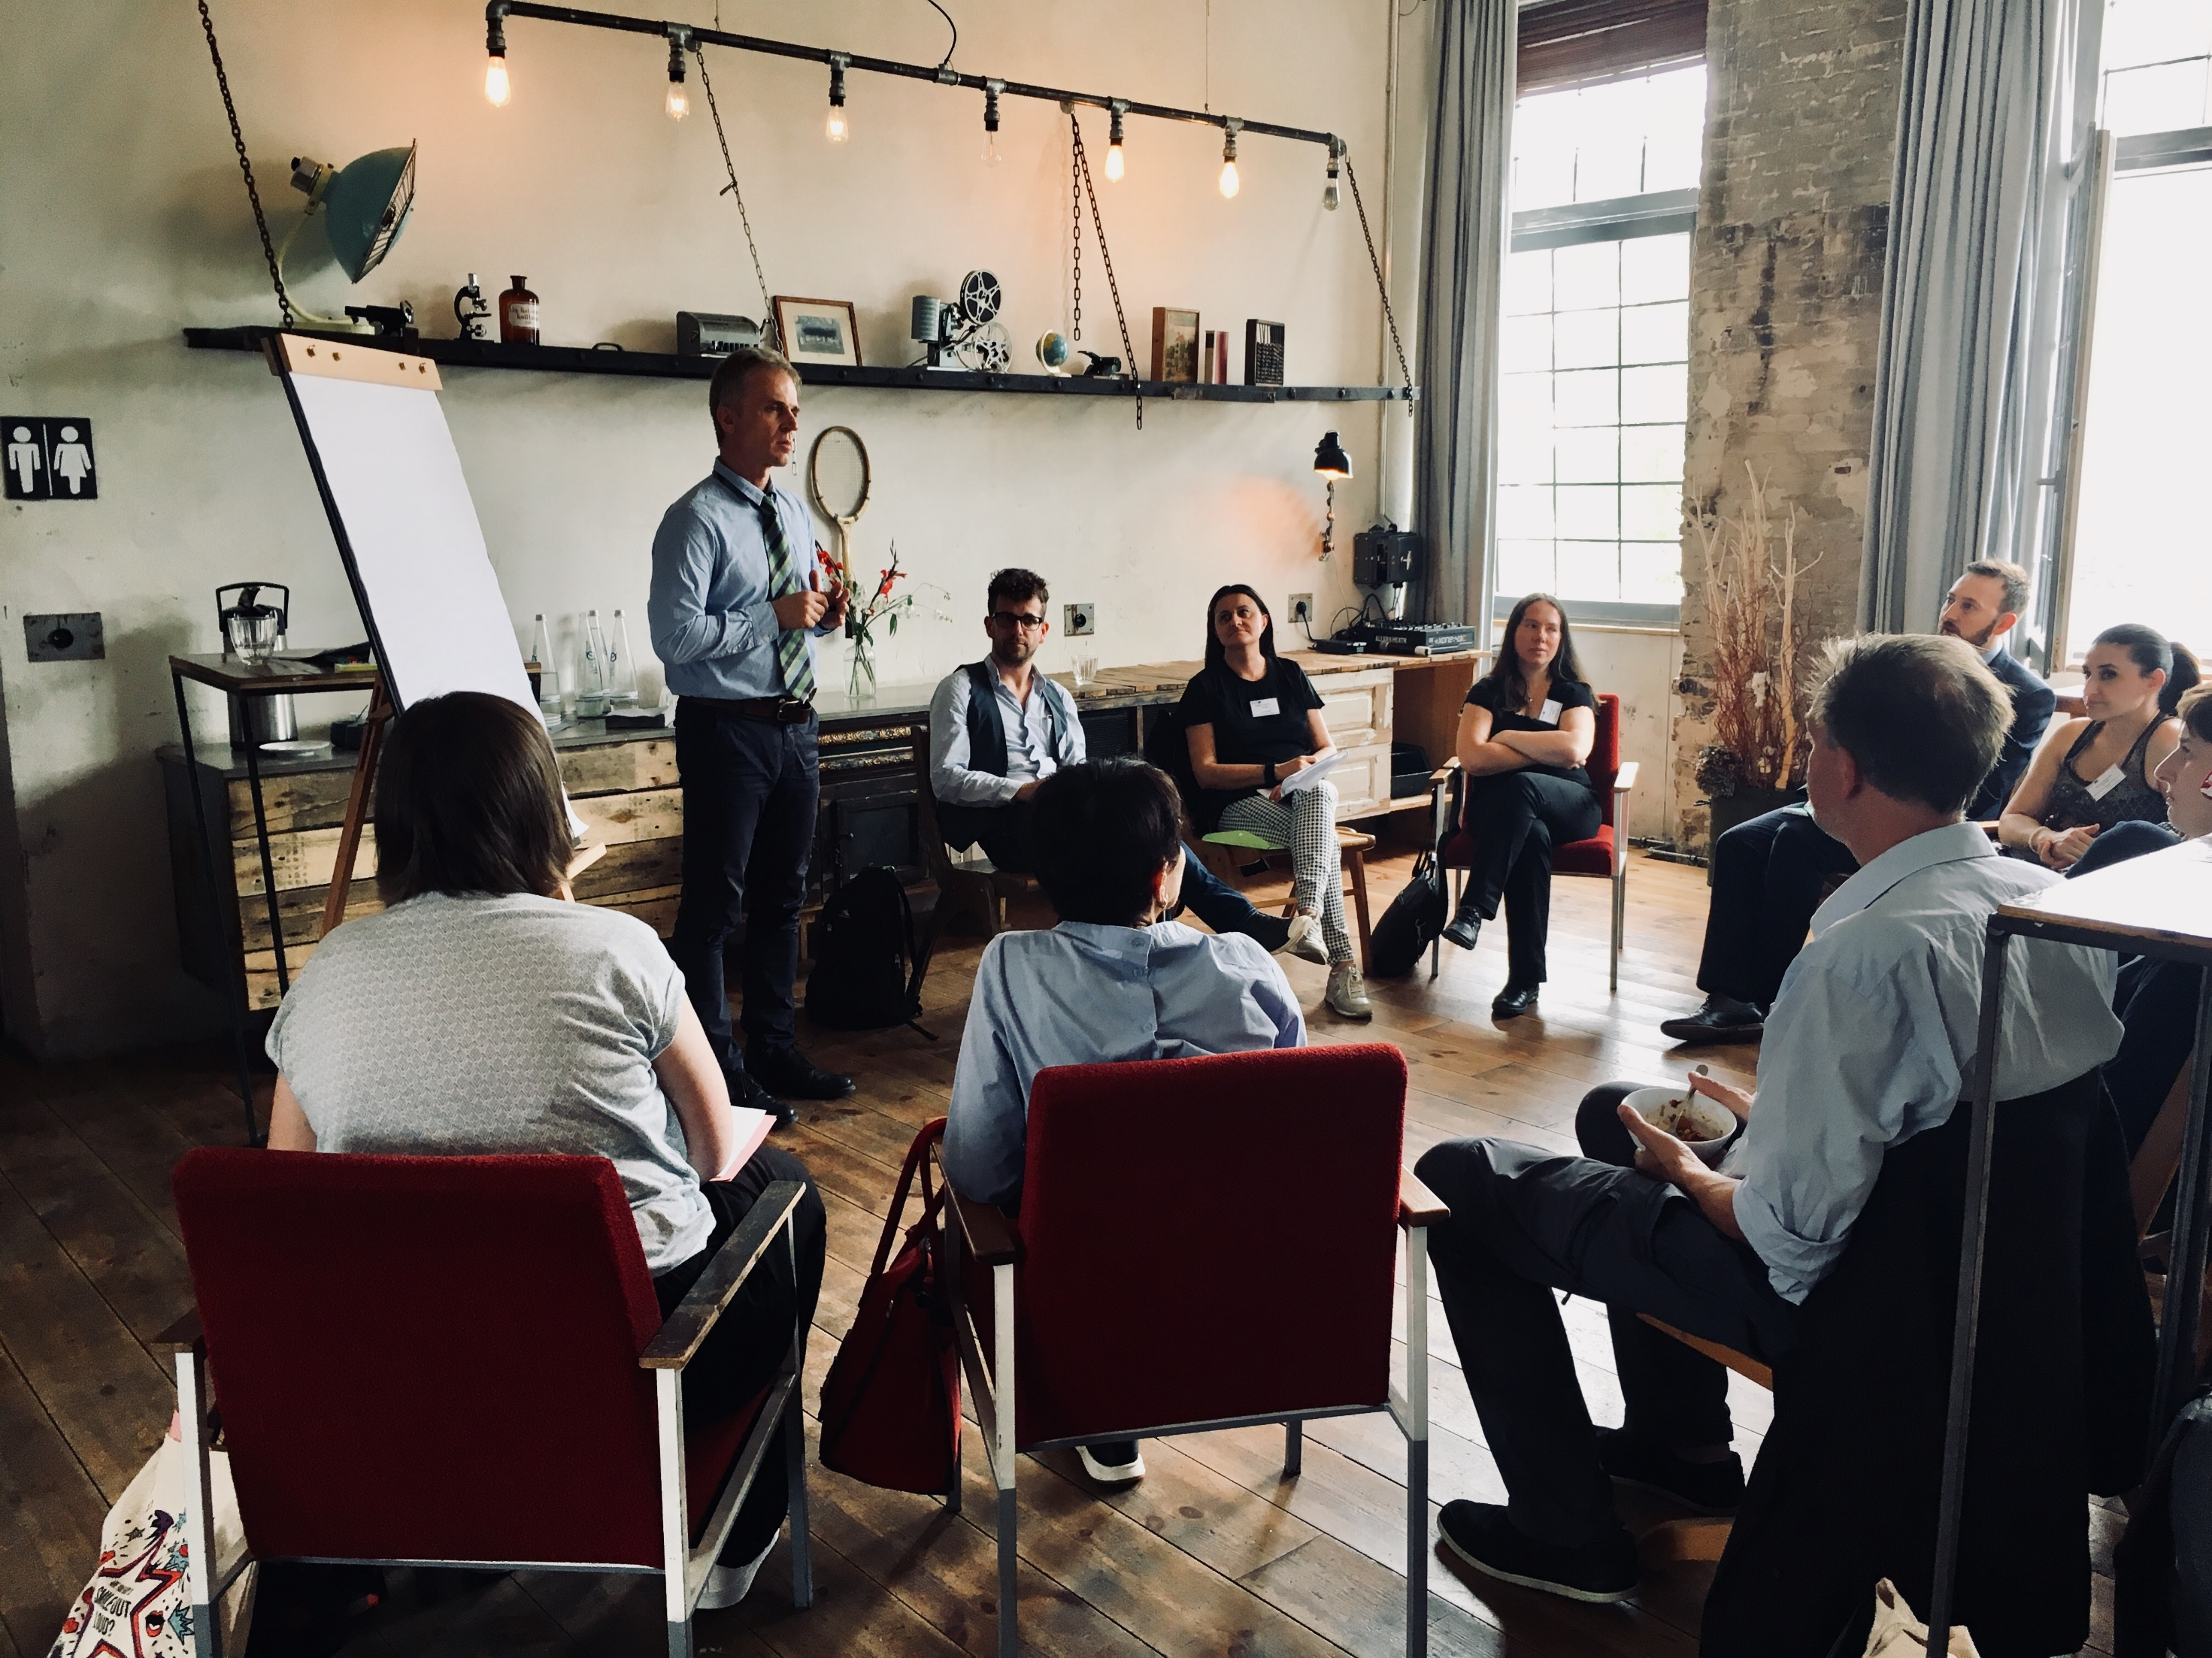
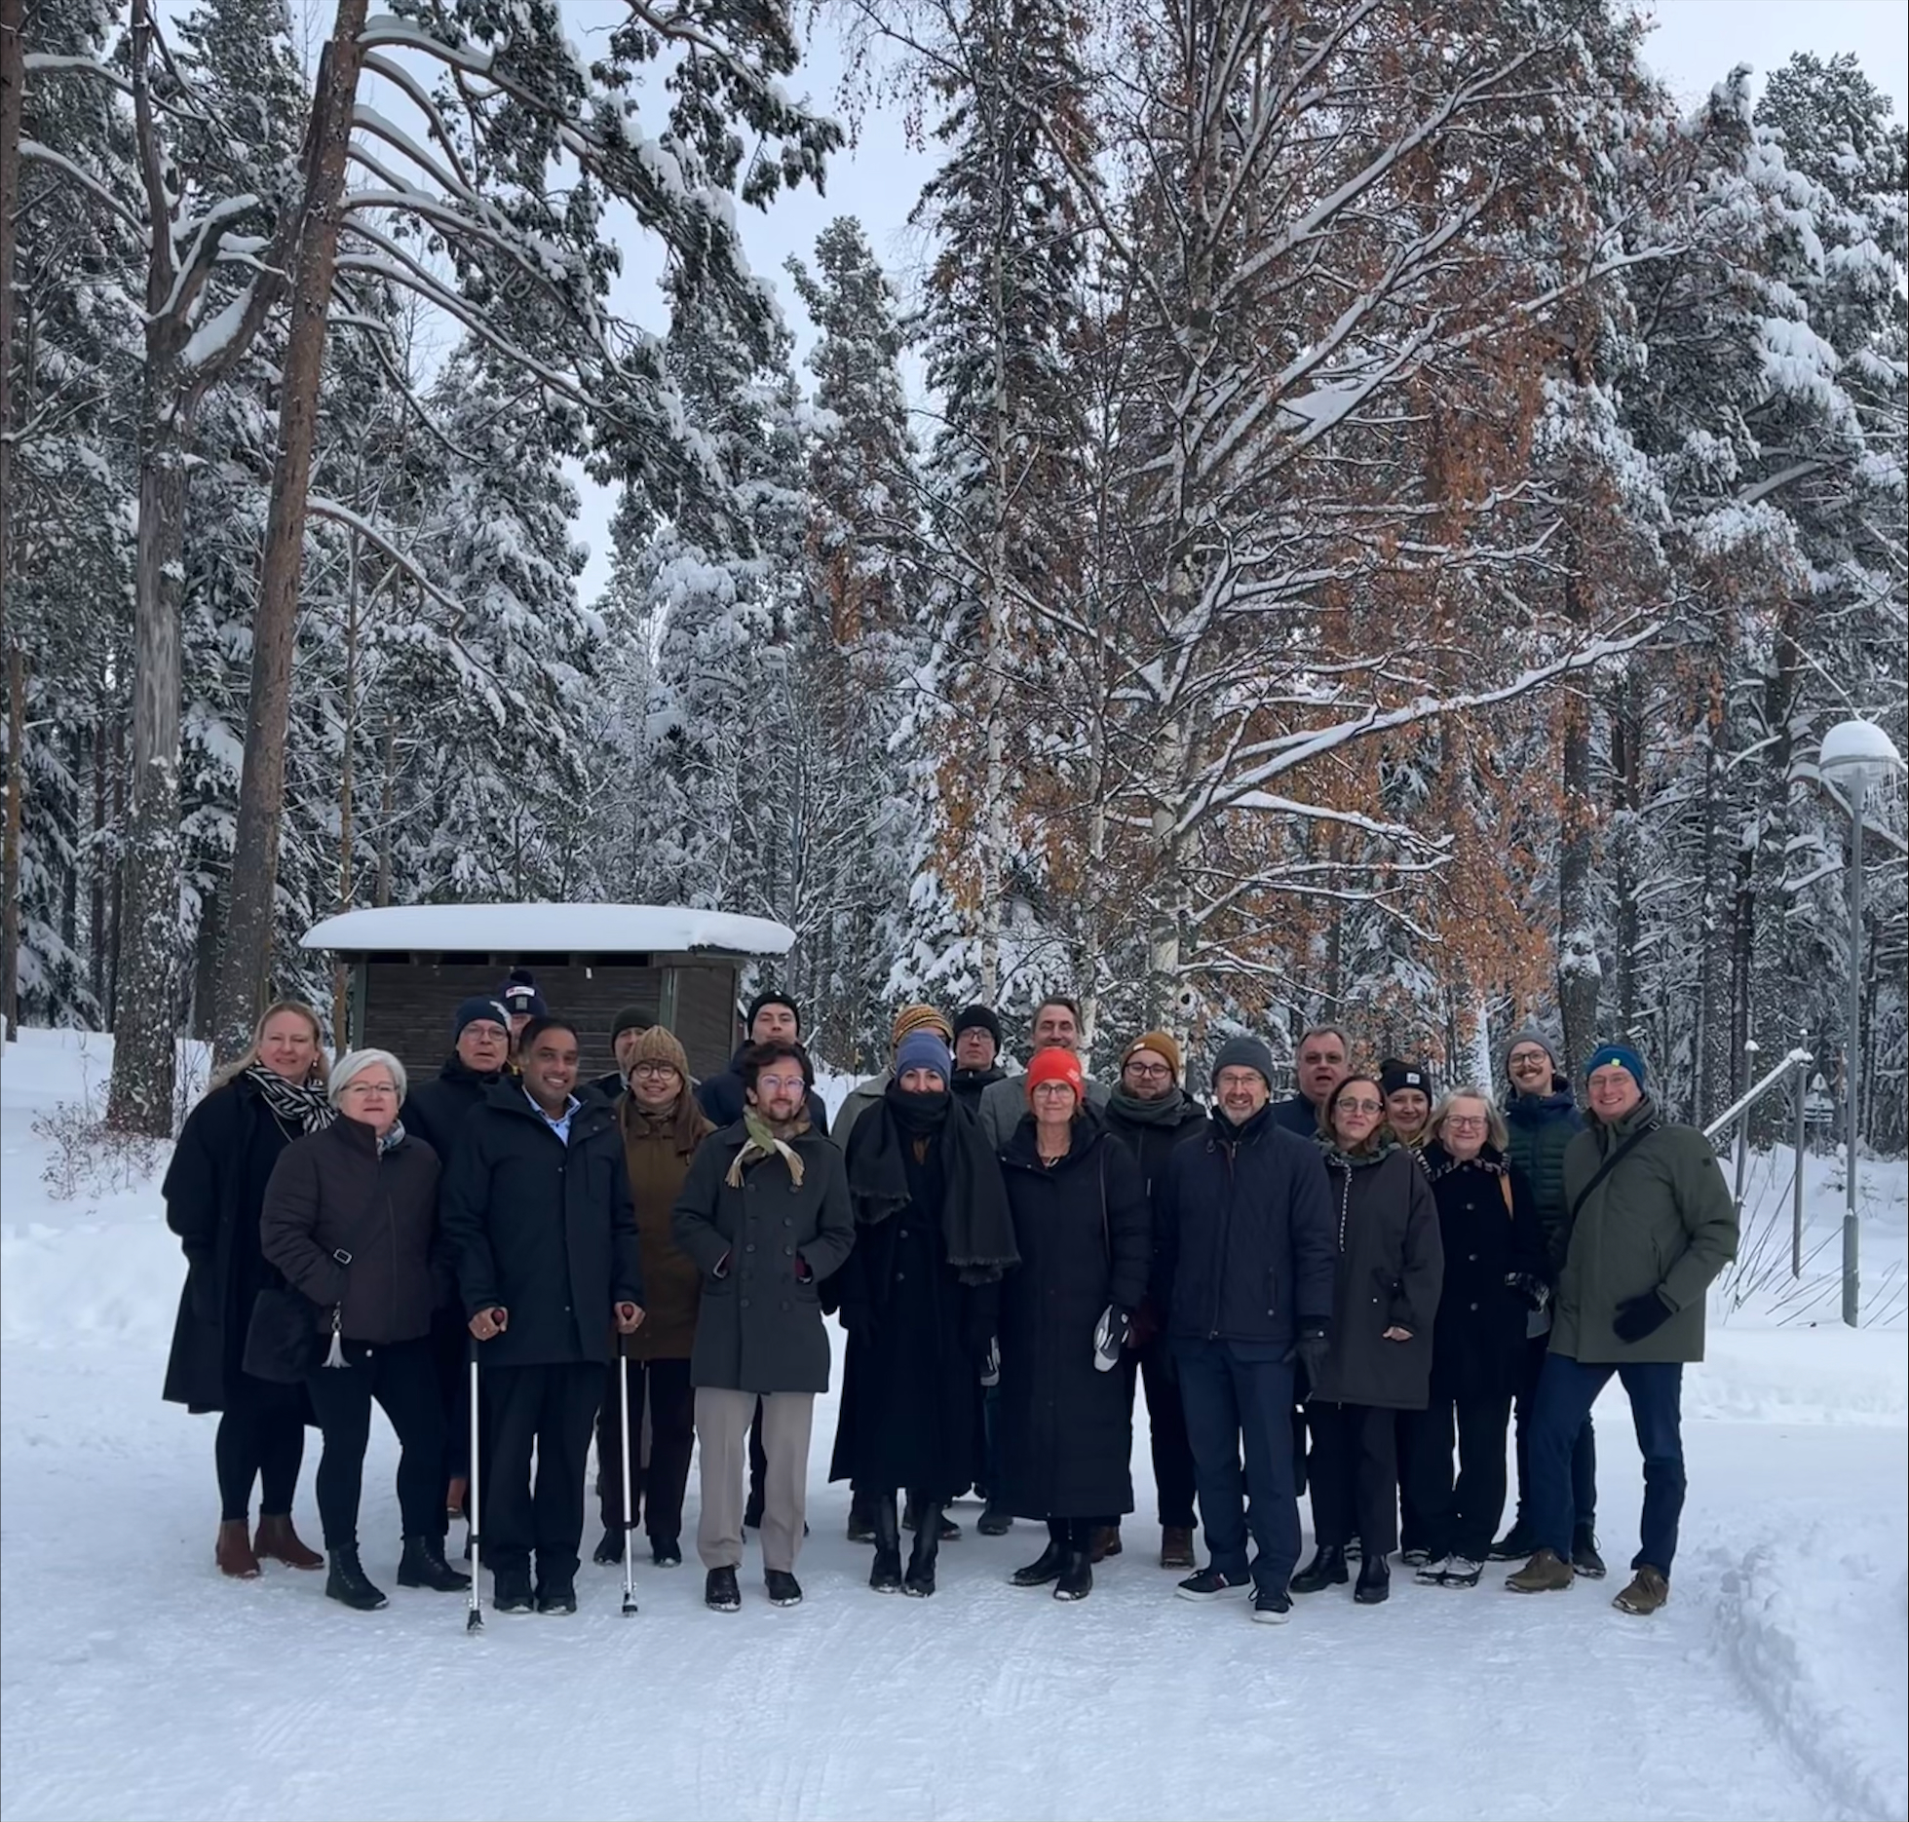
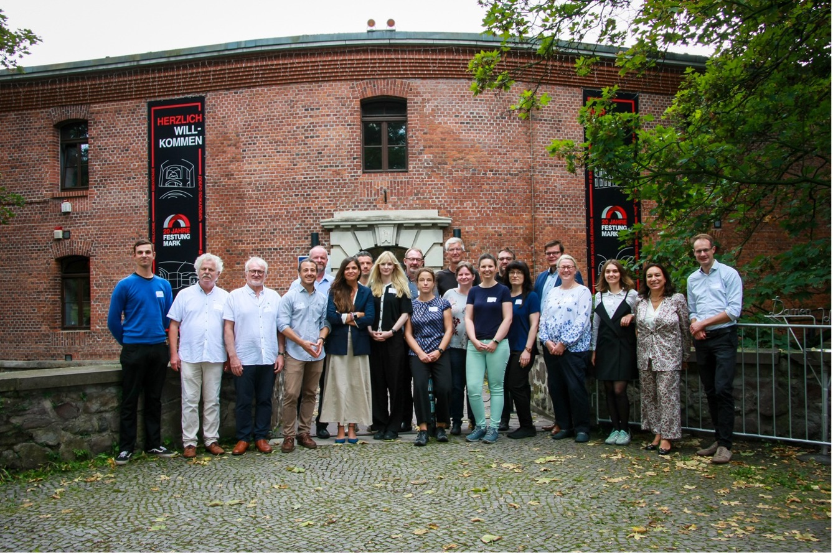
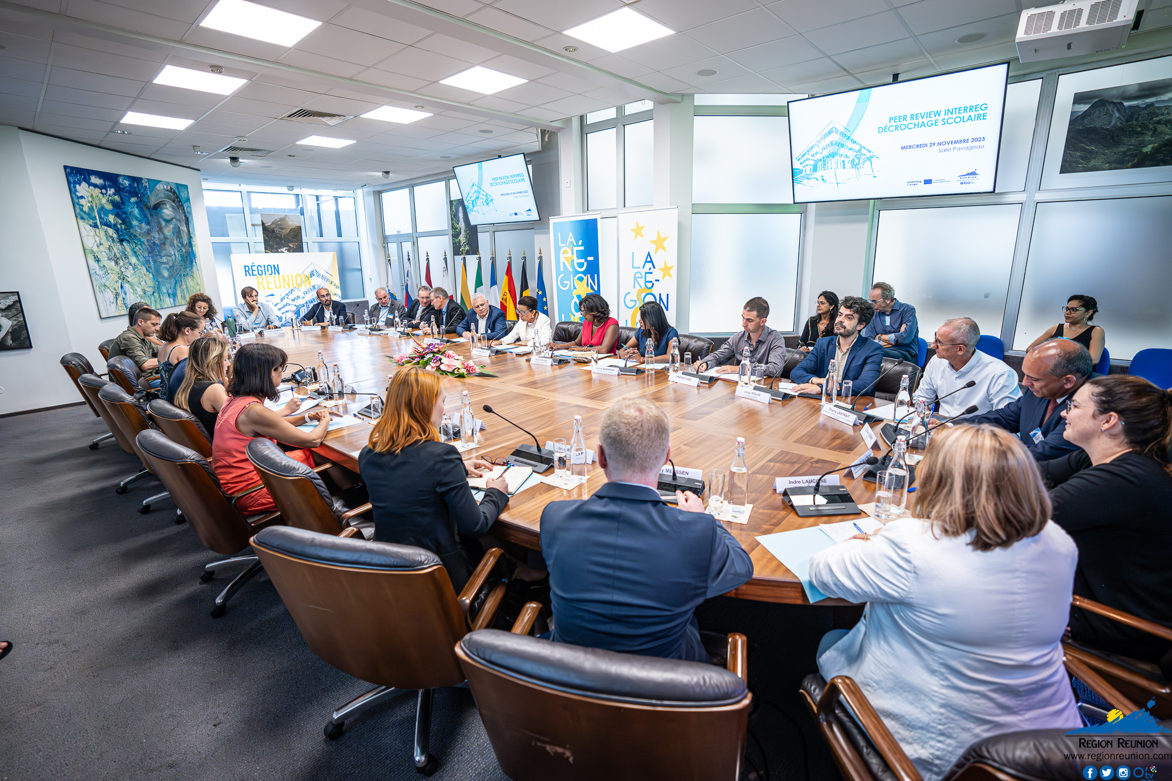
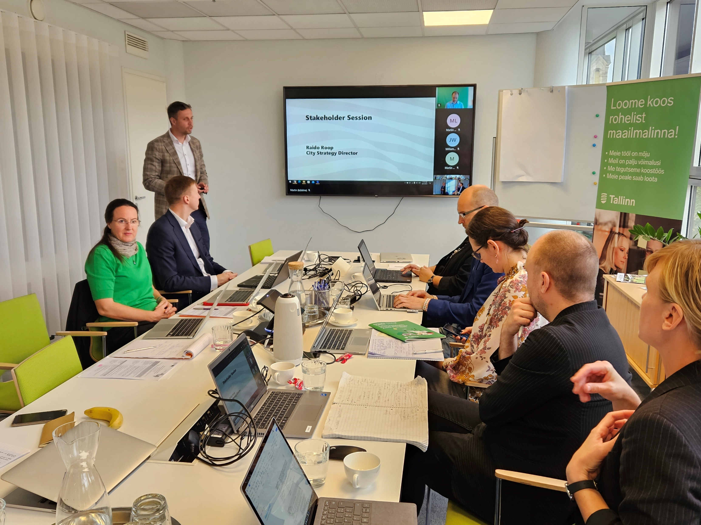
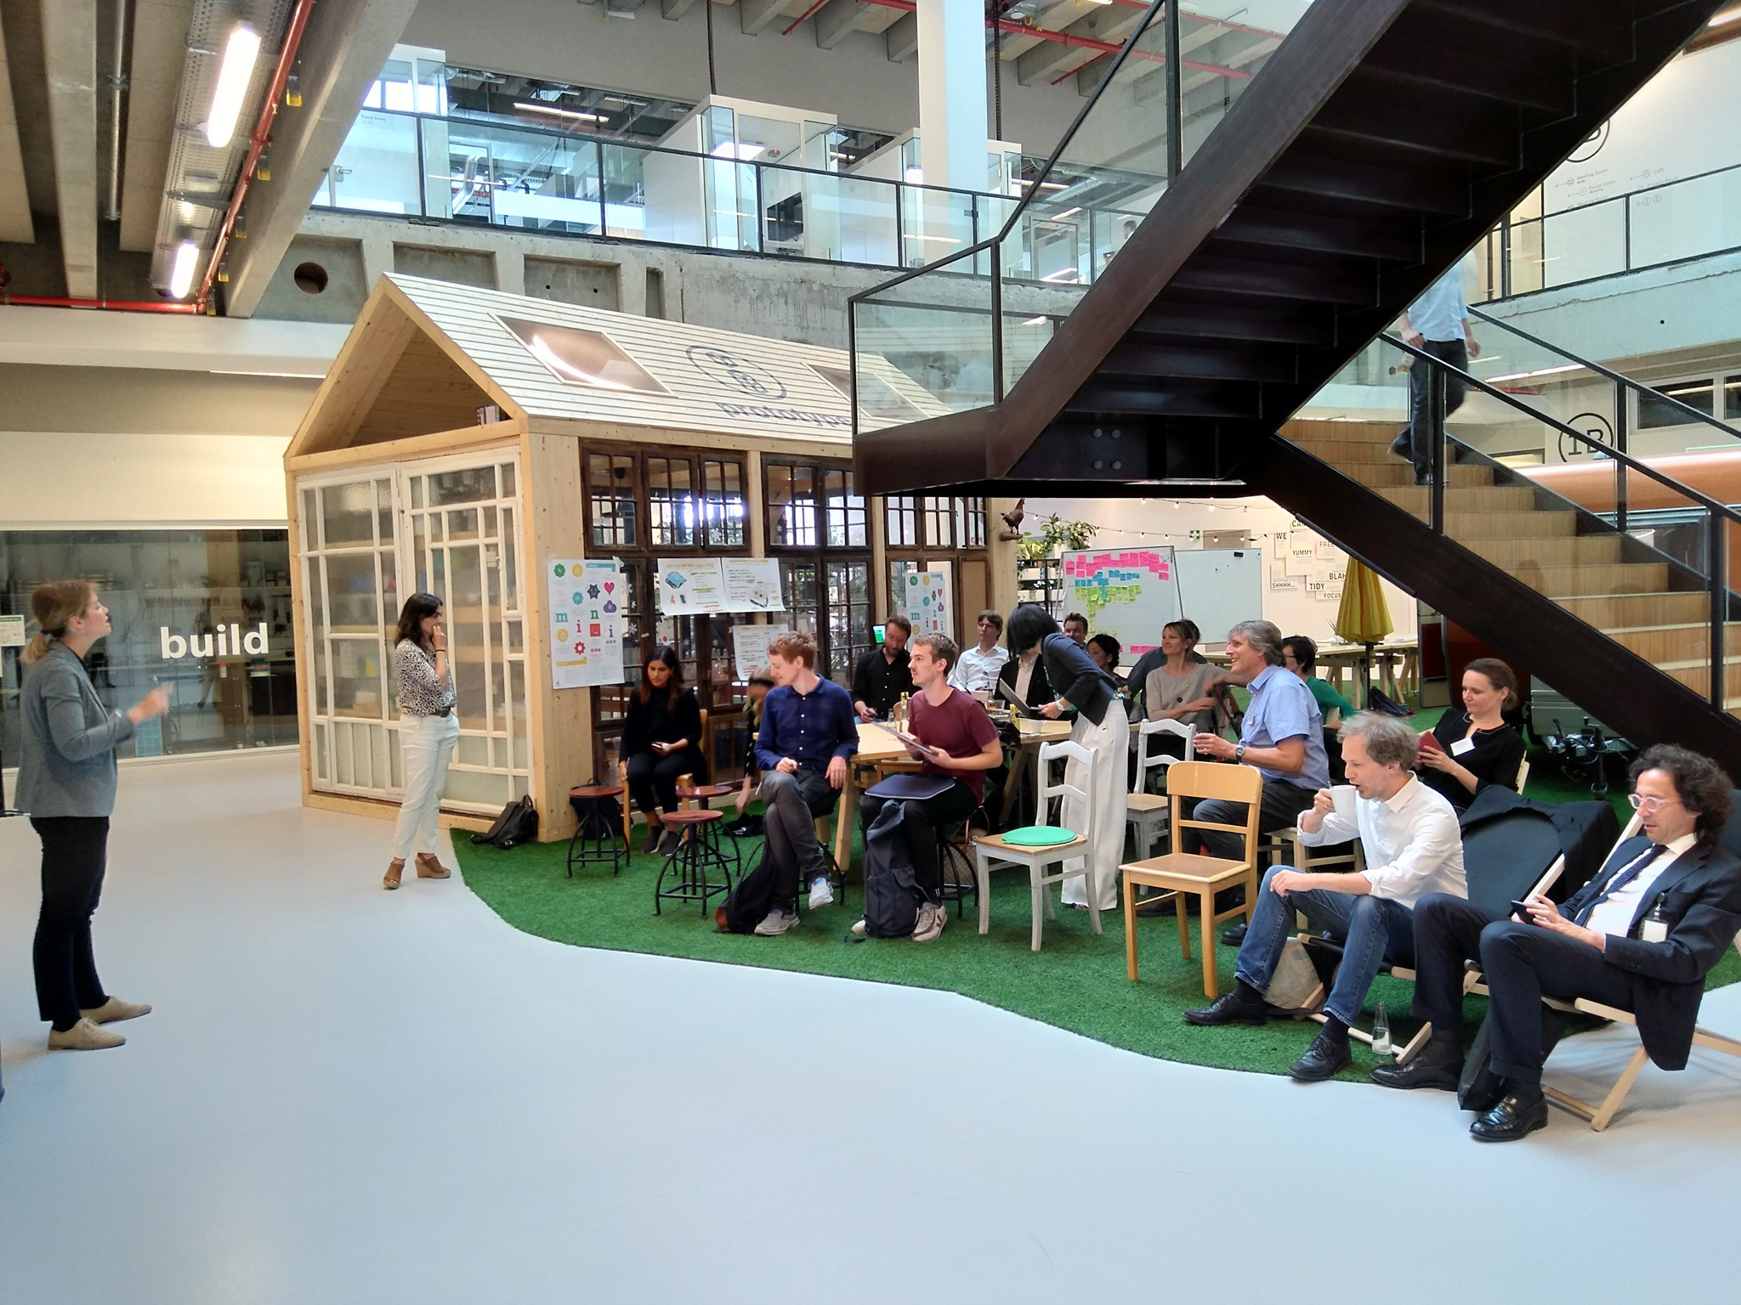
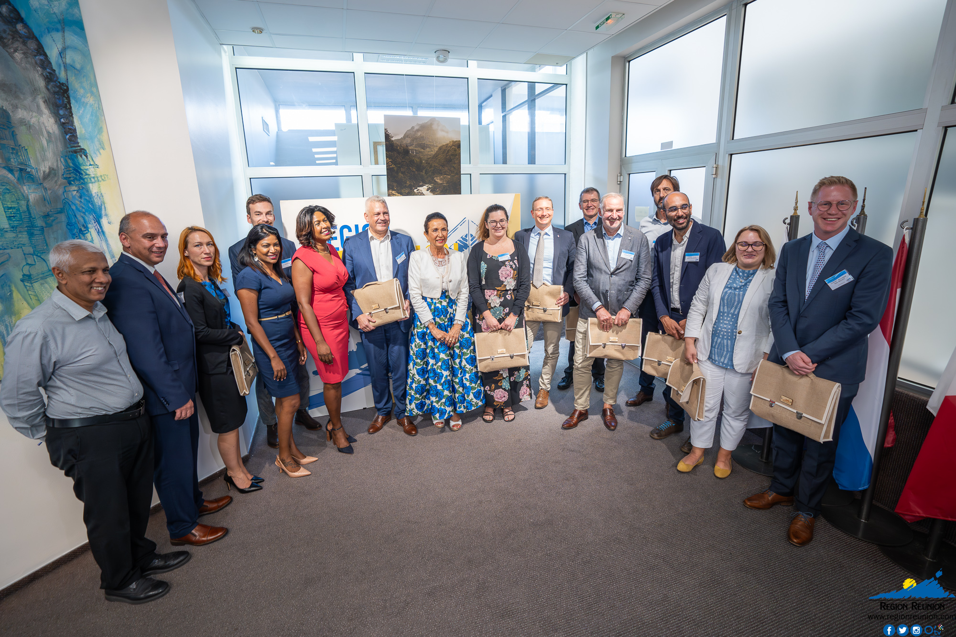
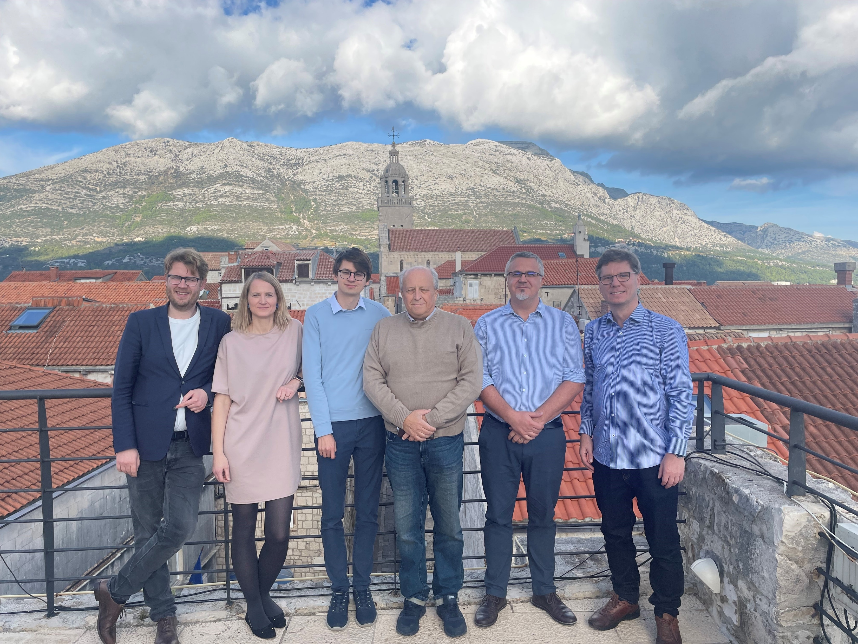
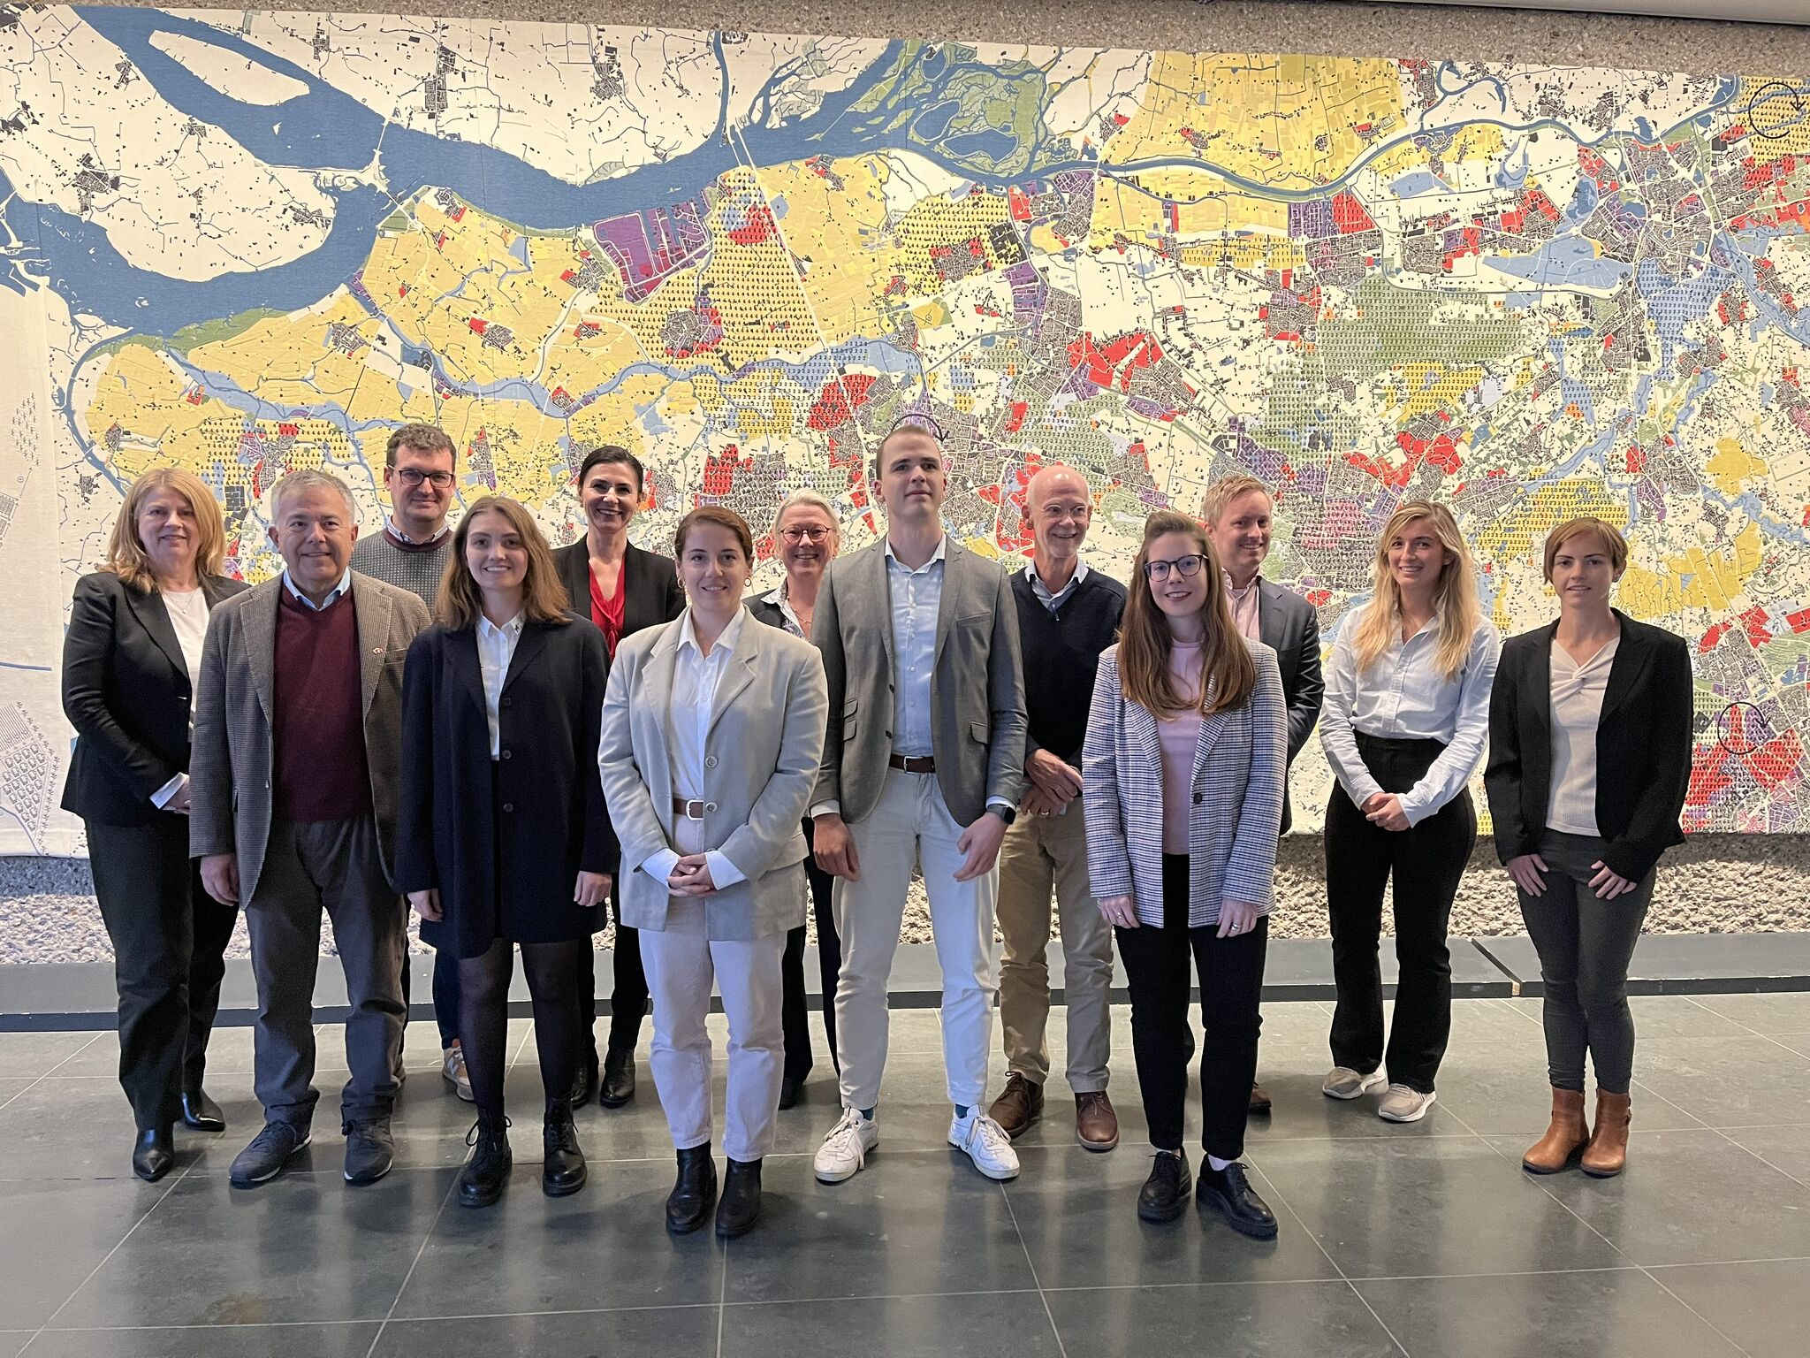

Slide 16
Launch of the third call.
Erwin Siweris, Interreg Europe

Slide 17
Third call
12 weeks
Opening: 20 March 2024
Closing: 7 June 2024 at 12:00/noon CEST
Decision: end of 2024
Application pack available
All topics open

Slide 18
Third call: a unique opportunity for you!
First time 36 countries are eligible!
Enlargement: main new feature of this call

Slide 19
Calls for proposals – state of play
First call (5 April – 31 May 2022)
134 | project proposals
72 | approved projects
54% | success rate
EUR 102 million | Interreg funds allocated
Second call (15 March - 9 June 2023)
146 | project proposals
78 | approved projects
53% | success rate
EUR 112 million | Interreg funds allocated
More than 60% of projects’ budget already allocated.
Don’t miss the third call!

Slide 20
Get ready for the third call.
Petra Geitner, Interreg Europe
Nicolas Singer, Interreg Europe

Slide 21
10 frequently.
asked questions.

Slide 22
QUESTION 1.
What is an Interreg Europe project for?

Slide 23
1/ Project objective
To improve the policy instruments of the participating ‘regions’ to better address a common challenge
Policy instruments?
Public interventions at local, regional or even national levels (e.g. Smart specialisation strategy, climate change action plan, social inclusion programme)
At least one policy instrument per project must be an Investment for jobs and growth goal programme (ERDF/ ESF+/JTF regional or national programme)

Slide 24
QUESTION 2.
What activities can be implemented in the projects?

Slide 25
2/ Project activities
Learning by exchanging experience (e.g., workshop, seminars, study visits, staff exchanges) related to good practices identification & transfer
Learning by doing: pilot actions from the start of the project or at midterm (max one per policy instrument)
increased capacity of people and organisations

Slide 26
QUESTION 3.
How long do the Interreg Europe projects run?

Slide 27
3/ Implementation of activities
2 phases over 4-year implementation
CORE | FOLLOW UP
3 years | 1 year
Exchange of experience to achieve policy improvements | Monitor policy improvements

Slide 28
QUESTION 4.
What topics can be addressed by the third call projects?

Slide 29
4/ Topics to be addressed by projects
All topics open.

Slide 30
QUESTION 5.
Who is eligible for funding?

Slide 31
5/ Who is eligible?
Public authorities
Public law bodies (bodies governed by public law)
Private non-profit bodies

Slide 32
QUESTION 6.
Who should be partners in projects?

Slide 33
6/ Policy relevance of partnership
Core target group: policy responsible authorities
Policy responsible authorities must be involved in project:
As partners for at least 50% of the policy instruments addressed
As ‘associated policy​ authorities’ for the remaining policy instruments
Example
Policy instrument | Regional Innovation Strategy for Mazovia Region (RIS Mazovia)
Policy responsible authority | Marshal's Office of the Mazovian Voivodeship

Slide 34
QUESTION 7.
How many countries should be represented in a project?

Slide 35
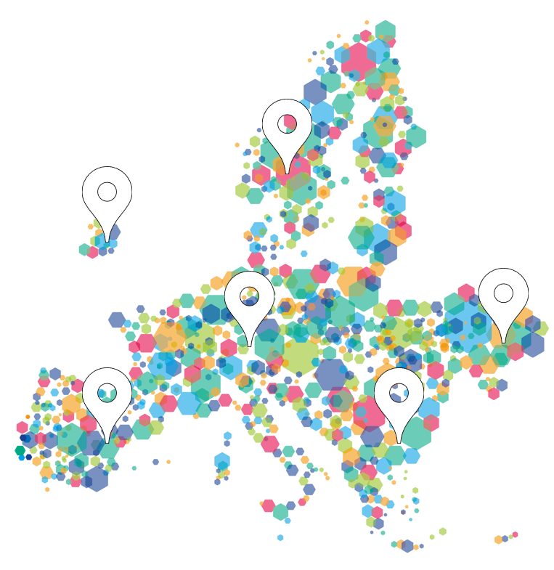
7/ Geographical coverage
Geographical areas | Countries covered
North | Denmark, Estonia, Finland, Germany, Latvia, Lithuania, Norway, Sweden
East | Austria, Bulgaria, Czech Republic, Hungary, Poland, Romania, Slovakia, Slovenia
South | Croatia, Cyprus, Greece, Italy, Malta, Portugal, Spain
West | Belgium, France, Ireland, Luxembourg, Netherlands, Switzerland
Candidate countries | Albania, Bosnia and Herzegovina, Moldova, Montenegro, North Macedonia, Serbia, Ukraine
Four out of five areas to be covered
Mix of more and less advanced regions
Notes:
Nico - What else to keep in mind? Geographical coverage
For NIDs in France, Spain and Portugal, please mention the exception to this rule for RUPs

Slide 36
7/ Geographical coverage (& innovative character)
Strong encouragement to involve partners from:
Seven candidate countries
Switzerland
Regions not yet represented in the first two calls

Slide 37
QUESTION 8.
Are there measures for the EU candidate countries to take part in projects?

Slide 38
8/ Discovery partner
Rationale: facilitate participation from the seven new countries
Albania, Bosnia and Herzegovina, Moldova, Montenegro, North Macedonia, Serbia, Ukraine
Main characteristics:
Lighter form of involvement: no need to address a policy instrument
Aim: to discover interregional cooperation and learn from others
Recommendation: max 2 per project

Slide 39
QUESTION 9.
What is the usual project budget and the co-financing rate?

Slide 40
9/ Projects funding
Co-financing rates | According to legal status or location
80% Interreg fund* | Public or public equivalent from the EU & 7 candidate countries*
70% Interreg fund* | Private non-profit from the EU & 7 candidate countries*
50% Norwegian fund | Public, public equivalent and private non-profit from Norway (NO)
Swiss fund | Public, public equivalent and private non-profit from Switzerland (CH)
* Subject to revised CP approval
Average Interreg fund budget per project: MEUR 1.4
Notes:
You have to provide the cofinancing, for 20% or 30% depending on your legal status

Slide 41
QUESTION 10.
What costs are covered in projects?

Slide 42
10/ Costs & simplified financial rules
Cost categories | Simplification
Preparation costs | Lump sum €17,500
Staff | Fixed % of the real gross employment cost
Office & administration | Flat rate of 15% of staff costs
Travel & accommodation | Flat rate of 15% of staff costs (real cost reporting only in specific justified cases)
External Expertise and Services
Equipment | Office equipment or limited to pilots
Infrastructure and Works | For pilots only
Plus:
Simplified reporting, faster payments to projects
Less control (sampling, risk-based verifications)
Notes:
Programme does not aim at financing infrastructure, it is very exceptional, just for specific pilot actions
Also we do not cover grants to third parties as a cost category, this means no cascade funding to third party through the partner is possible.
Now, what is possible is …
EES : public procurement rules must apply

Slide 43
Any lessons learnt?.

Slide 44
Lessons learned from previous calls
Eligibility
Ensure at least one Investment for growth & jobs goal programme is addressed
Check the ‘Policy responsible authority’ status of the organisations involved
Don’t wait for the last minute to prepared documents (e.g., declarations)
Notes:
Nico to review & adjust

Slide 45
Lessons learned from previous calls
Quality assessment
Partnership is key
Go beyond transnational areas (e.g., MED programmes covers 4 out of 5 areas)
Propose balanced partnership (countries, mix between more and less advanced)
Demonstrate policy relevance
Quality of results
Demonstrate the innovative character (especially when partners come back)
Clarify the expected policy improvements
Justify when programme recommendations are not followed
Notes:
Nico to review & adjust

Slide 46
Next steps towards projects.
Ilaria Piazza, Interreg Europe

Slide 47
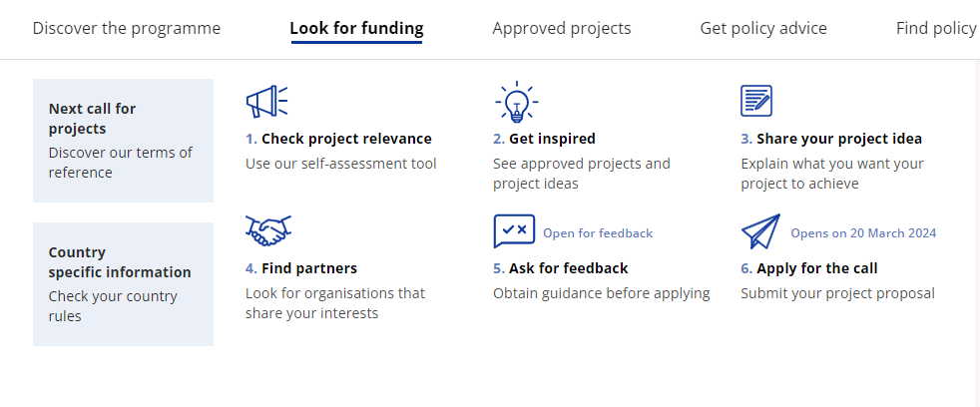
Programme assistance - online tools

Slide 48
Programme assistance - other tools
Programme manual
Third call documents
Terms of reference
Application form and declaration template
Website (FAQ, questions form, contact form)
Points of contact

Slide 49
Programme assistance - events
Info days
Various dates across Europe
Online Q&A sessions
5 Apr, 26 Apr, 17 May, 31 May: Q&A sessions (at 10:00 AM/CEST)
Lead applicant webinar week
15-18 Apr: Webinar series on project development (at 10:00 AM/CEST)

Slide 50
Keep up with our news
Join our online community
www.interregeurope.eu/user/register
Sign up to our newsletter
www.interregeurope.eu/#block-newsletterblock

Slide 51
Third call
12 weeks
Opening: 20 March 2024
Closing: 7 June 2024 at 12:00/noon CEST
Decision: end of 2024
Application pack available
All topics open

Slide 52
Thank you!.

Slide 53
Europe, let's
cooperate!
Interregional cooperation forum

