Slide 1
Exchange & Learning activities (E&L)
Identification of Good Practices
Yvan Corbat
External Expert
yvan@grupodex.com
13th September 2023| Online

Slide 2
Interregional learning process
The learning process is based on the identification, analysis and exchange of policy knowledge and practice from participating regions in the policy field tackled by the project.
Exchange of experience between partners may include activities such as:
Seminars
Workshops
Site visits
Peer reviews
Staff exchanges (not initially planned in Tourbo)

Slide 3
Reminder2:
At the end of the Project, the improvements should be presented/start to be implemented and monitored in Phase 2.
If no improvements, at least an “Action Plan” should be drafted…
Reminder
The key obligations of the partners is to improve, thanks to E&L processes and the collaboration with local/regional stakeholders, the previously identified Policy Instruments
ES: Plan of Reactivation, Transformation and Resilience for the Province of Seville
DE: Bremerhaven tourism strategy
FI: Lapland Sustainable Smart Specialisation programme (S4+) 2023
BG: Regional Tourism Strategy 2021-2027
HR: Development Plan of Koprivnica Križevci County for period 2021-2027
IT: Regional OP 2021-2027 of the ERDF for Marche Region
EL: Regional Operative Programme 2021-2027 of the European Development Fund (for North Aegean Region)
IE: County Donegal Development Plan 2018-2024 Sections: Economic Development and Tourism.
Either through “New projects financed by your instrument”, “Change in the management of the instrument” or “Revision of the instrument itself” (i.e. legislative changes)

Slide 4
Identification of Good Practices
Projects need to analyse the experiences and/or practices they exchange, and disseminate the most useful findings.
Main Good Practices will be reported through the Policy Learning Platform
GPs validated by the JS can be published in the project website
Also, GPs validated by JS can be counted under the indicator ‘number of good practices identified’
Indicator in the AF:
- 24 GPs to be identified (average, 3/Partner-country)!

Slide 5
Policy Learning Platform
It aims to boost EU-wide policy learning and builds on good practices related to regional development policies.

Slide 6
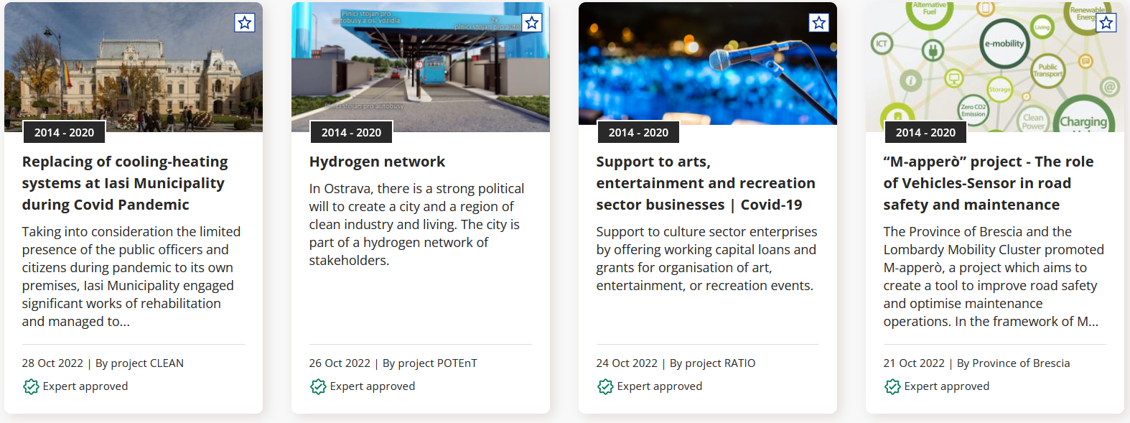
Policy Learning Platform
Interreg Europe asks its project partners to be actively involved in the Platform over the lifetime of their project by contributing content and by sharing their knowledge and experience.
Each region participating in a project is expected to provide the Programme with good
practices from their region and with a contact person for their specific policy field in order to create a community of regional practitioners throughout Europe.

Slide 7
Good Practice Definition
According to the Interreg Europe programme manual, a good practice is defined as “an initiative (e.g. project, project, process, technique) undertaken in one of the programme’s priority axes which has proved to be successful in a region and which is of potential interest to other regions. Proved successful means that the good practice has already provided tangible and measurable results in achieving a specific objective.”
Since Interreg Europe is dedicated to regional development policy improvements, a good practice is usually related a public intervention. A private initiative may be considered as a good practice only if there is evidence that this initiative has inspired public policies.

Slide 8
Plans according to Application Form
S2: Identify 8 GPs in relation to the topic and to reflect on how to improve the integration of quadruple helix actors into the value chain of the sector / special focus on Twin Transition
S3: Identify 8 GPs in relation to Innovative green transition and a highly practical digital transformation
S4: Identify 8 GPs in relation to Sustainable business models for resource efficient Tourism SMEs
… that means, only 1 GP per partner/Semester to be finally uploaded, during 3 Semesters starting from now!

Slide 9
Good Practices collection, selection & uploads
We propose to follow a 4 steps procedures:
Identification of GPs (till 13th October 2023)
Through a brief online questionnaire to know which ones you want to propose (number? 3 proposals/partner/semester?)
Pre-selection of the “best” (more appropriate) of GP (Peer review meeting, 9th November)
Taking into account criteria of appropriateness, complementarity, transferability potentials
Collection of an internal complete information on each GP (Nov-Dec 23)
Following an internal template or free format? (to be discussed if suitable)
Upload of the GPs in the platform (Jan-Feb 24)
Following using a compulsory template to brief the info previously collected (available)

Slide 10
Proposed Questions for step 1 (online questionnaire)
Name of the GP
Geographical scope (Local/Regional/National – and which country/region/city)
Challenge covered:
1 SMART EUROPE / 2: DIGITAL TECHNOLOGIES / 3: SUSTAINABLE BUSINESS MODELS/ Other (Please specify)
Field & classification of the GP:
Legal, Operational, Project, Other
Final Beneficiaries (sectorial classification)
Short description
Why do you think it can be a GP for the project / What is innovative / Transferable?
Which organisation was/is the promotor of such GP (name/profile)?
Do you have a close relation with them to gather further information?
Link

Slide 11
TO-DOS LET’S START
WHAT | WHEN | WHO
Distribute online questionnaire | ASAP | DEX
Identify first 3 potential GPs through the questionnaire | 13th October 2023 | All partners
Gathering of all proposed GPs and share with partners | 20th October 2023 | DEX
Peer review exercise in Croatia and selection of best GPs | 9th November 2023 | DEX and all partners
Complete and Exchange full information on at least 8 selected GPs | November-December 2023 | All partners (at least 1 GP/partner)
Upload/Submit GPs in the platform | January-February 2024 | All partners (DEX supervisión)
Validation/revision by Joint Secretariat
Start again process for 2nd round of GPs | Feb-March 2024 | All partners/DEX
12.3 MEUR

Slide 12
?
Time for questions

Slide 13
Thank you!
www.interregeurope.eu/TOURBO

