Slide 1
4th online meeting
“PIT”
Anne Furphy
Project Manager at Chamber of Commerce of Seville
Anne.furphy@camaradesevilla.com
14 SEPTEMBER 2023| Online

Slide 2
OUR AGENDA
Relevant information
Communication
Learning Phase
Meeting in Croatia
TOTAL

Slide 3
RELEVANT INFORMATION
FROM INTERREG EUROPE:
Portal is opened for reporting: But for the moment we have to wait until RfC of Greek partners is officially accepted.
26 to 28 September 2023 (Lille/France): Lead Partner workshop on reporting activities, finances and communication. Both LP and Lapland U. attend.
This event is targeted at lead partners, lead partners’ financial managers and controllers as well as communication managers.
12.3 MEUR

Slide 4
10 points to remember for the kick-off phase
REMEMBER THE DEDICATED LINK TO HELP ON PROJECT IMPLEMENTATION IN INTERREG EUROPE WEBSITE:
https://www.interregeurope.eu/help/project-implementation-2021-2027
12.3 MEUR

Slide 5
COMMUNICATION
OUR WEBSITE IS VERY LIVELY!
PUBLISH EVENT IN CROATIA IN WEBSITE
PUSH SOCIAL MEDIA ANIMATION (PP2) with partners
COMMUNICATE AND INVOLVE STAKEHOLDERS
SCRIPT FOR OUR 1ST VIDEO

Slide 6
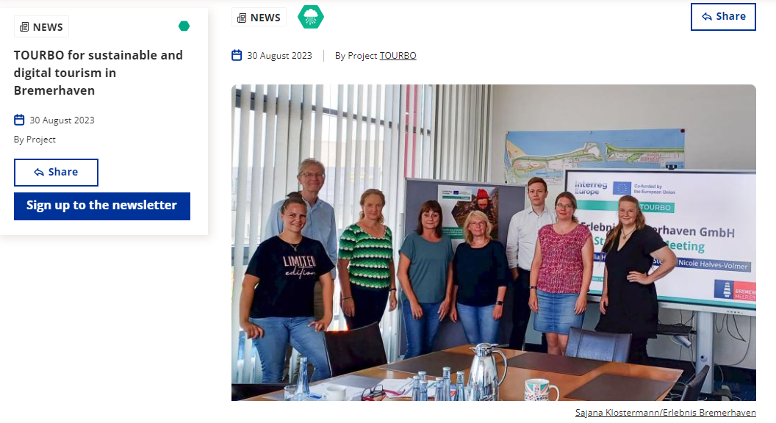
STAKEHOLDERS’ GROUP
-Check 1st stakeholders group meetings organized until now:
LP: 15/09
PP2: 29/09
PP3:
PP4: OK x2
PP5:
PP6: OK
PP7: OK
PP8:
REPORT YOUR MEETING WITH STAKEHOLDERS AND SHARE IT WITH REST OF PARTNERS
https://drive.google.com/drive/folders/1wnbMy5RlQTzYKWR1JF75PS51zOxfTna4?usp=share_link

Slide 7
SoA- INITIAL ASSESSMENT
FIND THE TEMPLATE HERE:
https://docs.google.com/document/d/1fQqHMA67B17Vrl7bYJP8dI7z-IlFXv1h/edit?rtpof=true
LEARNING PHASE
IDENTIFICATION OF GOOD PRACTICES
SUPPORTING DOCUMENTS:
https://docs.google.com/document/d/1ctg4GB55c70PQFiO7tZYOWu6Q23v5Rhh/edit?usp=sharing&ouid=115705946630176294194&rtpof=true&sd=true
https://drive.google.com/drive/folders/1riiIedSiYpVpQAhF49HLmO5xhmH3qfyQ?usp=sharing
LET’S START!

Slide 8
CROATIA EVENT
PRELIMINARY AGENDA

Slide 9
TO-DO’s in the next weeks
COMPLETE SoA ASSESSMENT
MEET STAKEHOLDERS
IDENTIFY BEST PRACTICES
FILL IN PRELIMINARY QUESTIONNAIRE TO BE SENT IN THE NEXT DAYS
PREPARE OUR EVENT IN CROATIA:
INVITE STAKEHOLDERS TO JOIN THE EVENT
FILL IN THE PARTICIPANT LIST
GET READY FOR 1st PROGRESS REPORT AND FOR THE USE OF THE PORTAL

Slide 10
?
Time for questions

Slide 11
Thank you!
www.interregeurope.eu/TOURBO

