Slide 1
1st online meeting
“PIT”
Anne Furphy
Project Manager at Chamber of Commerce of Seville
Anne.furphy@camaradesevilla.com
21 MARCH 2023| Online

Slide 2
OUR AGENDA
How do we manage our project?
Relevant information
Communication
TO-Dos, let’s start !
TOTAL
12.3 MEUR

Slide 3
HOW DO WE MANAGE OUR PROJECT
Monthly online “PIT” meeting – Performance, Issues, Target
Online google drive folder for all project documentation
https://drive.google.com/drive/folders/1pK-MpoIRXVt_vf6wj0dQwrpeOxMj8T_v?usp=sharing
Main reporting principles
12.3 MEUR

Slide 4
HOW DO WE MANAGE OUR PROJECT
Main reporting principles
12.3 MEUR

Slide 5
HOW DO WE MANAGE OUR PROJECT
Main reporting principles
12.3 MEUR

Slide 6
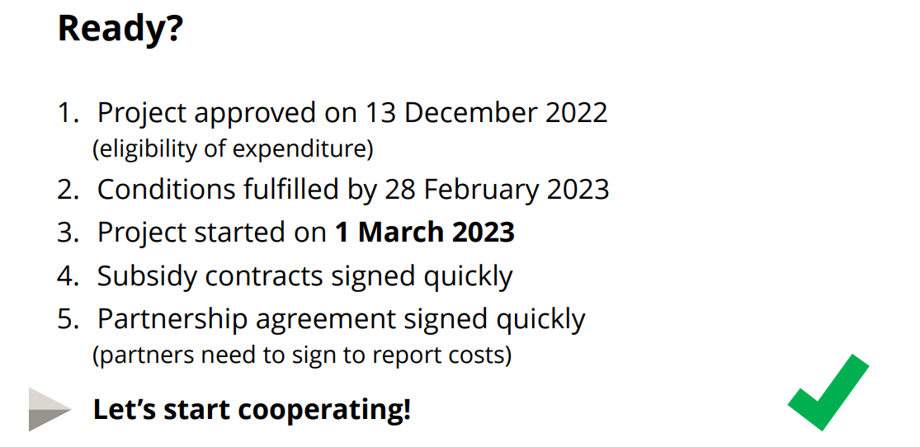
HOW DO WE MANAGE OUR PROJECT
Main reporting principles
12.3 MEUR

Slide 7
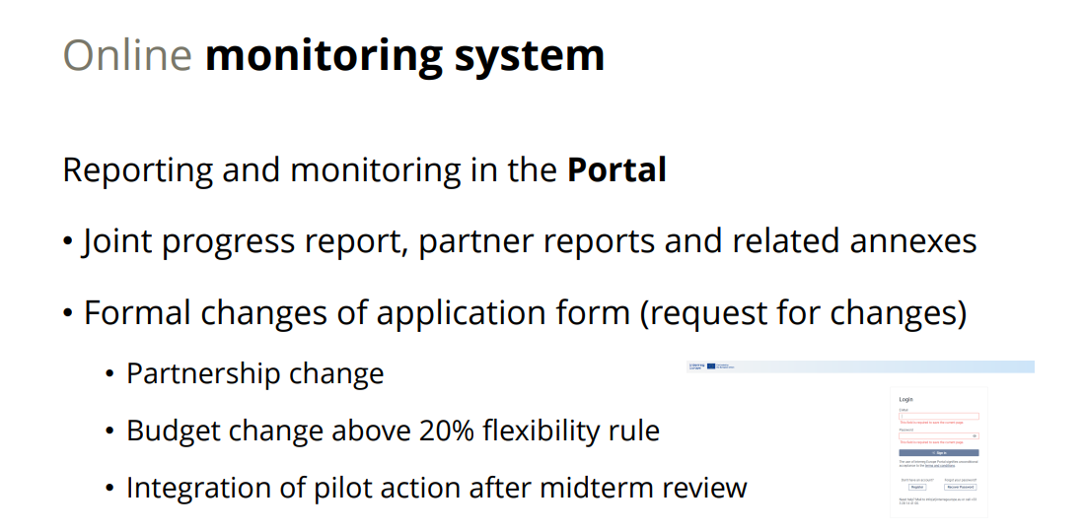
HOW DO WE MANAGE OUR PROJECT
Main reporting principles
12.3 MEUR

Slide 8
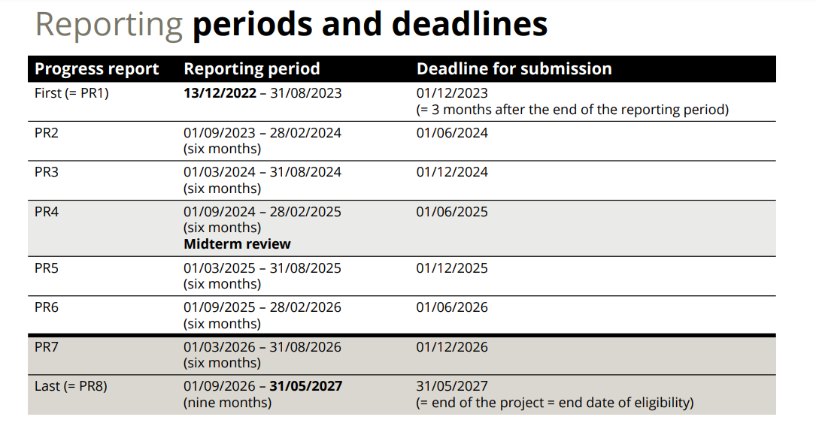
HOW DO WE MANAGE OUR PROJECT
Main reporting principles
12.3 MEUR

Slide 9
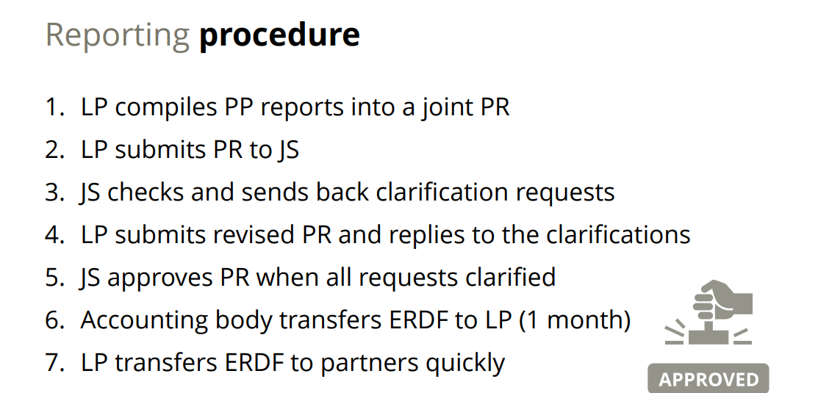
HOW DO WE MANAGE OUR PROJECT
Main reporting principles
12.3 MEUR

Slide 10
HOW DO WE MANAGE OUR PROJECT
Main reporting principles
12.3 MEUR

Slide 11
RELEVANT INFORMATION
GOOGLE DRIVE:
https://drive.google.com/drive/folders/1pK-MpoIRXVt_vf6wj0dQwrpeOxMj8T_v?usp=sharing
INTERREG EUROPE WEBSITE:
https://www.interregeurope.eu/
The PORTAL:
https://portal.interregeurope.eu/login

Slide 12
COMMUNICATION
A3 POSTER OF THE PROJECT

Slide 13
COMMUNICATION
POWER POINT TEMPLATE

Slide 14
COMMUNICATION

Slide 16
TO-DOS LET’S START
WHAT | WHEN | WHO
Set up your Project team | ASAP | All partners
Partners’ logos in Drive Folder | 28th march 2023 | All partners
Proposal for A3 poster picture and slogan | 05th april 2023 | LAPLAND with support of partners
Contact Associated Policy Authority | ASAP | For partners who are not policy owners (CCSEV, Lapland, CC Vratsa, Bremerhaven
BEFORE NEXT PIT MEETING
IDENTIFY and LIST STAKEHOLDERS | April 2023 | All partners
Start your subcontracting procedures |  | All partners
A3 poster ready | 10th april 2023 | All partners
Invitation letter for stakeholders | April 2023 | All partners
12.3 MEUR

Slide 17
?
Time for questions

Slide 18
Thank you!
www.interregeurope.eu/TOURBO

