Slide 1
Promoting the commercialisation of research results
.
Business Support Organization
on Regional Level (Upper Silesia – Poland)
Paweł Lejman

Slide 2
Regional policy challenges of Silesian Voivodship
The most populated and urbanised region in Poland
The most coal-dependent region in Europe
Strong depopulation and rapid ageing
Continuing the ongoing transformation of the post-coal industry

Slide 3
Types of research units operating in the Silesian Voivodship

Slide 4
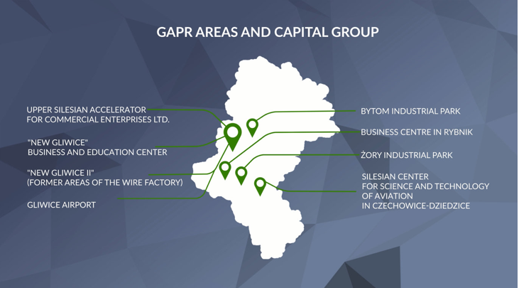
Upper Silesia Accelerator for Commercial Enterprise (GAPR)

Slide 5
Commercialisation Process in University of Helsinki (after Helsinki Innovation Services)

Slide 6
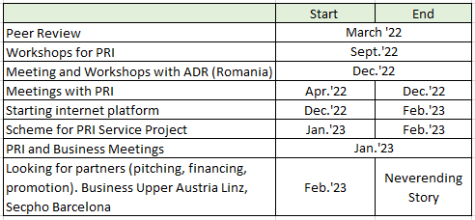
Actions in 2022-23

Slide 7
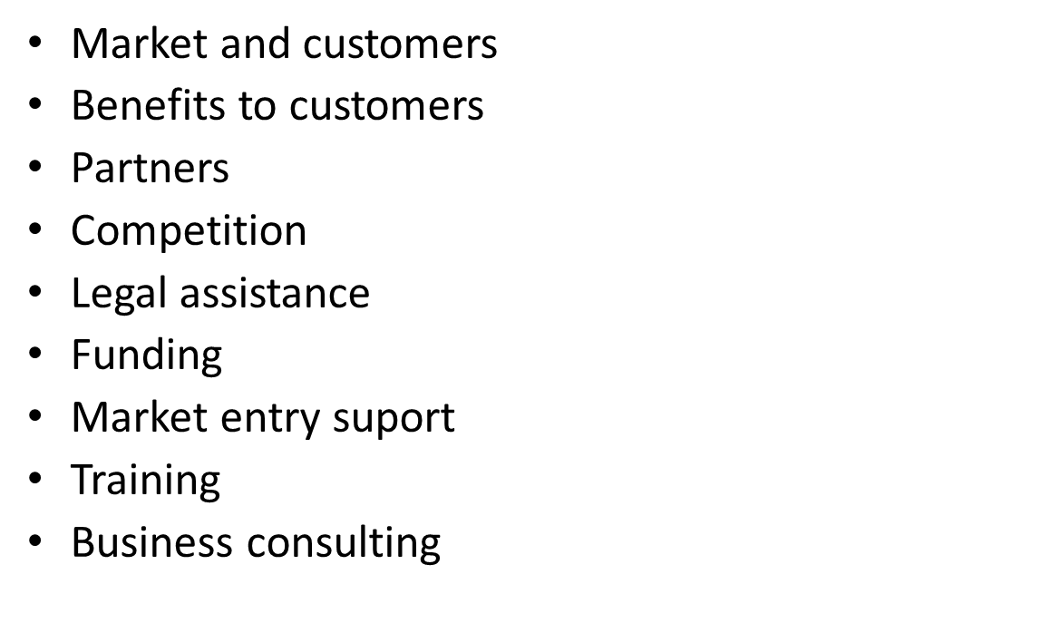
Identifying Fields of Support

Slide 8
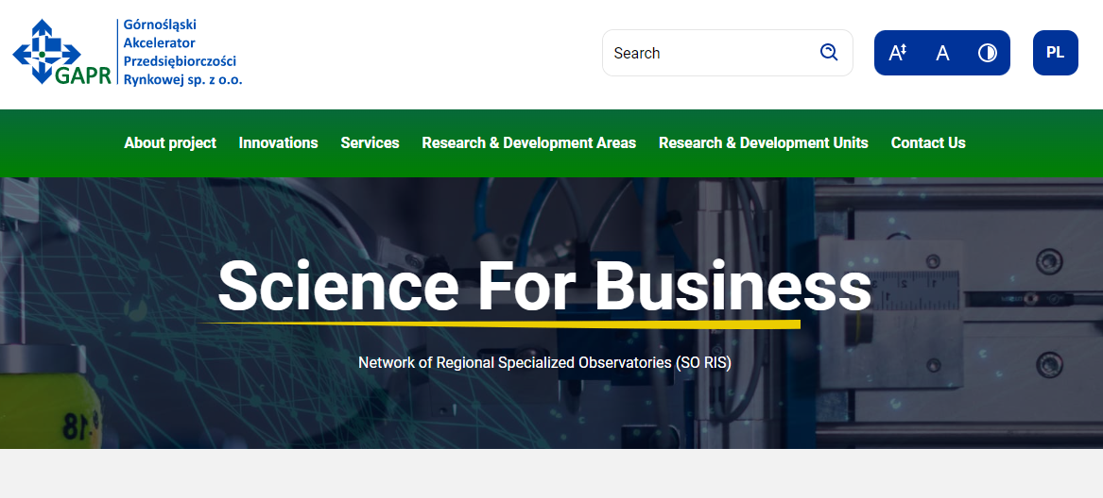
GAPR's support of knowledge-to-business processes upgrade

Slide 9
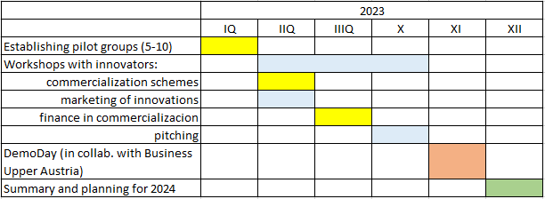
Continuation

Slide 10
Thank you for your attention
Contact:
plejman@gapr.pl

