Slide 1
The commercialisation of research results
Marc Pattinson and Arnault Morisson
Thematic Experts| Interreg Europe Policy Learning Platform
3 February 2023

Slide 2
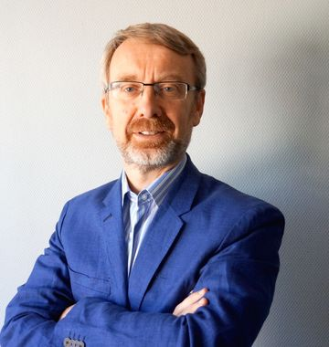
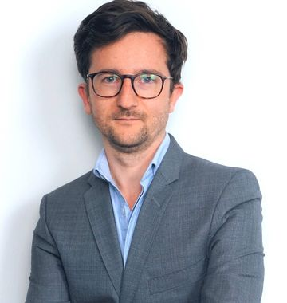
Marc Pattinson
Thematic Expert in Research and Innovation
Policy Learning Platform
WELCOME!
Arnault Morisson
Thematic Expert in Research and Innovation
Policy Learning Platform

Slide 3
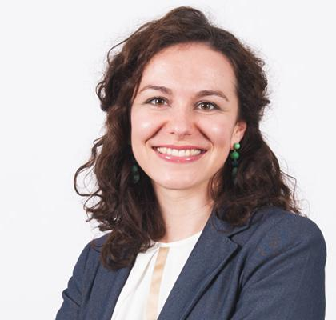
TECHNICAL DETAILS - ZOOM
Raluca Toma
Communication Manager
Policy Learning Platform

Slide 4
Agenda
Introduction (10:30-10:50)
Agenda and technical details
Introduction on the commercialisation of research results
Roundtable introduction
Building a support organisation for the commercialisation of research results (10:50-11:05)
Pawel Lejman, Upper Silesian Accelerator for Commercial Enterprises Ltd, Poland.
Research Valorisation Programme 2.0. (RVP 2.0) (TRACS3) (11:05-11:20)
Cosmina Moscalu, RIS3 Management Office, Regional Development Agency North-East, Romania.
Structured discussion (11:20-11:55)
Interregional learning and exchanges
Challenges and opportunities
Conclusions (11:55-12:00)

Slide 5
The commercialisation of research results Introduction
RESEARCH AND INNOVATION
PROMOTING ENTERPRISE,
BUSINESS DEVELOPMENT AND GROWTH
Third Mission
of the University
SOCIAL EQUALITY THROUGH COMMUNITY DEVELOPMENT AND ‘PLACE MAKING’
DEVELOPMENT OF REGIONAL HUMAN CAPITAL AND SKILLS

Slide 6
The commercialisation of research results Introduction
Consultancy Services
Innovation Vouchers
Knowledge Transfer Partnerships
Science Parks
Research & Technology Centres
high
RESEARCH AND INNOVATION
Complexity
low
Transactional,
high volume
Nature of the
intervention
Transformational ,
unique or rare

Slide 7
The commercialisation of research results Introduction
Graduate Enterprise
University Spinouts
Network and Cluster Development
Encouraging IP Development
International Linkages
high
PROMOTING ENTERPRISE,
BUSINESS DEVELOPMENT AND GROWTH
Complexity
low
Transactional,
high volume
Nature of the
intervention
Transformational,
unique or rare

Slide 8
University-Industry Collaboration Policy Brief & Workshop

Slide 9
?
Roundtable Introduction

Slide 10
Presentations!

Slide 11
Thank you!

