Slide 1
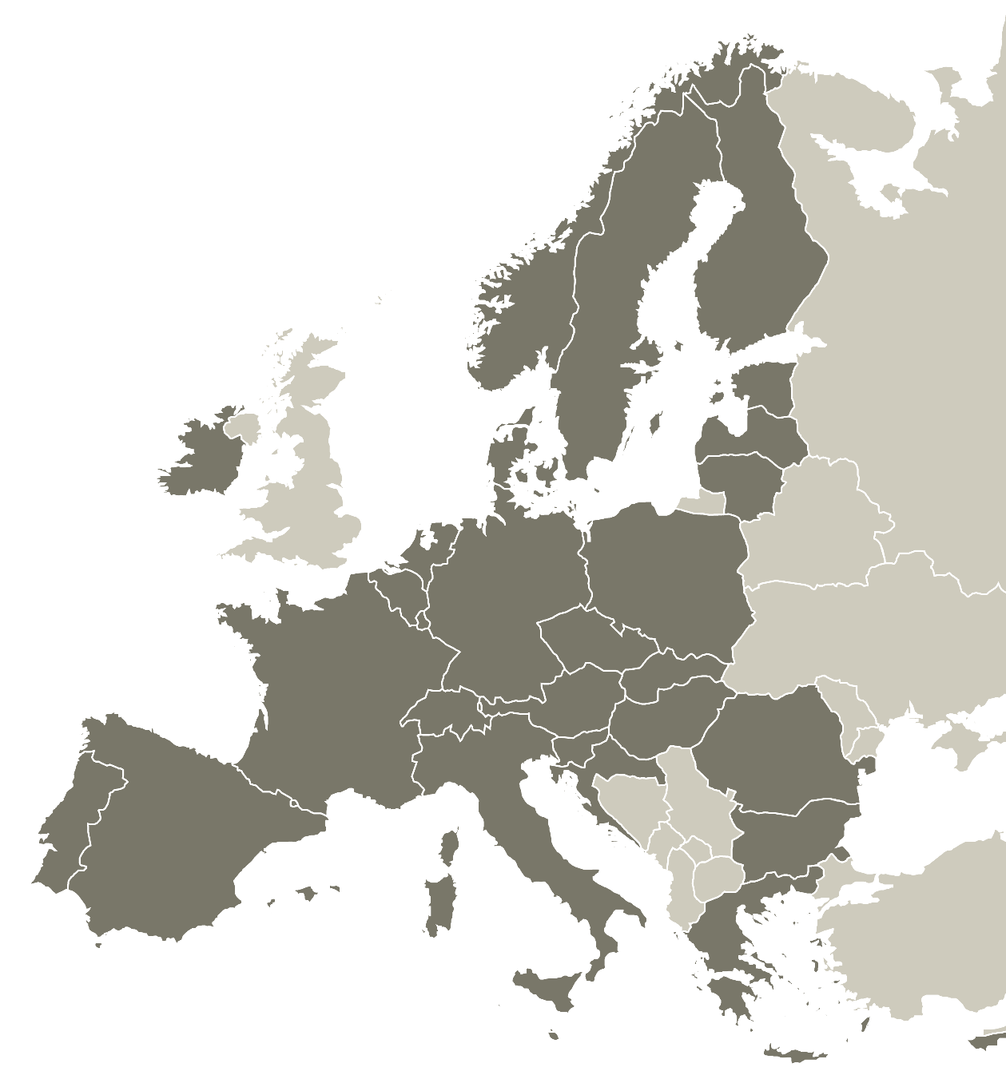

Multi-Level Governance
Marc Pattinson and Arnault Morisson
Thematic Experts| Interreg Europe Policy Learning Platform
27 January 2023

Slide 2
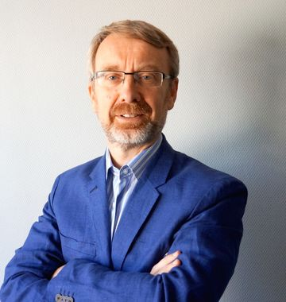
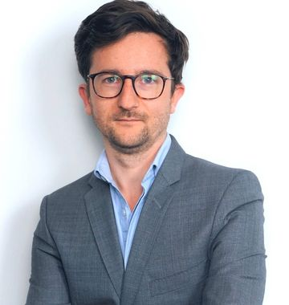
Marc Pattinson
Thematic Expert in Research and Innovation
Policy Learning Platform
WELCOME!
Arnault Morisson
Thematic Expert in Research and Innovation
Policy Learning Platform

Slide 3
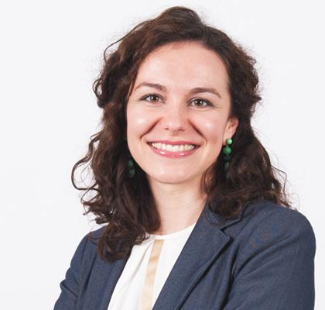
TECHNICAL DETAILS - ZOOM
Raluca Toma
Communication Manager
Policy Learning Platform

Slide 4





Agenda
Introduction (10:30-10:50)
Agenda and technical details
Introduction on Multi-Level Governance
Roundtable introduction
Multi-Level Governance (10:50-11:05)
Miren Larrea, Senior Researcher, Orkestra, Basque Country, Spain.
Building a sub-regional strategy (COHES3ION) (11:05-11:20)
Dmitri Domanski, Business Metropole Ruhr, Germany.
Structured discussion (11:20-11:55)
Interregional learning and exchanges
Challenges and opportunities
Conclusions (11:55-12:00)

Slide 5
Multi-Level Governance
Introduction
Regional innovation governance is all the processes of interactions among various actors that together determine the priorities, strategies, activities and outcomes in research and innovation at the regional level.
Regional innovation governance implies the adoption of institutional arrangements to favour systemic interactions among different innovation actors within the region with for instance the triple-helix model of innovation or between policy hierarchies with improving policy coordination through multi-level governance—different government levels (supranational, national, regional, local) and/or innovation promotion agents in territorial innovation systems (regional, local).
The Partnerships for Regional Innovation (PRI) put an emphasis on developing more effective multi-level governance and fostering synergies between policies and between different funding instruments—such as the Cohesion Policy and Horizon Europe—while broadening stakeholder engagement and participatory governance.

Slide 6
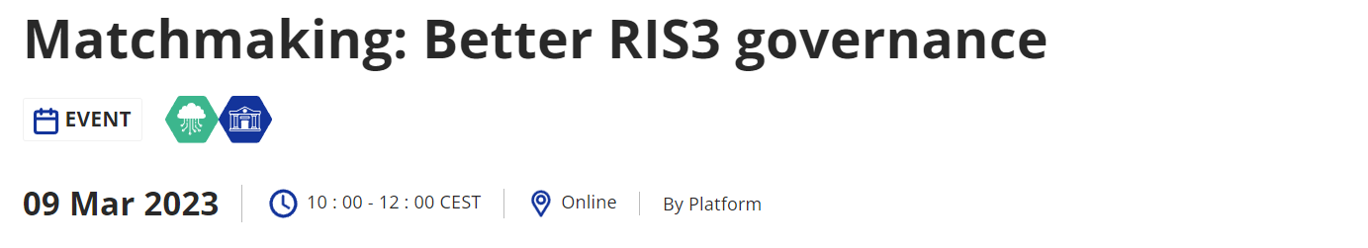
Better RIS3 Governance
Matchmaking

Slide 7
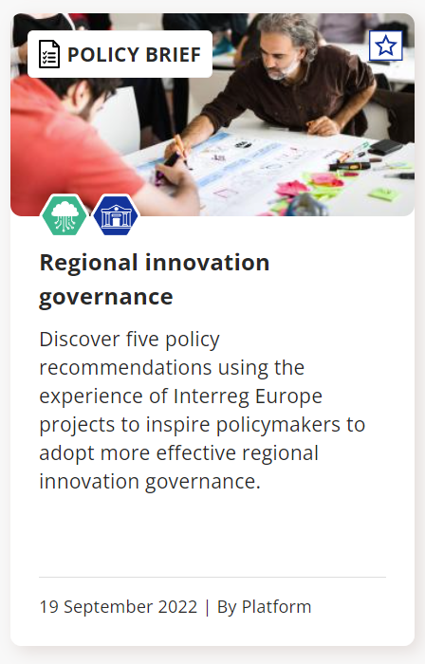
Better RIS3 Governance
Policy Brief

Slide 8
?
Roundtable Introduction

Slide 9
Presentations!

Slide 10
Thank you!

