Slide 1
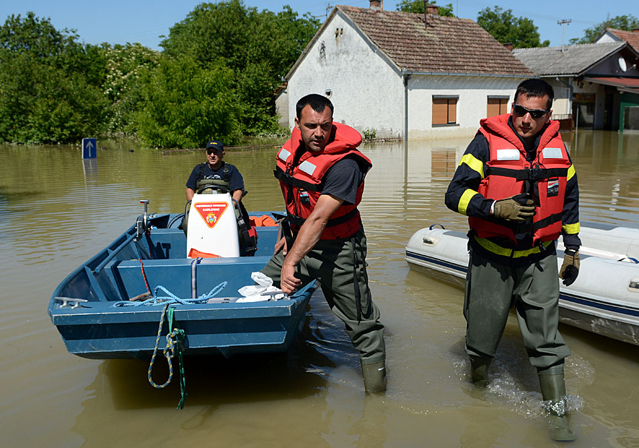
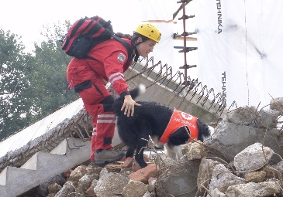
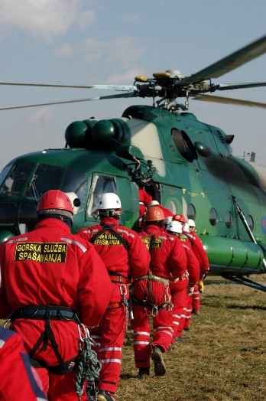
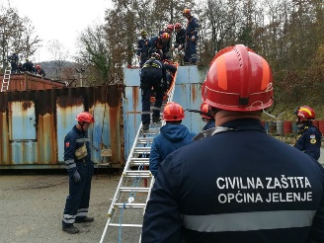
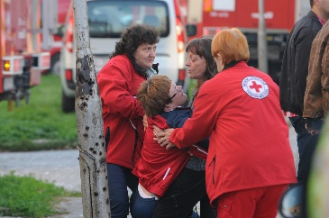
CIVIL PROTECTION DIRECTORATE
Minimizing Risk’s through Clever
Approach

Slide 2
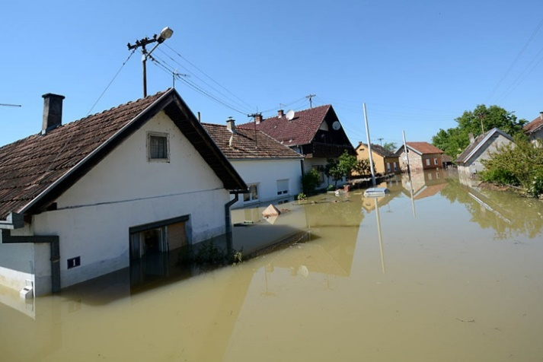
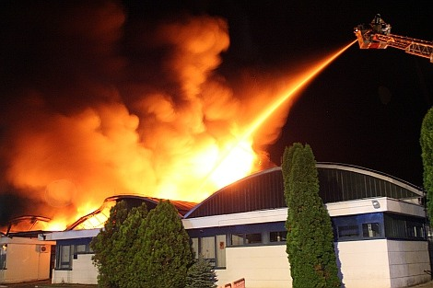
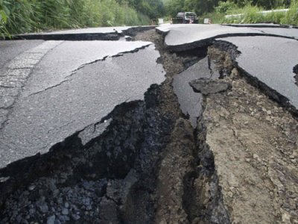
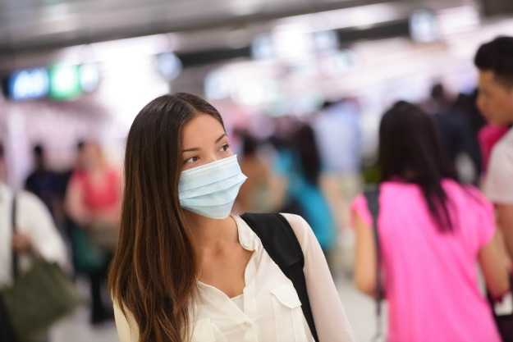
CIVIL PROTECTION DIRECTORATE
FIRE HAZARD
EARTHQUAKE
TERRORIST ATTACKS
FLOODS
EPIDEMICS
POLLUTION
MSc. Tatjana Čumpek, prof.

Slide 3
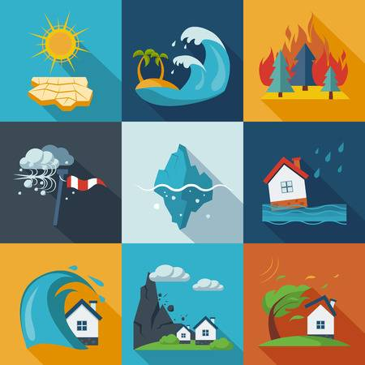
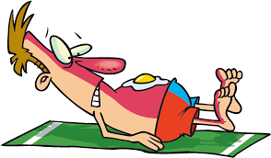
PREPAREDNESS in focus
RISK
THREAT
EXPOSURE
VULNERABILITY
=
x
x
Knowledge reduces consequences of disaster
What can I do to prepare & strenghten my capacities

Slide 4
Institutional approach (Legal obligations) - local risk assessment, action plans etc.
– versus –
practical use
Connecting: local authority, rescuers
and people
MSc. Tatjana Čumpek, prof.

Slide 5
IT sollutions
for swift and accessible communication with citizens
Main goal – provide all necessary and useful information to people
(because - emergency services know their job)
MSc. Tatjana Čumpek, prof.

Slide 6
IT sollutions
to warn people
to instruct them
to answer their questions

Slide 7
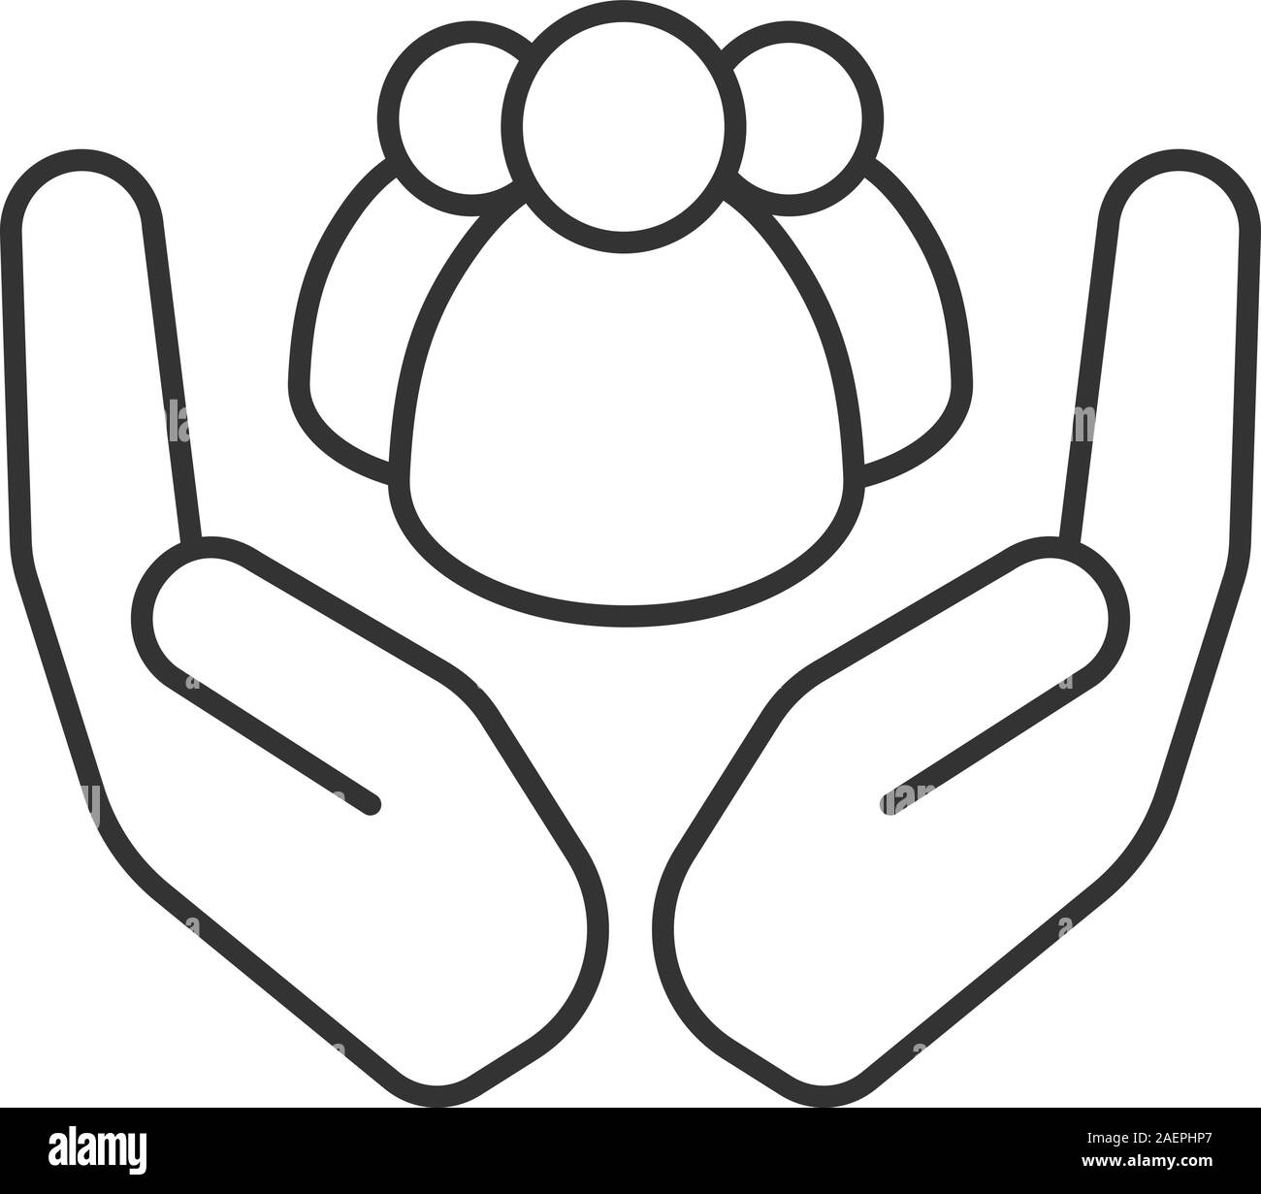
IT sollutions – for common safety
thank you for your attention and cooperation
thank you for your attention and cooperation
Thank’s for attention & cooperation!
MSc. Tatjana Čumpek, prof.

