Slide 1
The water guardians project
Development of a local territorial project for the water catchment area (26 municipalities) located in the south of Lille Metropole

Slide 2
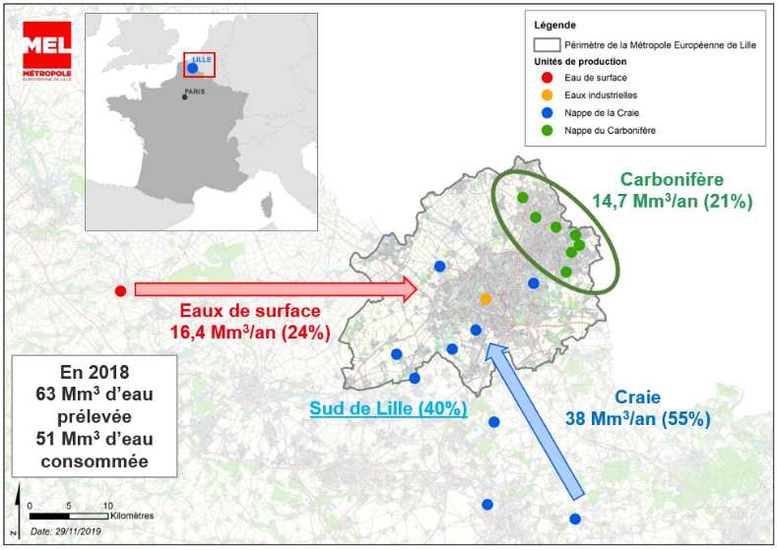
Drinking water supply in Lille Metropole
Drinking water supply in Lille Metropole
Water supply for more than 1 million inhabitants
A « self-supplied » territory up to 70%
3 mobilized resources
Lack of interconnections with other territories in situation of crisis
Shared groundwater

Slide 3
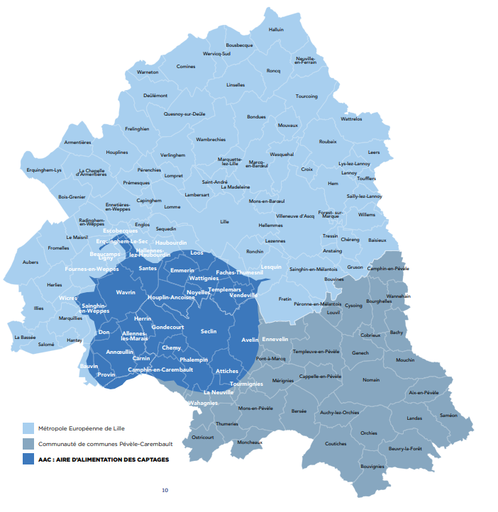
The perimeter of Supply of catchment areas (AAC) south of Lille
= All areas in which every drop of water that falls on the ground can reach out the catchments, either by infiltration or runoff
40% of the drinking water supply for more than 1 million inhabitants
52 active catchments
27 million m³ are produced
15,500 hectares
19% of the metropolitan territory
130,000 inhabitants
26 municipalities concerned in Lille Metropolitan Area
15 municipalities which supply catchment area exceeds 75% of the whole surface area
→ A very weak groundwater table
(- 5 meters during the 2018 summer, official drought declaration)

Slide 4


An enhanced legal and regulatory protection
Protection in line with the law on water (EUROPEAN DIRECTIVE 2006/118/EC - EUROPEAN DIRECTIVE 2000/60/EC)
Health protection tool and land purchasing (DUP/ 2007)
water Planning and management Scheme (SAGE/ Jan. 2020)
Protection in line with Urban Planning Papers (Urban Local Plan, Dec. 2019)
« zero extension » territory (-500to be removed)
Construction and planning regulations preventing quality and quantity damages (pollution and soil sealing)
= A strict application of the methodology « avoid/reduce/compensate »

Slide 5

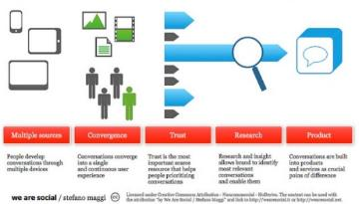
A co-design approach of a new territorial project
WHY?
A significant paradigm shift
Abandoned projects or to be reconsidered …
« Outdated » public policies or not specific enough
WHAT?
A chosen vision for the future
A common ambition
A guide to change the model and transform
public action
WHO? WITH WHO?
A political project designed by elected officials
A special moment to mobilize local stakeholders and citizens
HOW?
Make obstacles and opportunities emerge
Bring energies together, , get out of « compartmentalization » »
Go beyond restricting working methods
Mobilize « design-thinking » techniques

Slide 6
AMBITION : PRESERVE and ENHANCE
Principal issue: drinking water resource
QUANTITY
Minimize artificialization
Increase infiltration
QUALITY
Increase quality of discharges
Reduce pollution sources
ELABORATION OF AN OVERAL STRATEGY
PRESERVE / IMPROVE
Water resource
DEVELOP
The potential of the territory
LIVING WELL
In the area

Slide 7
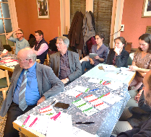
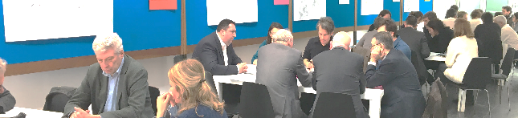
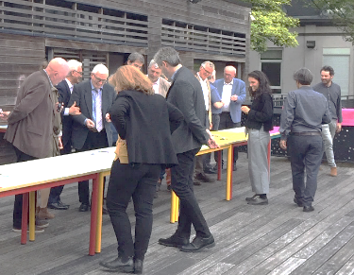
1st step: Nov. 2018/ Jul 2019 ORGANISATION SEVERAL workshops
+ 70 participants
(elected officials, economic stakeholders., social housing providers, associations,…)
26 municipalities Around 20 elected officials /workshops

Slide 8






Charter Gardiennes de l’eau (approved 12 December 2019)
Enhance agricultural areas and activities in synergy with water resource and the food project
Develop a territory of
« living differently »
Agriculture
Housing
DEVELOP
the potential
of the territory
LIVING WELL
in the area
recognize water environment as heritage for tomorrow
Water
Re-think mobility to reduce risks and create common links
Mobility
PRESERVE / IMPROVE
water resource
Adjust the economic development model and be part in the metropolitan dynamics of excellence
Economy
5 topics including a large number of public politics on wich is based a plan of 32 actions

Slide 9
ZOOM ON THE ACTION PLAN

Slide 10
The action plan
AXIS 2 : AGRICULTURE
AXIS 1 : WATER/ ENVIRONMENT
For an aqua-compatible and healthy agriculture
AXIS 3 : MOBILITY/ PUBLIC SPACE
To know better in order to preserve better
Safer flows, mobility that connects people
AXIS 5 : ECONOMY
AXIS 4 : HOUSING/URBAN PLANNING.
for an economic development compatible with the spirit of “Gardiennes de l’eau”
Living differently, be part of the territory

Slide 11
The action plan
AXIS 1 : WATER /
ENVIRONMENT
Graphic identity project (logo) for coordinated communication
Information on reducing consumption on water bills
Development of tools for knowledge and assessment of impacts on the resource and decision support on the development scenario - URB’EAU study with BRGM, COHMET study
Budget of 1ME/year taken from the water price + study resource contract
Approach to prefiguration of a perimeter of periurban agricultural and natural areas - support for to the evolution of practices and participations in the transformation and valorisation of landscapes (hedges, rural paths, small streams...)
Launch of a chief landscape architect mission for the project and for the Municipalities
Agricultural land management - Identification of owners of ex-urban extension areas to initiate a change in activities and/or enhancement of biodiversity
AXIS 2 : AGRICULTURE

Slide 12
The action plan
AXIS 3 : MOBILITY /
PUBLIC SPACE
Specific focus on the area for the elaboration of the metropolitan cycling plan
Reflection on the transport of dangerous materials
AXIS 4 : HOUSING /
URBAN PLANNING
Wavrin city center project wanted as a totem project.
Action: Internal reflection about innovation of and best practices of water cycle management, in relation to public space and urban planning.
AXIS 5 : ECONOMY
Regulatory work on activities and uses at major risk of pollution or artificialisation (via urban planning documents)
Reflection on a new economic development strategy - discussions for each "business park"

Slide 13
Project URB’EAU / Content & objectifs
  Clarify the impact of land uses on water resources in order to lead an appropriate urban planning policy
  Feed the project “Gardiennes de l’eau” : Identify the most efficient actions for the preservation and recovery of the water resource
  Two axes of study
  A mixed approach combining hydrogeology, geochemistry, sociology and economics to:
  Modelise and understand the consequences of land use in terms of water balance
  Construction and simulation of differentiated scenarios, according to the uses identified by the project “Gardiennes de l’Eau”:
    Demography, urban development
    Clean-up of polluted sites, wastelands and soils
    Adaptation of agricultural practices
    Upgrade of natural areas
  2. Defining the socio-economic benefits of preservation
  Study of 3 years, with thematic deliverables in connection with the animation of the territorial development project
  Amount of the programme 827 000€
  BRGM: 165 400€ (20 %)
  (Bureau de recherches géologiques et minières - Office of Geological and Mining Research)
  MEL: 661 600€ (80 %), which can be cofinanced by the Agence de l’Eau Artois-Picardie (National public water agency)

Slide 14
We are looking for partnerships and european projects about:
  Planning approach with the aim and purpose of better preserving the groundwater resource (stop further urbanization and urban sprawl)
  Compatibility of economic activities, particularly industrial and logistical activities, with the situation of fragility of groundwater resources.
  Preserve and enhance landscape, biodiversity, water cycle as a contribution to a an alternative development model for the area (agricultural, urban & economic activities, tourism, etc.)
  Exemples of ecosystem approach to improve soil services. How can an urban area contribute to groundwater supply? How the sanctuary of spaces for the correct functioning of the water cycle contributes to the development of the biodiversity of the living environment? How do new agri-environmental practices improve the initial status of groundwater?
  Business cases: how can a local authority finance actions carried out by the private sector in support of the objectives of the territorial project? e.g. aid to farmers, aid to industrial and logistical economic actors.
  European aid that can be mobilized for the implementation of our territorial project through different approaches:
    water and biodiversity protection
    the promotion of urban renovation
    agricultural policy
  Examples of projects constructions, urban planning projects who leads to improvement of groundwater condition.

Slide 15

Contact :

